Slide 1
Nada Stropnik Institute for Economic Research, Ljubljana, Slovenia stropnikn@ier.si An introduction to Slovenian geography, population and history, and to Slovenian leave policies 9th LPR annual seminar Ljubljana, 13-14 September 2012

Slide 2
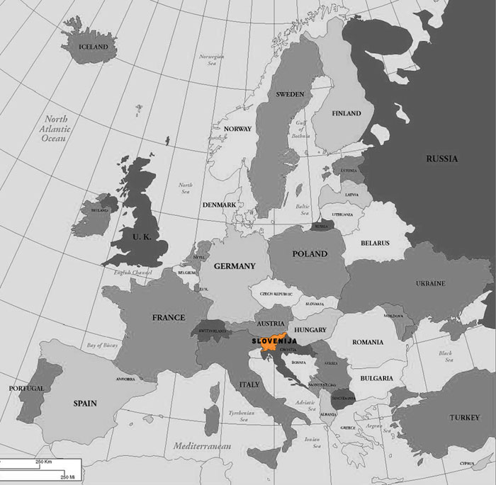

Slide 3
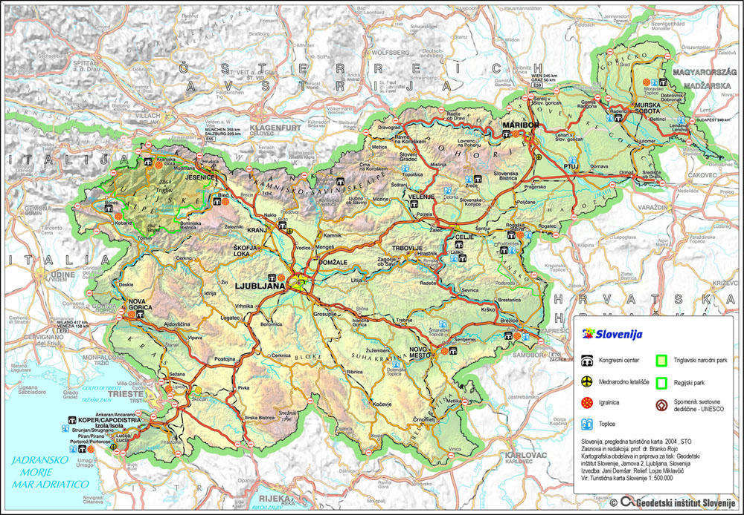

Slide 4
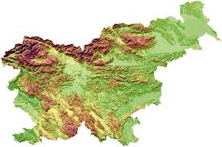
The Alps in N.
The Pannonian plain to the E and NE: essentially flat landscape.
Karst Plateau in SW: a limestone region of underground rivers, gorges, and caves, between Ljubljana and the Mediterranean.
Adriatic coastline in SW: 43 km (27 mi) from Italy to Croatia.
The majority of Slovenian terrain is hilly or mountainous (around 90% of the surface 200 meters or more above sea level).

Slide 5
Total area: 20,273 km²: land 20,151 km², water 122 km²
Comparison: half a Switzerland; slightly smaller than New Jersey or the Ontario lake
Arable land: 8.5%
Permanent crops: 1.4%
Forest: 58.5%
Highest point: Triglav 2,864 m (9,396 ft); 25 peaks over 2,000 m

Slide 6
HISTORY
Until World War-I: an integral component of the Austro-Hungarian Empire.
Between two World Wars: the Kingdom of Serbs, Croats and Slovenians.
After World War-II: Republic of Slovenia in the multinational federal state of Yugoslavia.
Since 25 June 1991: independent state.

Slide 7
POPULATION
2,046,976 people (April 2012): 1.968.816 citizens & 86.711 foreigners.
Ljubljana: around 280 thousand inhabitants.
Slovenia, 2010: 30.5% dependent persons (14% <15 & 16% >64)
EU, 2010: 33% dependent persons (17% <15 & 16% >64)
Fertility rate: 1.21 in 1999, 2001, 2002; lowest: 1.20 in 2003
2006: 1.31; 2008: 1.53; 2010: 1.57
Employment rate: 2010: 60% for men, 50% for women.

Slide 8
Development of the parental leave in Slovenia
1927: 84 days of maternity leave
1949: 90 days of maternity leave
since December 1959: 105 days of maternity leave
1975: 141 days of childcare leave were added (and could be taken as a half-time leave)
since February 1986: 260 days childcare leave (can be taken as a half-time leave)
since 2003: 90 days of paternity leave (implemented gradually in 2003-2005)
Now: 455 days of leave altogether
Note: Current leave is in bold.

Slide 9
During the 1990s debate to increase the length of parental leave to 2 (or even 3) years the proponents argued that:
free places would be occupied by the pre-school children for whom there were no vacancies in the day-care centres. This would be beneficial particularly for children over three years of age whose coverage was lower than in the EU-15.
Or, alternatively, if the parents took the second year of parental leave the number of children in organised childcare would decrease by about a fifth, leading to a higher quality of services (staff/children ratio).
Opponents warned of many foreseeable negative consequences of the long parental leave:
unequal opportunities for both sexes in the labour market,
organisational problems for employers,
budgetary constraints,
worsening of the financial situation of young families,
well educated women would not take it, since they would not be ready to experience the loss in their human capital and the opportunities for professional promotion.

Slide 10
Leave provisions
Maternity leave: 105 days
100% earnings compensation
Parental leave:
From 1975: 141 days (about 5 months)
From 1986: 260 days (about 9 months)
100% earnings compensation
From June 2012: temporarily 90% if the basis is €762 and over, with the ceiling lowered from 2.5 times to 2 times the average wage in Slovenia.
Fathers’ entitlement to parental leave :
Enacted in 1974 (like in Sweden), effective from 1975
Individual father’s right from 2002
Paternity leave:
15 days ( since 2003); 100% earnings compensation
From June 2012 temporarily 90% if the basis is €762 and over, with the ceiling lowered from 2.5 times to 2 times the average wage in Slovenia.
+ 75 days (since 2004-2005); social security contributions paid (based on the minimum wage)

Slide 11
Fathers’ take-up of leave
Parental leave
About 1% in the first decades (0.6% in 1999)
Over 2% from 2003
About 6% in 2009-2010
6.8% in 2011
Paternity leave
Up to 15 days:
2/3 in 2003-2005
75-80% in 2006-2011
More than 15 days
10% of leave takers in 2006, 15% in 2008, 19% in 2009 and 21% in 2010-2011.

Slide 12
BUT:
We have never asked mothers if they wanted their male partners to take some of the parental leave!
Before blaming fathers, we should first do that.

Slide 13
GLEJ MOJO PREZENTACIJO NA SEMINARJU LP&RN

