Slide 1
Fathers' changing roles: a global overview Margaret O’Brien

Slide 2
International Year of the Family 2014: three themes & inclusive of men in families
Confronting family poverty
Promoting intergenerational solidarity
Ensuring work & family balance
“ In a rapidly changing world, we will continue witnessing the growing momentum and recognition of the importance of men for gender equality, reconciling work-family life and impacting the future of their children”
Men in Families and Family Policy in a Changing World Report 2011
New York: United Nations Department of Economic and Social Affairs http://www.un.org/esa/socdev/ family/docs/men-in-families.pdf

Slide 3
Outline
Fatherhood research & policy trajectory
UN Report highlights
Future

Slide 4
The problem of men in families: fluid, fragmented, flexible, polarized

Slide 5
Anxieties about families without fathers

Slide 6
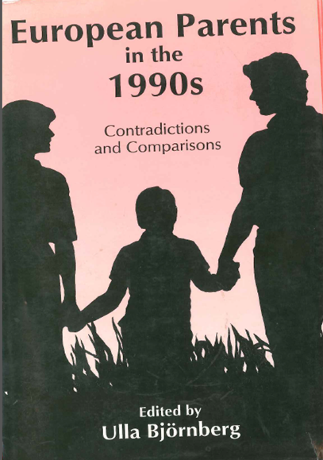
1970s, 1980s, 1990s

Slide 7
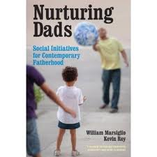
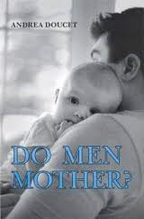
Fathers: partners, carers, involved, nurturers

Slide 8
Men, families, gender equality and care work
Fatherhood and families
Fathers in challenging family contexts: a need for engagement
Migration, families and men in families
Men, families and HIV/AIDS

Slide 9
Fathers: demographic & family contexts
Decline in marriage & rise in cohabitation
Increase in non-marital births
Higher rates of partnership breakdown
More non-resident fathers
Increase in dual earning couples
↑ Diversity of father figures
Source: Men in Families Report, UN 2011
Notes:
The role of fathers as breadwinners and parents has been undergoing dramatic changes over the past few decades. In the UK and elsewhere in Europe, there is a renewed policy emphasis and concern about the role of men in families. Changing cultural expectations on men to be more actively engaged in the care of children.
Fifteen per cent of Millennium Cohort (MCS) babies were born to mothers who were neither cohabiting with nor married to the father (Kiernan, 2006).
Divorce and finding new partners is more prevalent so that children are far more likely to have more than one father figure in their life (Calderwood, 2004).
By the early 2000s, the solo male earner accounted for only 27% of households across the EU-12, heralds the decline of the traditional male breadwinner model family
Men are becoming fathers or assuming family obligations in a growing variety of living arrangements, in particular through step-fatherhood, the fastest growing type of family in the UK - 10% of all families with dependent children
These demographic changes are mirrored across Europe: leading some commentators to speculate that European family life has become “de-institutionalized”, and men more marginal to families ?

Slide 10
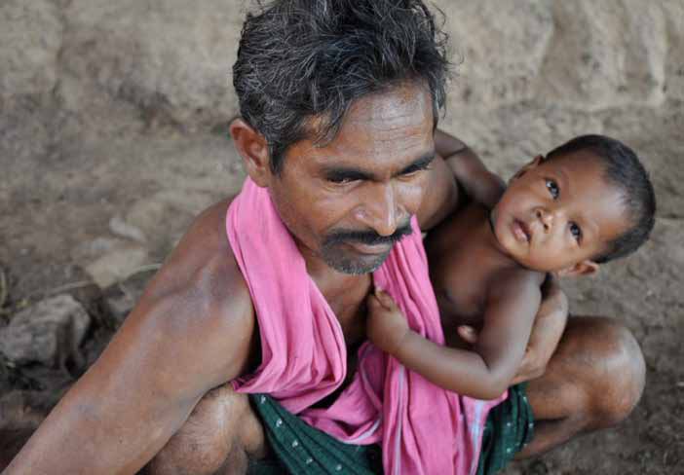

Slide 11
Fathering issues related to major social groups
Young fathers
Fathering and disabilities
Older fathers, grandparents and intergenerational aspects of fathering
Fathers separated from their children after marriage or cohabitation ends
Unmarried and non-resident fathers who are separated from their children
Fathers in prison
Fathers who hurt family & kin through violence, alcohol and drug decency
Data gaps/ Invisibility of both men’s care capabilities and their need for care/ fathering support deficit

Slide 12
Policy Recommendations
Improving global demographic data about fathers
Fathers inclusive international research networks
Paternity establishment initiatives
Promoting non-residential fathers’ contribution to the care of children
Engaging fathers of male kin in the care of children so as to prevent institutionalization
Invisible fathers and a fathering support deficit
Men, child maltreatment and family violence
Pre-retirement coaching for older men
United Nations active fatherhood taskforce (ACT)

Slide 13
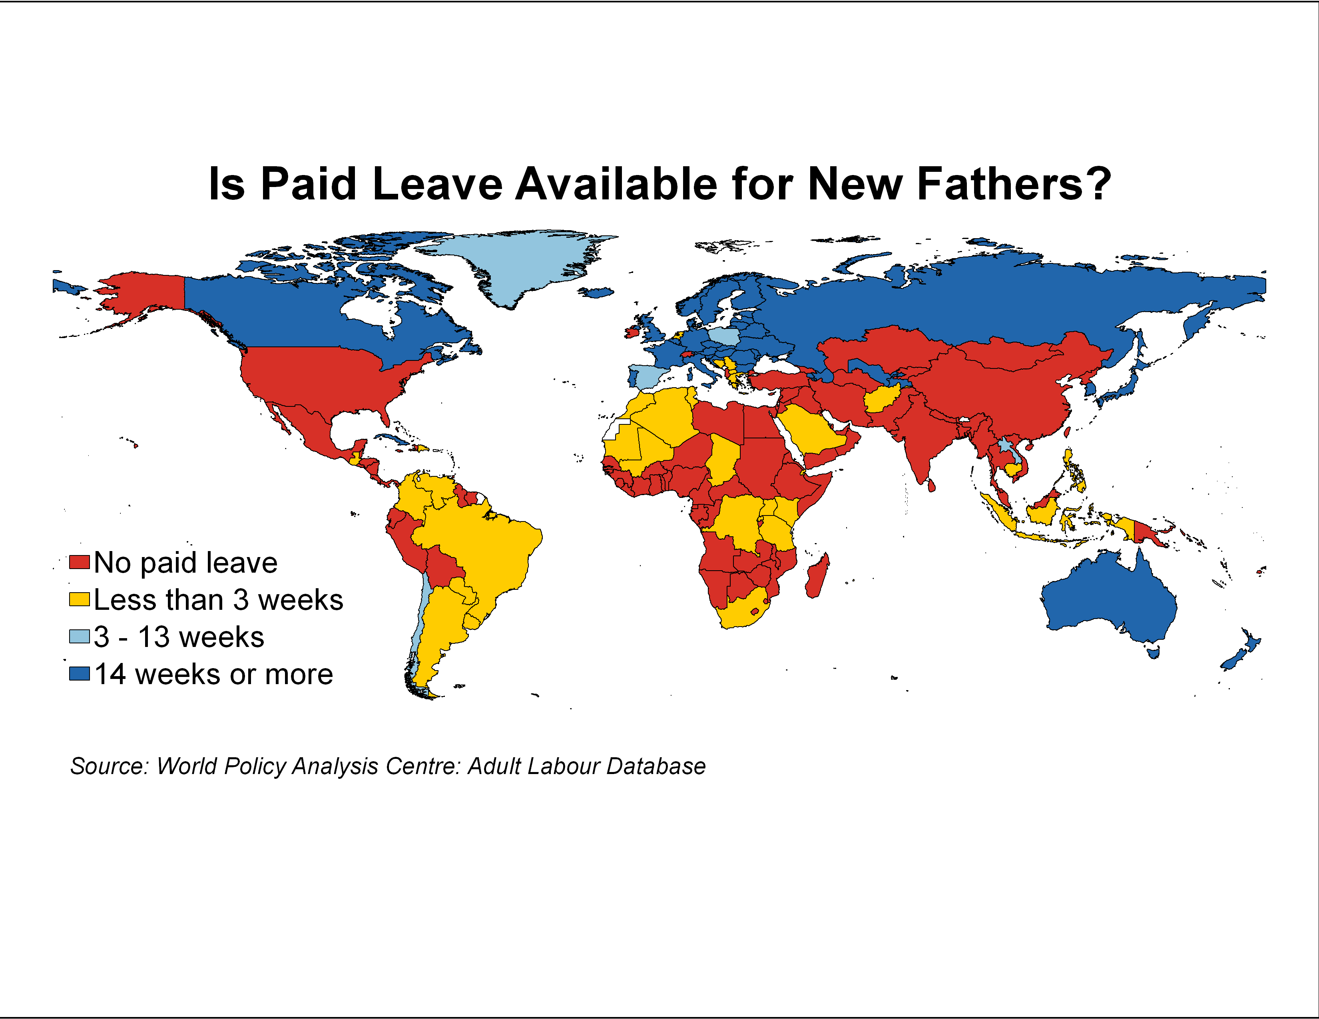
Source: Heymann SJ with McNeill K. Changing Children’s Chances. Boston: Harvard University Press. Forthcoming.

Slide 14
Usual weekly working hours for men and women aged 25-54, 2011 (OECD Employment database)

Slide 15
China's boomtown to offer more paternity leave than US
A Chinese man feeds his son as he takes part in a pre-school class with his wife at a child care education chain based in Beijing on April 17, 2010.
(GOU YIGE/AFP/Getty Images)
Source: Global Post (June 8th 2011) http://www.globalpost.com/dispatches/globalpost-blogs/the-rice-bowl/chinese-province-offer-more-paternity-leave-us

Slide 16
Korea- Recent Political Atmosphere & Law and Policies under Review
Presidential election will take place on December 16 2012
Work-Family Balance and ‘Labor Standard Acts priorities.
A reform of ‘Act on Equal Employment and Support for Work-Family Balance’ is proposed and currently under review (2012. 7.26)
This reform suggests
- a father’s month in parental leave
- father can use a 30 day full paid leave within 90 days of baby birth
Source: personal communication Dr Meejung Chin, Seoul National University

Slide 17
Future

Slide 18
References
O’Brien, M. (2012) Work-Family Balance, Background report for International Year of the Family 2014. United Nations Department of Economic and Social Affairs http://social.un.org/index/Family/InternationalObservances/TwentiethAnniversaryofIYF2014.aspx
O’Brien, M. (2011) Fathers in challenging family contexts: a need for engagement Men in Families and Family Policy in a Changing World Report New York: United Nations Department of Economic and Social Affairs http://www.un.org/esa/socdev/ family/docs/men-in-families.pdf

