Slide 1
The Nordic Council of Ministers
Merle Kuusk Adviser NCM Office in Estonia

Slide 2
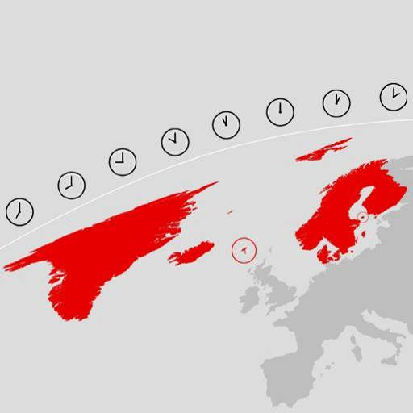
The countries
The Nordic Region consists of Denmark, Finland, Iceland, Norway and Sweden, as well as the Faroe Islands, Greenland and Åland.
26 million people and eight official languages.
The Nordic Region combined ranks between 10 and12th largest economies in the world.

Slide 3
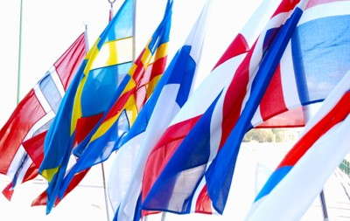
Co-operation
The Nordic Council has just celebrated its 60th anniversary.
The Nordic Council of Ministers turned 40 recently.

Slide 4
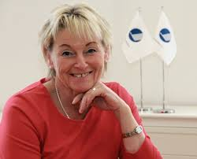
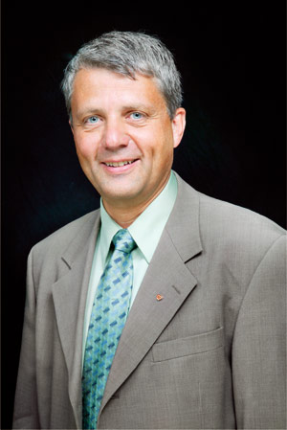
Co-operation
The Nordic Council – the inter-parliamentary forum Britt Bohlin, a former Member of the Swedish Parliament is the Secretary General.
The Nordic Council of Ministers – the inter-governmental body The current Secretary General is Dagfinn Høybråten, a former Norwegian minister and former President of the Nordic Council.

Slide 5
The ministerial councils
- Education and Research - Culture - Business, Energy and Regional Policy - Environment - Health and Social Affairs - Fisheries and Aquaculture, Agriculture, Food and Forestry - Working Life - Gender Equality - Finance -Legislative Affairs + Ministers for Cooperation: responsibility for Nordic co-operation and for areas of interdisciplinary co-operation such as the Arctic, Sustainable Development and Children/Young People.
Nordic Council of Ministers intergovernmental co-operation actually consists
of councils:

Slide 6
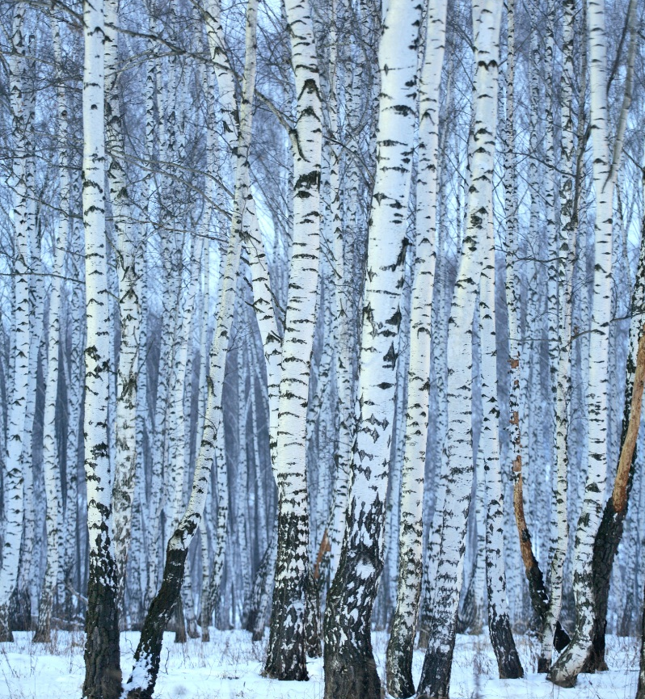
Activities and offices
A great deal of the Council of Ministers’ work is done in Nordic institutions, cultural centres, offices and by partner organisations.
Nordic co-operation funds 15 institutions and 20 other bodies spread throughout the Region.
6

Slide 7
Offices and culture centres
Offices in Tallinn, Riga and Vilnius (1991)
Office in Saint Petersburg with contact centres in Archangel, Murmansk and Petrozavodsk
Culture centres in Greenland, the Faroe Islands, Iceland and Åland
The “Nordic Region in Focus” offices:
Oslo
Stockholm
Copenhagen
Helsinki
Reykjavik
8 information points in the Nordic Region and the north of Germany.
7

Slide 8
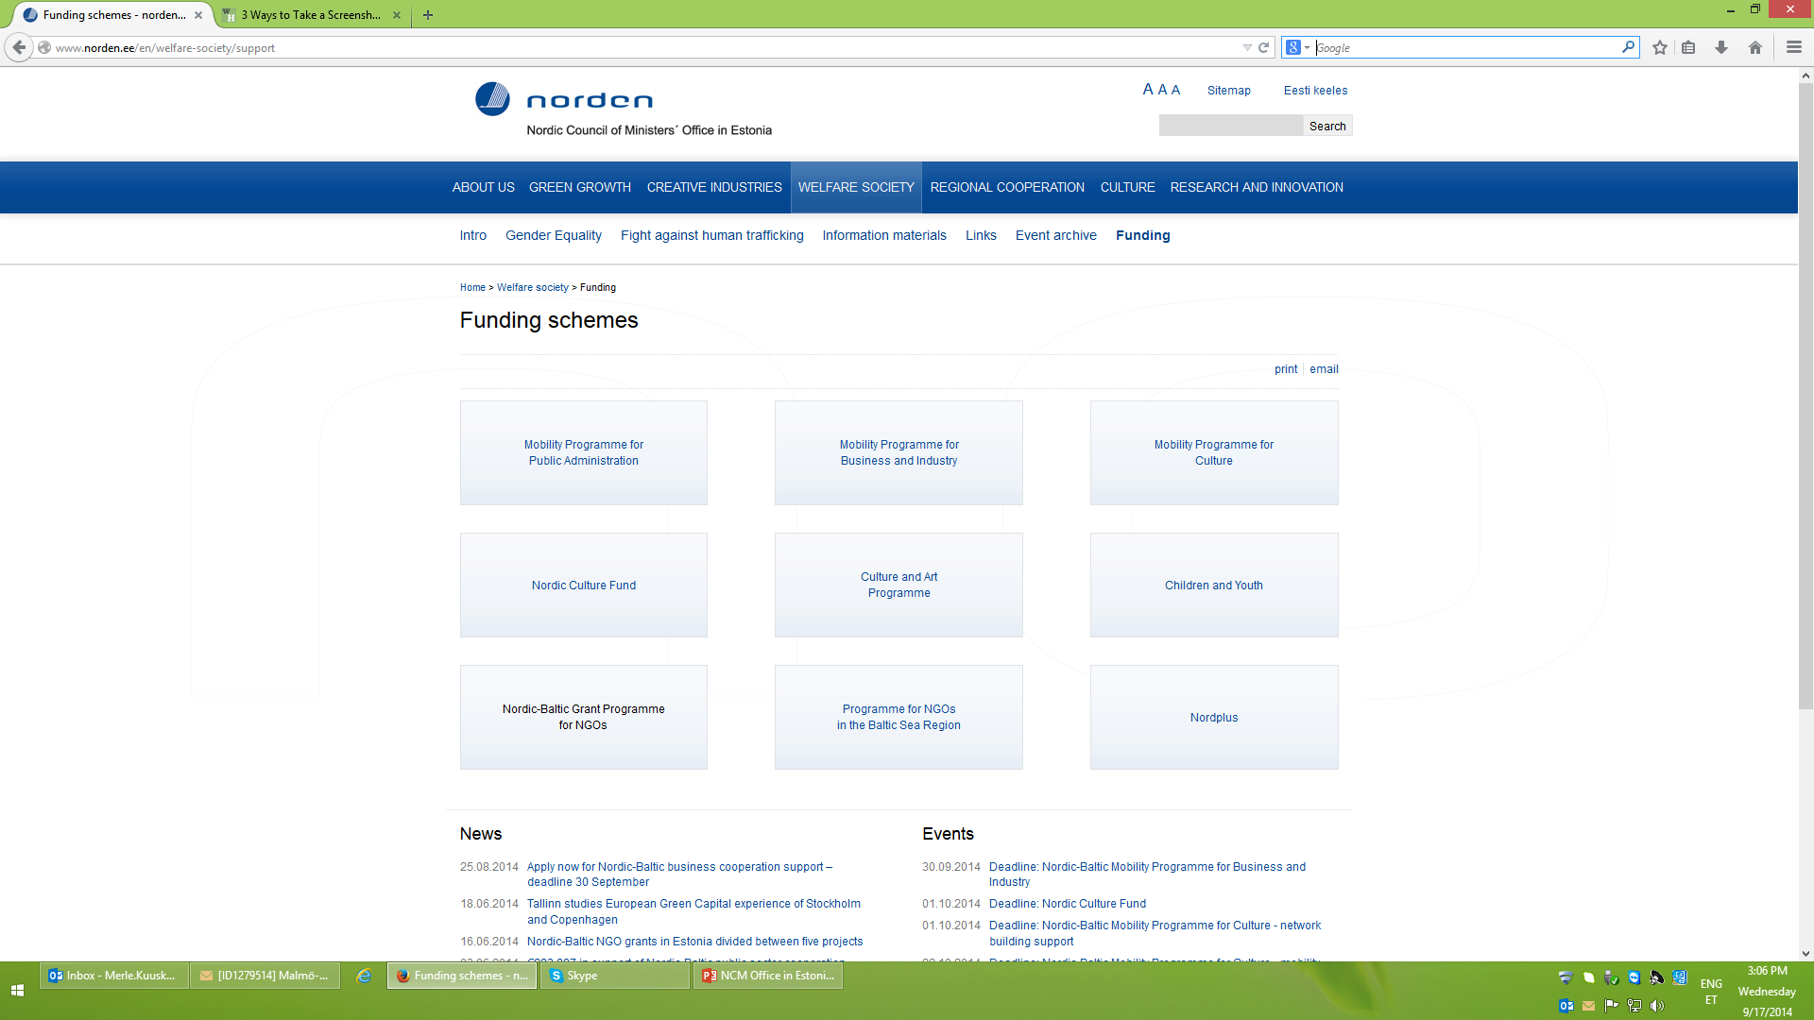

Slide 9
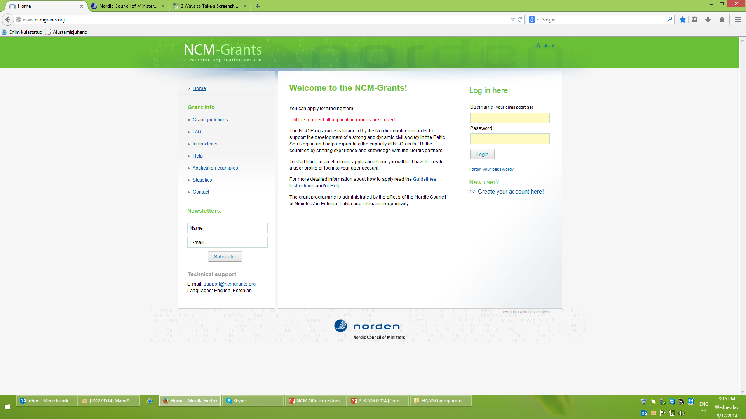

Slide 10
Sustainable development
Priority in 2014
Activities in line with the Nordic Strategy for Sustainable Development and with the national strategies in the applicant’s country.
Gender equality (40 years Nordic cooperation)
The Parental leave seminar today is one of the examples of the successful projects in our NGO Program

