Slide 1
Baltic and Nordic leave policies
Johanna Lammi-Taskula
Leave Policies and Research seminar, Tallinn 18.-19.9.2014

Slide 2
GNI per capita (2012/2013)

Slide 3
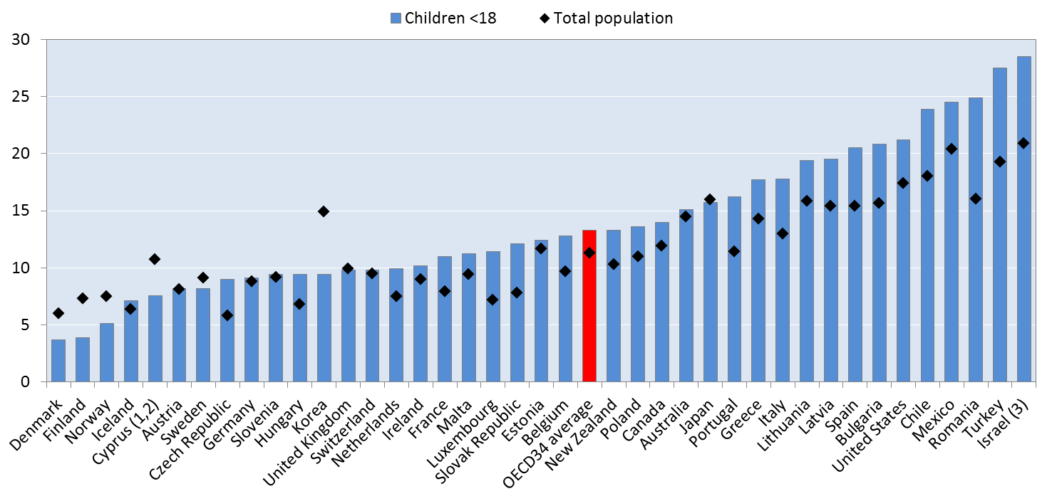
Poverty rate (50 % median income , 2010)

Slide 4
Employment rate 2009-2013 (20-64 yrs)

Slide 5
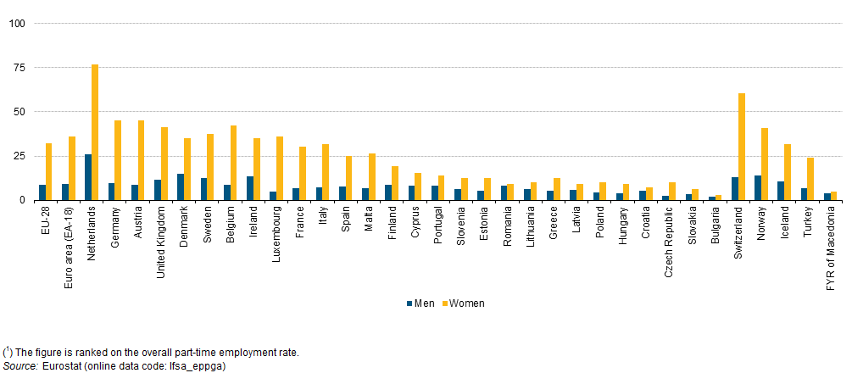
Part-time employment 2013 (15-64 yrs)

Slide 6
Leave schemes in Estonia, Lithuania, Finland and Sweden (2014)
weeks

Slide 7
Leave schemes if 100% equivalent salary replacement
weeks

Slide 8
Take up of leave by fathers (%)
 | paternity leave | parental leave
Estonia | 38 | 5-10?
Lithuania | ? | 5
Finland | 84 | 32
Sweden | 75 | 88

Slide 9
From Soviet model to Nordic model? (Karu 2011)
Employment
The soviet model of gender equality was rejected as it was forcing everybody to employment. Freedom of choice for mothers (not to work) was celebrated, why not for fathers?
Childcare
The soviet model actually enabled stay-at-home motherhood until the child was 3, but there were daycare places available. As many daycare centres were closed, there was actually no longer a ”freedom of choice”.
Fathers
Fathers were given leave rights after independence, but the take-up was low and fathercare was opposed by pediatricians. What is the role of EU-membership for fathers’ leave rights?

