Slide 1
Comparing leave policies across the Baltic States
11th LPR seminar:
18-19 September
Tallinn
Marre Karu and Ruta Braziene

Slide 2
What we are going to talk about?
1. Why we compare three Baltic states?
Geographical proximity
Shared history
Same starting-point
2. Social context
Demography
Employment
Childcare
Gender Equality
3. Leave policies in three countries
Common history of Soviet Union
Maternity, paternity and parental leave
Concluding remarks and future plans

Slide 3
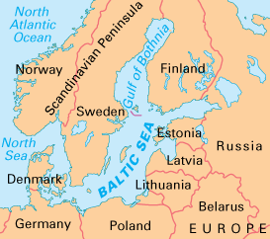
Why do we compare three Baltic states?
Experienced the Soviet authoritarian rule 1945-1991
Regained independence in 1990s
Processes of democratization Europeanization, globalization etc.
Drastic reforms of social policy over a period of 20-25 years
Where have 20 years of independent development taken us?
Our similarities and differences?

Slide 4
Leave policies: common history of Soviet times
Assistance for families with children was concentrated on the development of childcare institutions;
In theory, state provided many domestic services to free women for employment. In practice not;
Guaranteed employment for families with children; oblication to work?
Paid maternity leave, which was prolonged continuously to reach three years by 1989 (6 months in 1959; one year in 1982);
No right for fathers;
Monthly state grants for single mothers were paid up to the child’ sixteenth birthday.
Notes:
While in the Nordic countries the gender equality aspirations brought along expansion of leave rights to fathers already in the 1970s, the Soviet fathers were kept away from childcare. The maternity leave scheme in Estonia remained an exclusive right for women throughout the Soviet Union period, until 1991 when Estonia regained independence and fathers were given the right to parental leave – first as secondary carers, later on in equal terms with mothers (Karu 2011)
Estonia: While the leave in 1959 lasted six months, by 1982 mothers had a right to one-year leave with compensation equal to the minimum wage. By 1989 the leave was extended further to three years.
The study suggests that the lack of a gender equality perspective in Estonian policy making is partially due to the coercive ideology of gender equality in the Soviet Union. While the Soviet equality ideology was modern in its ideal of the dual earner family model, the means of achieving it were drastically different. Furthermore, fathers had no role in family life and in reality a model of dual earner/state and female carer model was prevalent. The dual earner model has been preserved until now, but the father’s role in the family was acknowledged not before 1991 when fathers became eligible for parental leave. (Karu 2011)
However, in comparison with contemporary democratic societies, the means of achieving gender equality differed radically in the socialist society. Soviet society did not respect personal freedom of choice; employment was compulsory for everyone and the leave policies providing parents the opportunity to care for their children were only available to mothers – fathers had to have no role in family life other than being one of the breadwinners. This coercive way of implementing the equality and the fact that it was limited only to the labour market, not the family, made people resistant and fall back to appreciating the traditional gender division when the coercion was over. Kurvinen (2008) argues that during the transition period, the traditional biology-based gender images were emphasised as a part of the concern for survival of the Estonian nation. (Karu 2011)

Slide 5
Some characteristics of social and family policy reforms after regaining indepence
Male breadwinner ideology;
Child-care facilities were cut back (especially in Lithuania);
Development of Gender equality mechanisms;
And etc.

Slide 6
More recent developments
Rapidly growing economies in 2004-2007
Recent changes in the period of 2008-2012
Estonia as a Baltic “success story”

Slide 7
Background: Small decreasing populations
In 10 years the population has decreased:
Lithuania by 427,000 (13%)
Latvia by 253,000 (11%)
Estonia by 46,000 (3,4%)
Low fertility rate
High immigration rate

Slide 8
Background: fertility rates below replacement levels

Slide 9
Background: Employment rates by gender (EE, LV, LT) (%) Eurostat, 2013

Slide 10
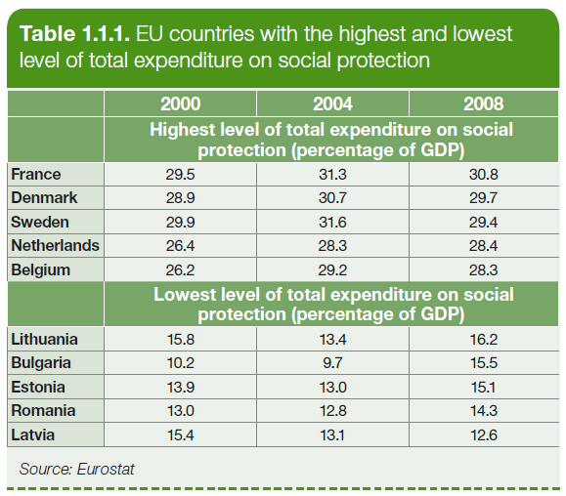
Background: Baltic States spend quite little on social protection
Baltic States spend less on social protection as compared with EU15 and EU27. Baltics on average (2000-2010) 13-19%. EU27 spends 27%

Slide 11
There is a CARE GAP! Childcare for children less than 3 years by hours, 2005-2012, Eurostat

Slide 12
Childcare: for children between 3 years and compulsory school age by hours, 2005-2012

Slide 13
Leave policies now: general remarks
Maternity leave/benefit has not changed much since Soviet period
Benefits were and still are earnings-related (with min and max ceilings)
Eligibility is based on social insurance contributions and residency
Expenses paid from the social insurance money financed by pay-as-you-go schemes
Crisis: Latvia and Lithuania have had cuts in all benefits in last few years, Estonia only in paternity leave

Slide 14
Maternity leave in the Baltics
 | Duration (cal.days) | Payment | Ceiling | Floor | Eligibility
EST | 140 flexible | 100% 12 months average | None | Min wage for those who did not work during past 12 months, but worked before | All employees incl temporary contracts + self-employed
LAT | 126 70+56 | 80% 6 months average (100% until 2011) | Benefit exceeding 925€ per month is reduced 50% Since 2011 | None | All employees + self-employed
LIT | 126 70+65 flexible | 100% | 1379 EUR i.e. 3,2x average insured monthly income Since 2010 | None | Employees or self-employed if insured for 12 months during last 24 months
Notes:
Conclusion: quite similar. Differences in eligibility rules: in Lithuania not everyone is eligibile, requires quite long employment track. Latvia has reduced % due to economic situation. Estonia: no ceiling, but some kind of floor.
Latvia 70+56 if pregnancy is registered by 12th week + pregnant women goes to the doctor (56+56 if not). 14 days added if twins or more; complications.
Benefits are payd according to act „On Maternity and Sickness Insurance“
The minimum annual earnings used to calculate benefits for self-employed persons and voluntarily insured persons are 2,160 lats.
If the benefit amount exceeds the threshold of 11.51 LVL per day, the maximum amount paid equals 11.51 LVL + 50% of the sum above the threshold.
The study showed that the policy (Estonian parental benefit) was influenced by two forces – the path de­pendency with the force to retaining the previous system of long leave sup­porting the female carer model, and on the other hand there was a new aspi­ration to learn from and to resemble the Nordic countries. The result was a policy scheme quite similar to the Swedish parental benefit in many aspects, but it lacked some crucial features that were significant in the Nordic countries. For instance, instead of providing fathers with the individual right for leave, the Estonian scheme restricted the access of fathers to the parental benefit. Together with the reluctance towards the Soviet gender equality, the ideology carried out and reinforced to people and the revival of the traditional gender roles in the wake of independence play a role in the policy creation and use. The policy does now provide fathers with legal rights and financial conditions to take paren­tal leave, but the take-up still remains marginal.

Slide 15
Paternity leave in the Baltics
 | Duration | Payment | Ceiling | Eligibility | Timing | Flexibility
EST | 10 work days | 100% 0% 2009-2011 | 3x average wage | as for maternity | 2 months before or after birth (date) | Can be divided into parts
LAT | 10 calendar days | 80% 100% until 2011 | as for maternity | as for maternity | 2 months after the birth, | In one row
LIT | 28 calendar days | 100% | as for maternity | as for maternity | First month after childbirth | In one row
This is the only leave for only fathers (no quotas) = Estonia and Latvia do not meet the Directive requirement of 1 month.
Notes:
in all countries similar regulation than for maternity leave. Except there is a ceiling in Estonia which is not there for maternity leave. Also, can be taken day by day in Est.
In Estonia the 1 month father’s month is said to be there if combined 10 days of paternity leave + payd and unpayd yearly leave days which is provided addition to regular leave to parents with small children. However, this is not a really a solution, these days are taken usually just to prolong the summer holiday.

Slide 16
Parental leave in the Baltics
 | Duration | Payment | Ceiling | Floor | Eligibility | Working parents
EST | Until child is 3 yrs old | 100% until 1.5yrs 38€ per month after | €2378 per month (3x average wage year before las) | €355 if empl history €320 no empl. history | All parents | Reduced according to a formula if earnings above 320 eur
LAT | 1,5 years, to be used until child is 8 | 60% for 1 yr + 43€ per month after OR 43,75% for 1.5 yrs | Benefit exceeding 925€ per month is reduced by 50% | 142€ per month | All employees + self-employed | 30% benefit is paid
LIT | Until child is 3 yrs old | 100% up 1yr OR 70% for 1yr + 40% for second yr | €1,379 per month 3.2 time’s average insured monthly income | 142€ per month | Insured for 12 months during last 24 months | Benefit is paid partly 1st year (reduced if any earnings) and fully 2nd year
Family entitlement in all countries.
Father’s take-up around 7% Estonia; 12% in Lithuania
Notes:
LATVIA – a lot of changes since 2010; less generous
ESTONIA - few changes towards more generos (for those who work during parental beenfit)
LITHUANIA – also retrenchments
Working A1. If a parent returns to work during parental leave he or she can receive 50% of the parental benefit (this is a transitional arrangement in force from July 1, 2009 to May 2, 2010). in 2011 the benefit is fully withdrawn if a parent returns to work.

Slide 17
Recent changes:
 | MATERNITY | PATERNITY | PARENTAL
EST | No change | 2008: 4,25€ → 100% 2009: 100%→0% 2011: 0%→ 100% | 2013: working was made more beneficial (benefit is less reduced than before)
LAT | 2011 100%→ 80% Ceiling introduced | 2011 100%→ 80% Ceiling introduced | 2011: Ceiling introduced + working parents get no benefit (before received full benefit) 2014: 70%→ 60% Choice: 60% 1yr OR 43,75% 1.5 yrs Working parents receive 30%
LIT | 2010 Ceiling introduced | 2010 Ceiling introduced | 2008: 100% for 24 months 2009: 100% for 12 months + 85% 12-24 mnths 2010: Ceiling introduced 90% for 12 months + 75% 12-24 mnths 2011: 100% for 12 months OR 70% for 12mnths and 40% for next 12 months

Slide 18
In the Baltics parents (i.e. mothers) take long parental leave
Persons who took parental leave to care for their youngest child aged less than eight, by duration leave (age 15-64), Eurostat 2010

Slide 19
Conclusions
Leave policies in the Baltics are characterized
very long leaves (path-dependency)
weak gender equality components, no daddy’s months
take-up of leave is very gendered
later developments driven by economic situation
differences in activity requirements and paying benefits during working

Slide 20
THANK YOU FOR YOUR ATTENTION
marrekaru@gmail.com
ruta.braziene@gmail.com

