Slide 1
What is the case for paid parental leave? 11th LPR Network seminar, Tallinn, 18-19 September 2014
Elin Kvande
Department of Sociology and Political Science,
Norwegian University of Technology and Science

Slide 2
Development of the Norwegian parental leave sceme 1993-2014. Number of weeks.
Total number of weeks | Before birth | Mother’s part | Sharable part | Father’s quota
1993: 52 | 3 | 6weeks | 39 weeks | 4 weeks
2005: 53 | 3 | 6 | 39 | 5
2006: 54 | 3 | 6 | 39 | 6
2009: 56 | 3 | 6 | 37 | 10
2011: 57 | 3 | 6 | 36 | 12
2013: 59 | 3 | 14 | 28 | 14
2014: 59 | 3 | 10 | 36 | 10
Notes:
Development of the Norwegian parental leave sceme over 20 years
In addition: 2 weeks of daddy leave upon birth – paid by the employer
Eligibility
Financed by tax income
Employers cover the first 2 weeks
Up to a ceiling of 6 G – which is about Nok 510 000

Slide 3
Eligibilty :
Both parents must have been in the working life for at least 6 of the last 10 months before birth of their child.
100 per cent of earnings 49 weeks or 80 per cent for 59 weeks ( euro 65,302)
Supports: Dual earner and dual carer
Notes:
Dette kravet har vært strengere før, bla krevdes det at kvinner måtte ha hatt minst halvtidsstilling for å bli regnet som kvalifisert. Nå holder det med pensjonsgivende inntekt (1 G) som et minimum.
Dette er et viktig prinsipp –
foreldrepengene skal erstatte tapt arbeidsinntekt, og den er rikelig kompensert. Bare de høytlønnede får ikke full erstatning, men de får som regel ekstra kompensasjon fra arbeidsgiver. Høy stønad er viktig for menn.
Den belønner arbeide – det er gjennom arbeid at man skal tjene opp velferdsrettigheter. Incitament til å etablere seg i arbeidslivet før en får barn. Engangsstønaden for ikke-yrkesaktive er veldig lav.
Utgiftene betales av statens skatteinntekter.
‘Sommerbarnene’
Parental money may either be taken for 49 weeks at 100 per cent of earnings or for 57 weeks at 80 per cent of earnings, up to a ceiling of six times the basic national insurance benefit payment (i.e. NOK492,732 a year, €65,302).
Compensation over this is a result of collective bargaining
Non-employed women receive a flat-rate payment of NOK35,263 (€4,673).
Funded from general taxation.

Slide 4
General ideals in Norwegian family policies: Gender equality and Universialism
Parental leave :
90 % of mothers eligible
Fathers have the same rights
Day care:
From 2009 : all children have the right to day care from 12 months
2012:
70% of all 1 year olds
91% of all 2 year olds
97% of 3-5 year olds
Maximum price

Slide 5
Research Questions.
Does paid leave increase available parental leave time with children or does it simply crowd out unpaid leave?
What effect does paid leave have on a broad range of child, parent and family outcomes?
How do any benefits compare relative to costs?
Are there progressive or regressive distributional effects?

Slide 6
Policy reforms 1987 to 1992
Paid parental leave expanded from 18 weeks to 35 weeks
Use quasi-experimental design
3 months before and 3 months after compared for each expansion

Slide 7
Findings
Each reform increases the amount of time spent at home versus work by roughly the amount of weeks allowed (Income replacement was 100% , the reforms caused an increase in mothers time spent at home after birth, without a reduction in family income)
2) The expansions had little effect on children’s school outcomes, parental earnings and participation in the labor market (in short and long run) fertility, marriage and divorce
3) Paid maternity leave has negative redistribution properties

Slide 8
Quasi experimental studies
Compare short time period before and after the introduction of a reform
QES can as a rule only be applied to first persons who are effected
QES can only identify parts of a total effect over time
QES can only be applied to a certain context , no general conclusions

Slide 9
Marit Rønsen and Ragni Hege Kitterød
Gender Ecualizing Family Policies and Mothers Entry into Paid Work; Recent Evidence From Norway.
Feminist Economics , 2014
Panel data from period 1996-2010
Findings;
Mothers enter work faster after childbirth in the late 2000s than a decade earlier
More equal division of paid and unpaid work among parents

Slide 10
The fathers’ quota in Norway 1993-2013
2003
2013
Notes:
Vi har med andre ord hatt denne ordningen i 20 år , i fjor var det 20 årsjubileum
The first book was written when the father’s quota had been in existence for 10 years, and the last one (an edited collection) came out just recently and deals with 20 years of experience with earmarked leave for fathers.
This presentation is concerned with what has happened – in what ways the father’s quota is used, and has been received by fathers and employers.

Slide 11
Increased quota leads to increase in father’s use of parental leave
From 4 to 78 % during first five years
Later continuous 90+ percent
Everytime the quota has been increased (2005, 2006, 2009, 2011), the father’s uptake has also increased
Which means : More fathers taking longer parental leave
Parents positive to the quota
Notes:
Etter å ha hatt rett til å ta ut foreldrepenger i 15 år (siden 1977), hadde andelen fedre som tok permisjon steget sakte fra under 1 prosent til 4.
Senere en saktere økning av andel fedre.
Vanskelig med helt sammenlignbare tall, for samtidig har stadig flere grupper fedre fått rett til permisjon. Det er mindre strenge krav. Men, fremdeles må både mor og far ha vært yrkesaktive i forkant.
Etter å ha hatt rett til å ta ut foreldrepenger i 15 år (siden 1977), hadde andelen fedre som tok permisjon steget sakte fra under 1 prosent til 4.
Senere en saktere økning av andel fedre.
Vanskelig med helt sammenlignbare tall, for samtidig har stadig flere grupper fedre fått rett til permisjon. Det er mindre strenge krav. Men, fremdeles må både mor og far ha vært yrkesaktive i forkant.
Arbeidsinnvandrerfedre

Slide 12
Why does it work?
Earmarked individual right
Non- transferable to mothers
No negotiations with mothers
Collective right for all fathers
It is a right for working fathers
No negotiations with employers
Notes:
The state interveens and has done the negotiations and also pays for it , a very generous incentive
The fathers do not have to negotiate individualy it is a right that they have has a father and as an employee
The fact that it is nontransferable represents an extra incentive or push for fathers
It is in their working contract , it is right they have earned the right through working 6 of the last 10 months before birth (it is like the right to holiday)

Slide 13
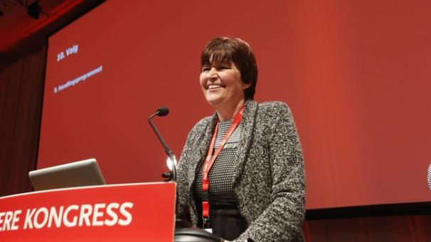
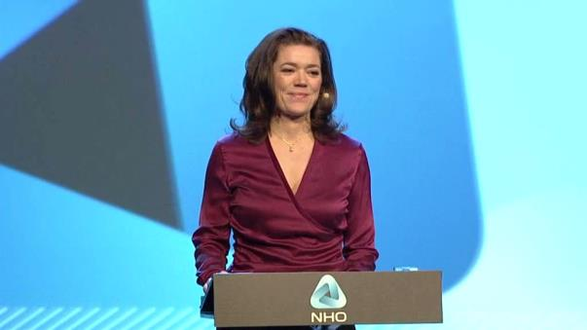
Notes:
The top leaders of the Employers organization in Norway is very much in favor of the father’s quota and the whole parental leave
So is the top leader of the trade unions.
They totally agree on this matter

Slide 14
Thank you for your attention!

