Slide 1
Policy learning: the helicopter view
Agnes Uhereczky
Tallinn, 19th September 2014

Slide 2
Family policy landscape

Slide 3
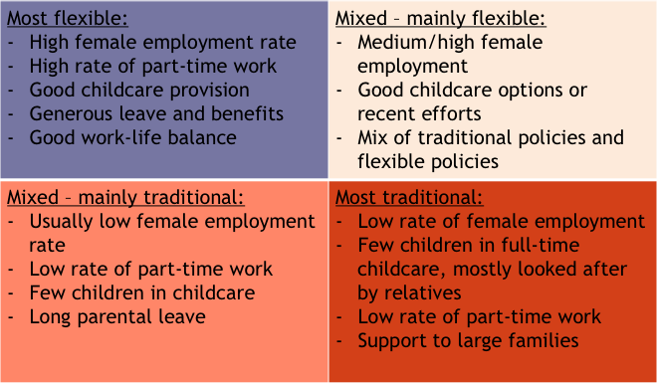
Categorisation of regions/countries

Slide 4
Seeing in a different light
The notion of pressure in a field, which is not EU competence
Not wanting to be on the bottom of the list
One-way transfer (was Sweden interested in learning something from Germany?)
Reciprocity – Mutual learning – Best practices (don’t seem to work)
Childcare – only mention costs, any cost-benefit analyses done? Social investment paradigm?
Why not reinvent the wheel? Political ambition – voters? Economy? Very individual national contexts!

Slide 5
Some more questions:
Role of the European Parliament, MEPs, Council, Perm Reps?
Family ministers – women versus men (gender element)
Lobby/pressure groups (conservative vs. lefty/green/women)
Were there structured dialogue events, citizens’ consultations or stakeholder consultations?
The needs of families – and the need for families to plan ahead (university studies, jobs, grandparents, moving)

Slide 6
More points
Hungary – Austria case of inspiration for the “GYED Extra”, but not for extending the childcare coverage, especially U3
Poland: new system inspired by Sweden
UK and France – shared parental leave (very different reactions and reasons for opposing)
Why Sweden, and not Finland or the Netherlands?
Leading us towards a more and more uniform system? (Labour market mobility needs to become family mobility)

Slide 7
EU level parallel developments
2007 German Presidency: Alliance for European Families DG EMPL – Unit D4 Demography
Belgian Presidency 2010 – Child poverty recommendation
FP7 – strong family policy priority (Family Platform, now Families and Societies)
2011 Hungarian and Polish Presidencies – strong focus on family
2012 – new Director and Director General at DG EMPL: dismantling unit D4, Defamilialisation of family policy (Mary Daly), re-creation of EPIC, focus on investing in children
Social Investment package – long-term care as much attention!

