Slide 1
Regulations in practice: the law on parental leaves, public childcare and parental opinions in Bulgaria
18th Leave Policies and Research Annual Seminar
16–17 September 2021, Helsinki
Finnish institute for health and welfare
Kalina Ilieva, Elitsa Dimitrova, Tatyana Kotzeva
Institute for Population and Human Studies,
Bulgarian Academy of Science

Slide 2
SCOPE OF THE PRESENTATION
A SHORT HISTORICAL OVERVIEW OF THE POLICY ON PAID PARENTAL LEAVES AND ECEC
RECENT DEVELOPMENTS
A SURVEY ON YOUNG MOTHERS’ ATTITUDES TOWARDS PAID PARENTAL LEAVES AND CHILDCARE

Slide 3
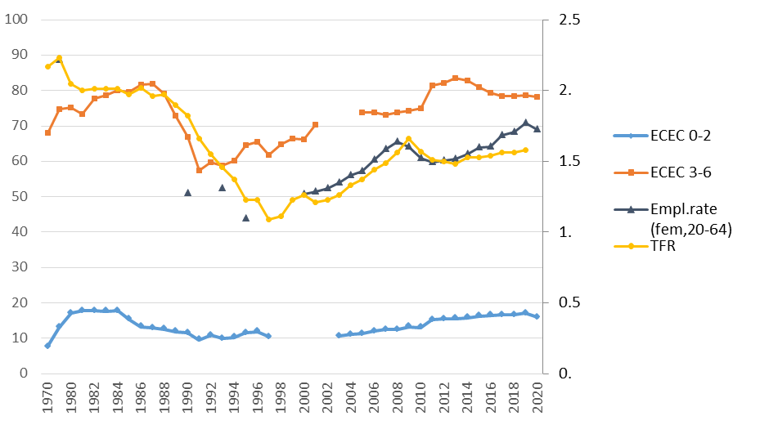
Context
Sources: National Statistical Institute; Eurostat.

Slide 4
The social state – ideology and priorities
The socialist state (1944-1989) – institution of rights around pregnancy and childbirth, pronatalistic policy AND high women’s employment, a wide network of crèches and kindergartens, other social advantages for families with children
1990s – inflation of social payments, incl. maternity compensation, expansion of low-paid parental leave, cut off of kindergartens
After 2000 – onset of EU legislation transposition in national law, recognizing diversity of parental contexts, expansion of well-paid maternity leave

Slide 5
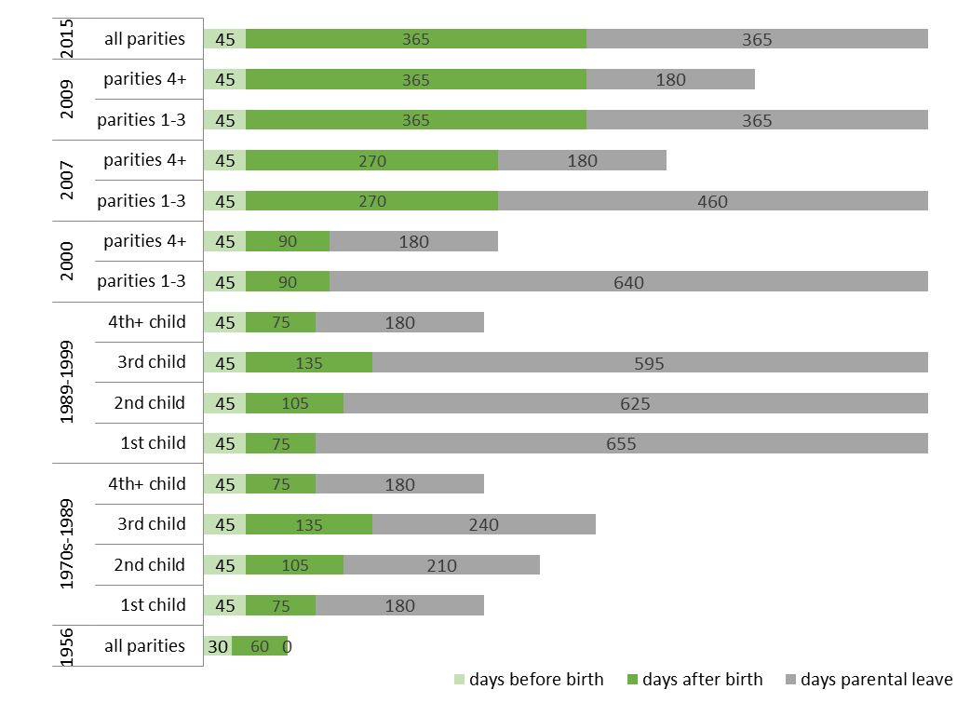
Maternity/Parental leave designs in time

Slide 6
Recent developments in Maternity/Parental leaves
The pronatalistic logic of parity-based entitlements – gradually removed
Progressively inclusive of other persons 1st year (well-paid) leave
Fathers (2009)
Grandparents (2017)
Adoptive parents are treated equally to birth parents (2018)
Lone adoptive mother/father – the same rights as couples
Foster families entitlements
Parental leave (2004)
Maternity/Parental leave – not fully aligned with biological (2017)
Right of 50% maternity/parental benefit – if the mother returns to work before ending of leave (2017)

Slide 7
The father’s entitlements
Paternity leave – 15 calendar days at birth (2009)
Incl. cohabiting fathers (2017)
Excl. adoptive cohabiting fathers (2018)
Maternity/parental leave (after the 6th month of the child)
Birth and adoptive fathers (2009)
Foster fathers (2017)
Paid parental leave (between the 1st and 2nd year of the child)
Birth and adoptive fathers (1986)
Foster fathers (2004)
Use of paternity leave – 21 749 fathers (~30%) in 2020
Use of transferred maternity leave after the 6th month – 342 fathers in 2020

Slide 8
Trends and Developments in ECEC
Due enlargement of the ECEC sector – 10,000 without childcare places in 2020
A new compensation for parents whose children 3-6 y. do not have a place in a public kindergarten (~€180 per month)
Rigid forms of public ECEC services – only collective, ‘medicalized discourse’, quality framework to be developed
Geographical variation in provision and in attendance rates – unmet demand in large cities and the capital
Lack of state-regulated individual forms – municipal or market-based
Share of informal unpaid care – cultural norms to use grandparents

Slide 9
Some implications
The rule for determining maternity compensation penalizes the situation of job insecurity – in case of gaps in work experience – filled with the minimum wage
Mean mother’s vs. father’s compensation for maternity/parental leave - BGN32.74 vs. BGN62.97(daily) in 2020
economic disincentive for families to use the transferred maternity/parental leave
The employer’s prism – long absence of mothers from work since maternity or parental leaves cannot be split and postponed
Co-resident non-biological parents are not entitled the right of leave and also a cohabiting father is eligible for paternity leave if he has formally acknowledged the child

Slide 10
A survey on parental attitudes to ECEC
Data collection – February, 2017, online form
Non-random sample of 748 parents:
mothers (98%), fathers (2%)
one child (53%), two children (42%), three or more (5%)
median age 35
residence: capital (50%), big city (32%), small town (15%), village (4%)
education: higher (81%), secondary (18%), primary (1%)
employed (59%), on maternity leave (30%), unemployed (9%), in edu (2%)
income brackets: low (21%), medium (42%), high (37%)

Slide 11
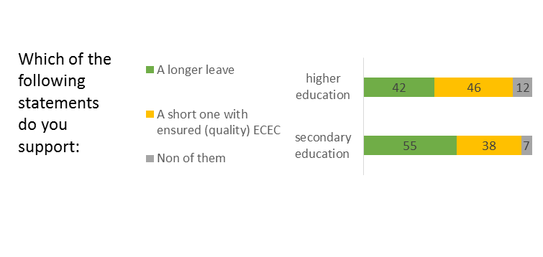
Policy changes and parental attitudes
p<0.02
Open-ended question: both propositions, underlining choice

Slide 12
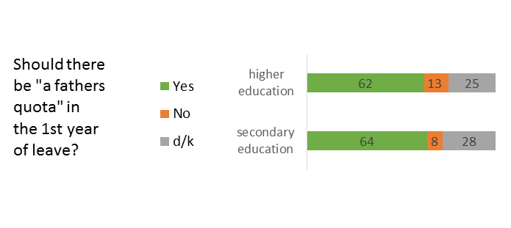
Policy changes and parental attitudes
Open-ended question: useful – yes, necessary - no

Slide 13
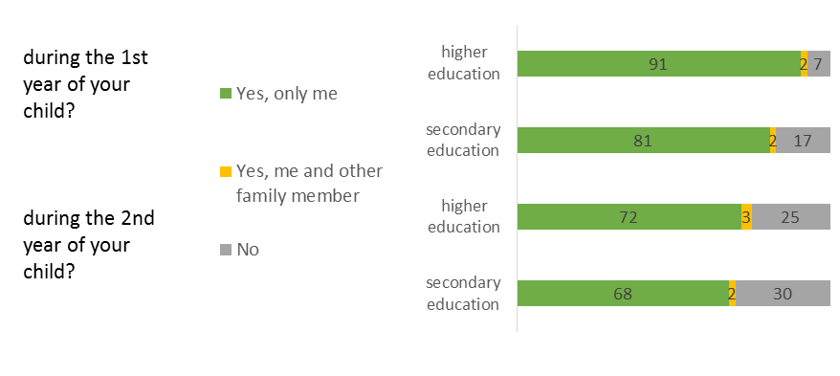
Parental experiences – use of paid leave
Have you used parental leave:
p<0.001

Slide 14
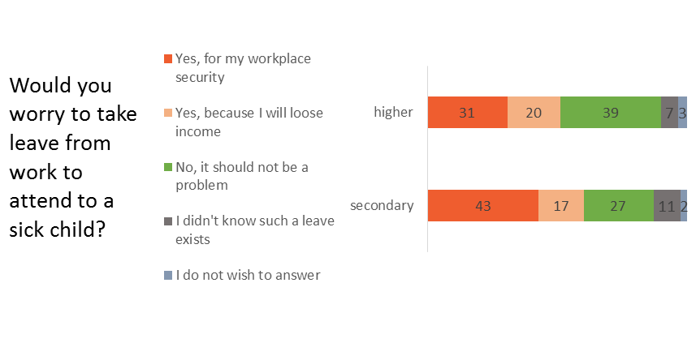
Parental experiences – perceived job insecurity
p<0.02

Slide 15
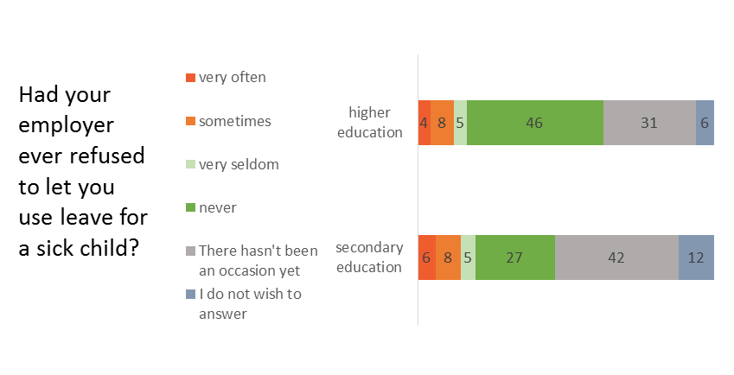
Parental experiences – leave vs. employment
p<0.001

Slide 16
Survey findings
Ambivalent attitudes towards the length of parental leave, education gradient
Mothers tend to use their entitlements; fathers – much lower rates
A ‘father’s quota’ within the well-paid period may be a bonus, but should not affect or be conditioned on the mother’s rights
Hidden regulations in private sector – women with secondary education are not eager to take sick leave
Preference for home-based childrearing for very young children

Slide 17
Conclusions
The law: entitlements of well-paid leave (during the 1st year) are ‘mother-centered’, non-use of the transferable portion after the 6th month
A gap between law regulations and practices
As the length of maternity leave extends in time – full use and slow reentry of mothers into the labor market
The ECEC sector: the lack of individual forms for ages 0-3 is backed up with informal care by grandparents, or, with
Individual market-based care – expensive, unregulated for quality and affordability for parents (uncapped fees)
The parents: still underserved due to shortage of places in big cities
Hidden norms for non-absence from work for family reasons
A field to be developed – individual forms of childcare

Slide 18
Sources & literature:
Eurostat (online data codes: demo_find, T2020_10)
National Statistical Institute. Statistical Yearbook, 1981, 1986, 1991, 2003, 2006, 2010.
National Statistical Institute. Infostat on-line database. [Accessed: 22.08.2021]
Dimitrova, E., Kotzeva, T. and Ilieva, K. (2021) ‘Bulgaria country note’, in Koslowski, A., Blum, S., Dobrotić, I., Kaufman, G. and Moss, P. (eds.) International Review of Leave Policies and Research 2021. Available at: https://www.leavenetwork.org/annual-review-reports/
Mruchkov, V. (1978) The Bulgarian labour legislation and the international labour conventions and recommendations. Nauka I izkustvo Publ. Sofia. (In Bulgarian)
Yossifov, Y., Banova, V., Zhupunov, L., Marinova, A., Kotzeva, T., Dimitrova, E., Moraliiska, St., Ilieva, K., Gerginova, E. (2018) Early Childhood Development in Bulgaria: Views from Inside. A Study of the Systems Supporting Early Childhood Development, their Interconnections and the Interactions with Parents. Sofia, For Our Children Foundation (in Bulgarian).

