Slide 1
Family leave after Brexit: losses & gains for British working parents
Thomas Coram Research Unit
Margaret O’Brien
University College London
INLR Annual Seminar, Fordham University New York
June 22nd 2022

Slide 2
Preview
Brexit - United Kingdom’s departure from the European Union (‘Britain’ & ‘exit’) after 47 years following a national referendum in 2016
Return to national freedom & sovereignty “take back control” or Britain’s greatest act of “self-harm”
Have “new freedoms” improved or hindered parents’ leave entitlements?
Main message – “the divorce process” has provided little space for innovation & there are signs that British parents may be loosing out

Slide 3
Divided country & preoccupied government
Divided & unsettled country- 51.89% Leave vs 48.11% Remain, a small margin of 3.78%. Two of 4 regions voted to remain (Northern Ireland, Scotland)
Ongoing political turmoil about what sort of Brexit– lost two PMs, two general elections (2017, 2019), Northern Ireland peace agreement under strain, intensification of Scottish separation
Transition period 2016-2020
- Withdrawal agreement (2018)- money, citizens rights, Northern Ireland, Customs union, but “constitutionally no change”
- Trade and Cooperation Agreement (TCA) 31st January 2020

Slide 4
Implications for Employment rights
National Rhetoric “full regulatory autonomy” “global race to the top on standards” “Singapore-on Thames”
Legal Reality UK free to make new employment laws; not bound by EU directives but has agreed not weaken or reduce workers’ rights. Non-regression/ Level playing field principles- “not to reduce level of existing social protection in such a way as to distort competition”
Joint aspiration “shall continue to strive to increase their respective labour & social levels of protection.”
Currently two EU Directives due to be implemented in August 2022
Parent and Carers Directive (2019/ 1158)
Transparent & Predictable Working Conditions (2019/1152)
UK-EU Partnership Council for facilitating TCA and settling disputes

Slide 5
EU Parent and Carers Directive (2019/ 1158): new minimum standards & UK comparison
Paternity Leave
Leave from work for fathers/ second parents on the occasion of the birth of a child for the purposes of providing care (Article 3)
Duration & Pay At least 10 working days, compensated at least at the level of sick pay. UK√√
Eligibility all workers who have employment contracts or other employment relationships including fixed term, temporary agency contracts UK x
length of service qualification should not exceed 6 months UK √

Slide 6
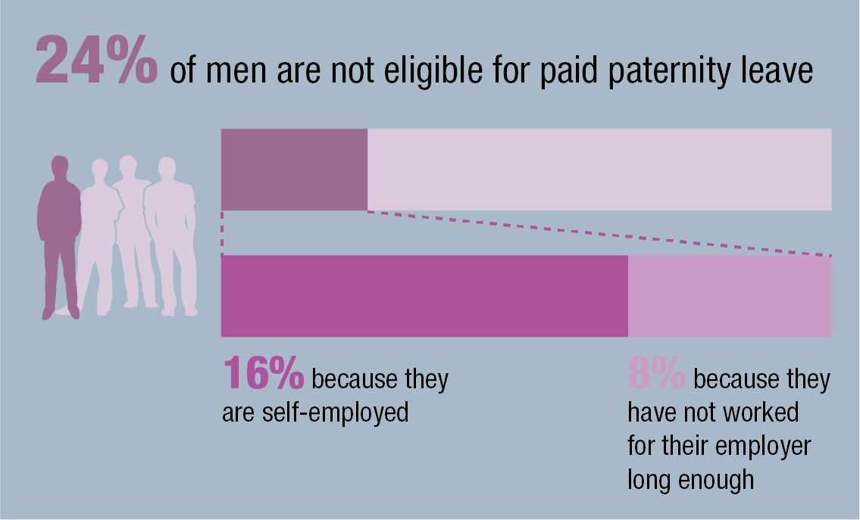
Notes:
Margaret O’Brien (UCL), Matthew Aldrich (UEA), Sara Connolly (UEA), Rose Cook (UCL) and Svetlana Speight (NatCEN) (2017) Inequalities in Access to Paid Maternity & Paternity leave & Flexible Working
http://www.modernfatherhood.org/publications/inequalities-in-parental-leave-full-report/

Slide 7
EU Parent and Carers Directive (2019/ 1158): new minimum standards & UK comparison
Parental Leave
Leave from work for parents on the grounds of the birth or adoption of a child to take care of that child. (Article 3)
- Duration 4 months of parental leave (2 out of the 4 months non-transferable from a parent to another) UK √
Payment “set up in such a way as to facilitate the take-up of parental leave by both parents” UK X
Flexibility Parents will also have the right to request to take the leave in a flexible way UK X
Eligibility all workers who have employment contracts or other employment relationships including fixed term, temporary agency contracts UK x;
length of service qualification should not exceed 12 months UK √

Slide 8
What are UK working parents loosing if EU WLB Directive not fully implemented?
Expanded pool of eligible fathers to be entitled to paternity leave
Expanded pool of eligible parents to be entitled to parental leave
Payment for mothers and fathers when they take parental leave (including incentives for fathers/ second parent)
A more flexible parental leave design

Slide 9
A new Employment Bill was promised for 2019, delayed by pandemic & has not been included in 2022-2024 parliament workstream
The Employment Bill was due to cover:
Leave for neonatal care
Extending redundancy protection for pregnancy and maternity
Leave for unpaid carers
Making flexible working the default
The right to request a more predictable contract
A single enforcement body
Cross-party support & extensive national consultation
Notes:
The Employment Bill was due to cover the following reforms, which have all been under discussion since at least December 2019.
Making flexible working the default. The government had already backtracked on this somewhat by proposing a more modest new right to request flexible working from day one, and consultation on this proposal closed in December 2021. This forms the backdrop to discussions about “new normal” working arrangements, so it would be surprising if there was no response to the consultation this year despite its omission from the Queen’s speech.
Extending redundancy protection for pregnancy and maternity. The government has promised to extent priority for alternative employment opportunities on redundancy to all pregnant employees and for up to 6 months after return from maternity leave, with similar protections for parents returning from adoption or shared parental leave.
Leave for neonatal care. The government has promised a new right to 12 weeks' paid neonatal leave for parents whose babies spend time in neonatal care units. Consultation on this proposal closed on 11 October 2019, and the government’s response to the consultation said they will go ahead with legislation, although this is not expected until 2023.
Leave for unpaid carers. The government has proposed that working carers will be able to take up to 5 days’ carers leave each year to help them carry out their caring responsibilities, although this will be unpaid. The government published some detail on how this new right will operate in September 2021, but there has been no further progress since then.
Tips to go to workers in full. The government’s proposed regulations governing how tips are to be distributed would require employers to pass on all tips and service charges to workers and ensure that tips are distributed on a fair and transparent basis, to be supported by a statutory Code of Practice.
The right to request a more predictable contract. Based on the Good Work agenda, the government had been expected to introduce a new right for workers with variable hours to request a more stable and predictable contract after 26 weeks' service and, possibly, new rights to reasonable notice of working hours and compensation for short-notice shift cancellation. It is worth noting that the EU transparent and predictable working conditions directive will introduce similar rights on an EU-wide basis in August 2022.
A single enforcement body. The Good Work Plan proposed a single labour market enforcement agency, with the intention to combine existing bodies, and expand this new body’s remit into the enforcement of statutory sick pay, holiday pay for vulnerable workers and the regulation of umbrella companies.
What about other expected reforms?

Slide 10
The Ministerial and other Maternity Allowances Act 2021- innovation can happen
In November 2020, the government minister Suella Braverman MP announced that she was expecting her second child in early 2021. At the time, she was the government’s chief law officer: the Attorney-General.
In order to allow the Prime Minister to appoint another MP to cover for Ms Braverman, the government rushed through new legislation that would allow Ms Braverman to take six months paid Maternity leave at full income replacement, a much more generous allowance than statutory Maternity leave benefit.
The Ministerial and other Maternity Allowances Act 2021 also allows a limited number of Opposition MPs (e.g. the Leader of the Opposition in the House of Commons) to take Maternity leave on the same terms.
Innovation in eligibility, duration and payment

Slide 11
Have UK’s “new freedoms” improved or hindered parents’ leave entitlements? - reflections
Some reduction in leave provision advancements. UK may have lost an important external driver of gender equality innovation
Lack of clarity about why new Employment Bill did not appear given prior widespread consultations & UK’s post-Brexit freedom to make new employment laws
Increasing parents’ eligibility to higher paid leave (in line with WLB Directive) has some traction but access to ECEC has more visibility
Brexit has crowded out innovation. Reactive and confusing policy environment – e.g. The Ministerial and other Maternity Allowances Act 2021
National disquiet exists about poor support for working parents “Boris Johnson to launch fresh push to cut childcare bills in bid to ease cost of living crisis” May 2022 but “Boris faces the wrath of Mumsnet readers over Partygate” June 2022

