Slide 1


The Impact of Employment Precariousness on Parental Leave Benefits in Southern European Countries (Portugal, Spain, Italy, And Greece)
Susana Atalaia and Mafalda Leitão (ICS-ULisboa/ OFAP)
20th Leave Policies and Research Annual Seminar
Athens, 29-30 June 2023
This presentation was supported by national funds through the Portuguese Foundation for Science and Technology (FCT, I.P.), under the contract number DL57/2016/CP1441/CT0018.

Slide 2
Aim and sources of information
    Aim: To understand the impact of employment precariousness on access to parental leave benefits in Southern European countries (Portugal, Spain, Italy and Greece).
    Main sources of information:
    LEAVE Network country reports,
    MISSOC (Mutual Information System on Social Protection), Eurostat (Labour Force Survey).
Notes:
Por esta razão o objectivo desta apresentação

Slide 3
Research relevance
Why is it important to study employment precariousness and eligibility for parental leave benefits in Southern European countries?
Changes in leave policies (more gender equality)
Changes in labour legislation (higher job insecurity)

Slide 4
Research questions
Should parental leave eligibility remain linked to the parent’s employment status and their social insurance record?
What policy measures have been adopted in order to minimise the impact of precariousness on access to parental leave benefits?
Is it possible to think of a parental leave scheme linked to a more universal and inclusive concept of leave entitlements?

Slide 5
Theoretical framework
Emergence of a new paradigm in the field of parental leave research - the social inequality paradigm (Fagnani and Boyer, 2007; McKay et al., 2016; Dobrotić and Blum, 2019; Dobrotić and Blum, 2020). This approach raises the question of inclusiveness/exclusiveness associated with parental leave benefits as social rights (Dobrotić and Blum, 2020).

Slide 6
Main topics
Eligibility criteria for maternity and paternity leave benefits (2004 and 2019): contributory and non contributory schemes.
Labour market conditions (2004, 2009, 2014 and 2019): employment rate, employment precariousness (temporary work; part-time work; self-employment) and their level of involuntariness.

Slide 7
Eligibility criteria (1st topic)
- Contributory
- Non-contributory schemes

Slide 8
Eligibility criteria
- Indicators
(Contributory and non-contributory schemes)
  1st Dimension – Employment History
  2nd Dimension – Employment Sectors & Forms of Employment
  3rd Dimension – Citizenship-based criteria (non-contributory)

Slide 9
Eligibility criteria
- Contributory scheme indicators
  1st Dimension – Employment History
  Previous insurance contributions
  Employment situation at childbirth

Slide 10
  1st Dimension – Employment History (eligibility for maternity and paternity benefits), 2019
 | PORTUGAL | SPAIN | ITALY | GREECE
PREVIOUS INSURANCE CONTRIBUTIONS | x | x | x (mothers with non-fixed term contracts) | x (private sector mothers)
EMPLOYMENT SITUATION AT CHILDBIRTH |  | x | x | x (public sector mothers and all employed fathers)
UNEMPLOYMENT | x (if receiving unemployment benefit) | x (if receiving unemployment benefit) | x (if receiving unemployment benefit)

Slide 11
Eligibility criteria
- Contributory scheme indicators
  2nd Dimension – Employment Sectors & Forms of Employment
  Employment sector (public, private, non-profit sector)
  Economic activity sector (agricultural, industry, services)
  Forms of employment (including non standard workers and self-employed)

Slide 12
  2nd Dimension – Employment Sector and Economic Activity (eligibility for maternity and paternity benefits), 2019
 | PORTUGAL | SPAIN | ITALY | GREECE
EMPLOYMENT SECTOR (public, private, non-profit) |  | x (regional/ local differences for public servants) |  | x (mothers)
ECONOMIC ACTIVITY (agricultural, industry, services, etc.) |  | x (only partial access for agricultural workers) | x (distinction by professional occupation)

Slide 13
  2nd Dimension – Forms of Employment (eligibility for maternity and paternity benefits), 2019
 | PORTUGAL | SPAIN | ITALY | GREECE
FORMS OF EMPLOYMENT
SELF-EMPLOYMENT | x | x | x (maternity leave is not compulsory for self-employed) | x (mothers only partially entitled and fathers not entitled)
NON-STANDARD WORK | x (minimum record of social contributions, exclude very short-term contracts and some categories of voluntary social security) | x | x (non-fixed term contracts need to fulfil previous period of insurance contributions) | x (exclude vocational trainees)

Slide 14
Eligibility criteria –
Non-contributory scheme indicators
  3rd Dimension – Citizenship-based criteria
  Entitlement
  Lenght of leave
  Payment level
  Eligibility conditions

Slide 15
3rd Dimension - Citizenship-based criteria (eligibility for maternity and paternity benefits), 2019
 | PORTUGAL | SPAIN | ITALY | GREECE
WHO IS ENTITLED | Mothers and fathers | Mothers | Mothers | Mothers
LENGTH OF LEAVE | 120, 150 or 180 days (initial parental leave) and fathers’ exclusive leave (25 days) | 42 days of mandatory maternity leave (56 days in specific situations) | 150 days (5 months), mandatory maternity leave | The mother should not have worked 42 days before and after birth.
PAYMENT LEVEL | Between 274 and 343 euros/month | 537 euros/month (2019) | 421 euros/month (Stato) 346 euros/month (Comuni). Can be accumulated | 440,20 (total amount)
ELIGIBILITY CONDITIONS | Family income (until 80% of IAS per person), 348,6 euros (2019) | Working mothers | Low income working and non working mothers; temporarily unemployed mothers. | Low income working mothers (maximum of 586,94 euros monthly family income)
Notes:
O Subsídio social em regra não inclui o pai. Só em Portugal é que o pai é abrangido.

Slide 16
Eligibility criteria (conclusions)
In Southern European countries, parental leave benefits are mainly an employment-based entitlement (selective model); more stable careers: better protected than those with less secure jobs (e.g. short-term or temporary contracts).
Differences between public and private sector employees, (Greece); professional occupations (Italy); and previous insurance contributions (Portugal and Spain): results in a general restriction of fully paid maternity and paternity leaves benefits for some groups of parents, generally non-standard workers (temporary, part-time, family workers, etc.) and the self-employed.

Slide 17
Eligibility criteria (conclusions)
As a way of including workers with less stable and secure careers, the analysed countries introduced a flat-rate social parental benefit available for mothers (and fathers in the Portuguese case) who do not met eligibility criteria and/or live in a very low-income household.

Slide 18
Labour market conditions
(2nd topic)

Slide 19
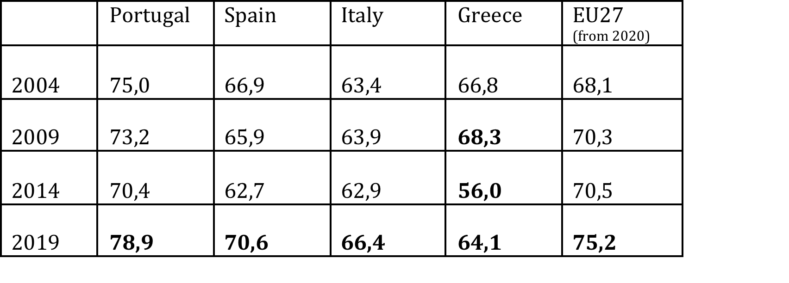
Table 1 – Employment rate population aged 25-64 years (Portugal, Spain, Italy, Greece, and EU27), 2004, 2009, 2014, and 2019 (%)
Source: Eurostat, 2020.

Slide 20
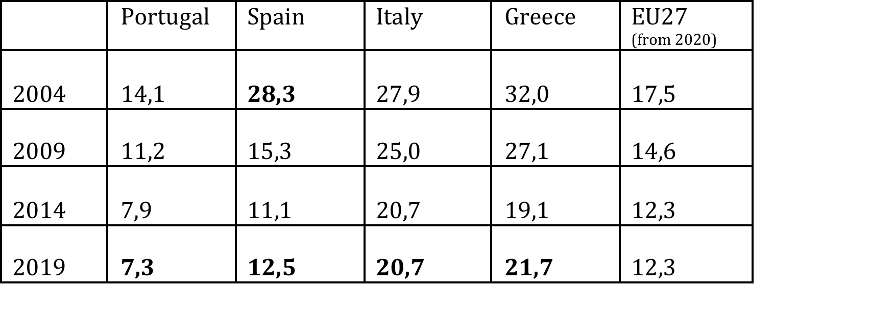
Table 2 – Gender employment gap population aged 25-64 years (Portugal, Spain, Italy, Greece, and EU27), 2004, 2009, 2014, and 2019 (difference p.p.)
Source: Eurostat, 2020.

Slide 21
However...
  The growth of the employed population and the professional integration of women have been closely accompanied by the increase in subcontracting or underemployment, that is, lower quality of employment contracts (non-standard contracts – temporary jobs and part-time employment) with less social protection rights.

Slide 22
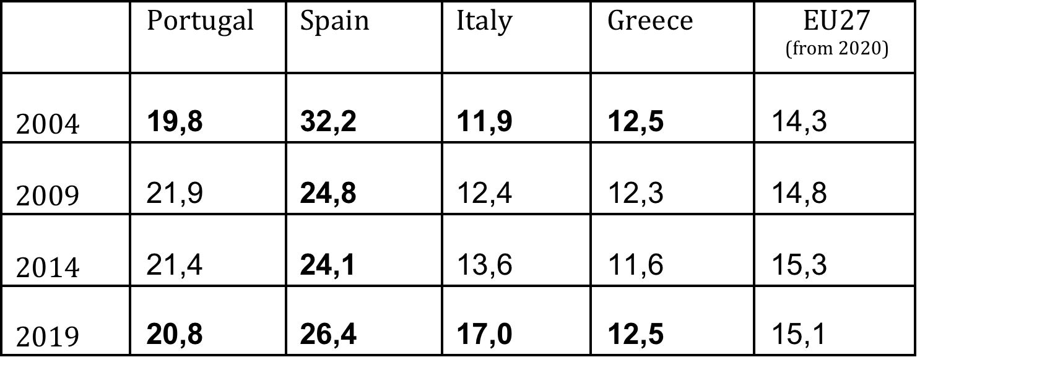
Table 3 – Temporarily employed population aged 15-74 (Portugal, Spain, Italy, Greece, and EU27), 2004, 2009, 2014, and 2019 (%)
Source: Eurostat, 2020.

Slide 23
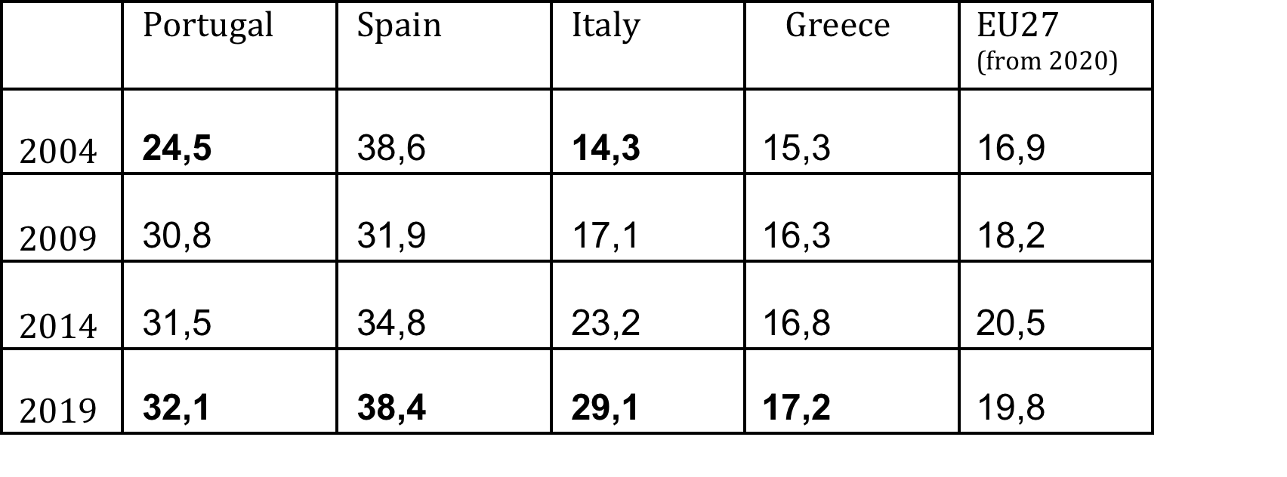
Table 4 – Temporarily employed population aged 25-34 (Portugal, Spain, Italy, Greece, and EU27), 2004, 2009, 2014, and 2019 (%)
Source: Eurostat,2020.

Slide 24
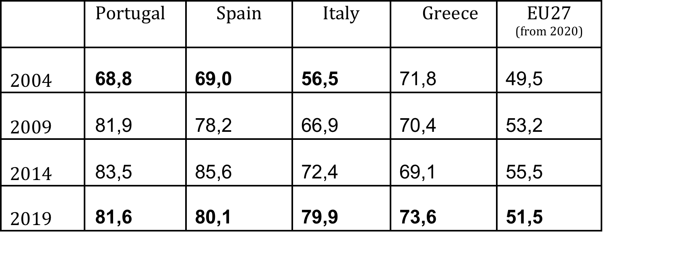
Table 5 - Involuntary temporary employment population aged 15-74 (Portugal, Spain, Italy, Greece, and EU27), 2004, 2009, 2014, and 2019 (%)
Source: Eurostat, 2020.

Slide 25
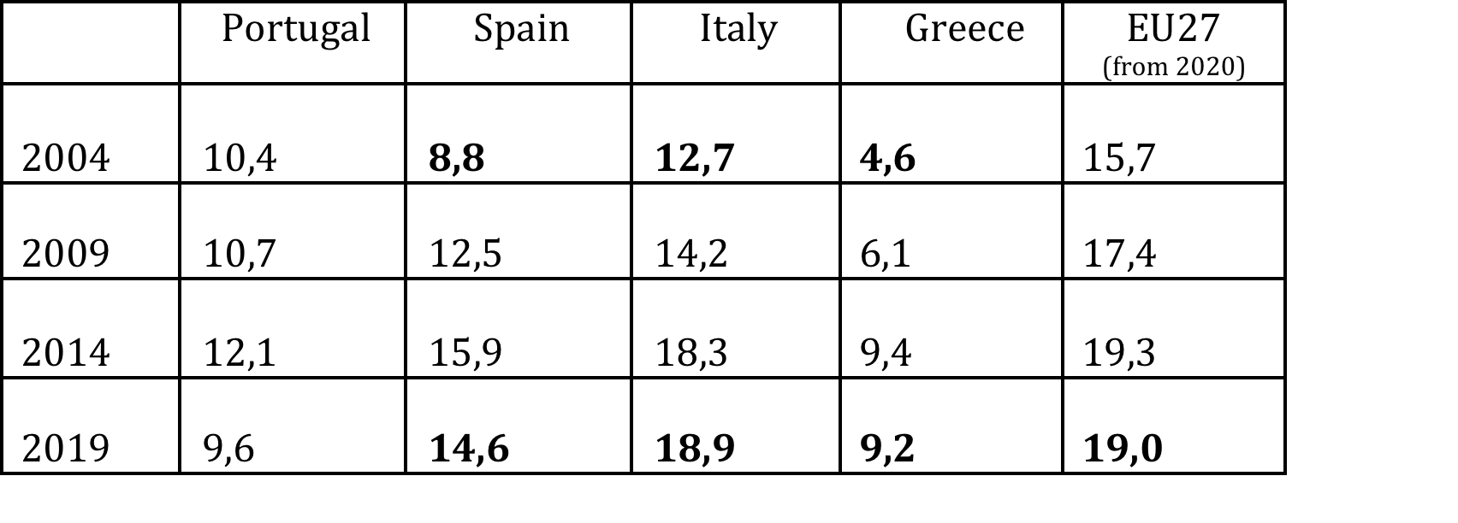
Table 6 – Part-time employment rate population aged 15-74 (Portugal, Spain, Italy, Greece, and EU27), 2004, 2009, 2014, and 2019 (%)
Source: Eurostat, 2020.

Slide 26
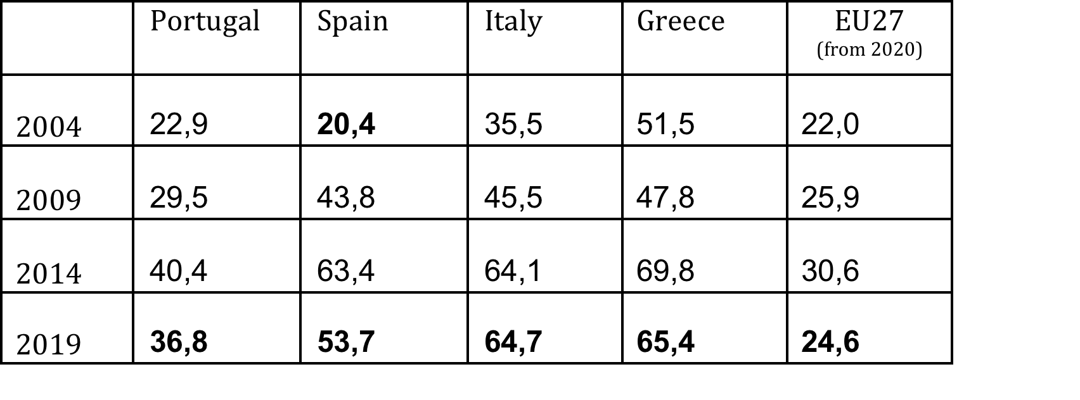
Table 7 – Involuntary part-time employment, population aged 15-74 (Portugal, Spain, Italy, Greece, and EU27), 2004, 2009, 2014, and 2019 (%)
Source: Eurostat, 2020.

Slide 27
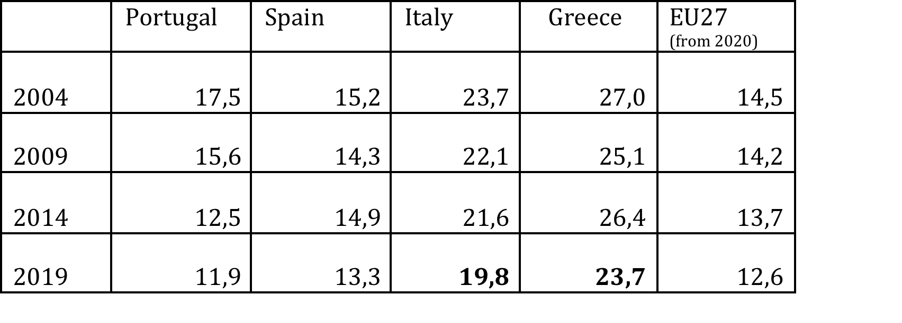
Table 8 – Self-employment rate population aged 25-49 (Portugal, Spain, Italy, Greece, and EU27), 2004, 2009, 2014, and 2019 (%)
Source: Authors’ own calculations based on Eurostat, 2020.

Slide 28
Final Remarks (i)
  In Southern European countries, at least one-quarter of the population of reproductive age (W 15-49 years; M 15-54 years) cannot fully benefit from existing parental protection schemes.
  Huge discrepancy regarding parental leave entitlements (time and payment), depending on men’s and women’s working status and insurance schemes.
  In some categories of employment precariousness (temporary workers aged 25-34 years old), these figures increase to higher percentages.

Slide 29
Final Remarks (ii)
  To include workers with less stable jobs and secure careers some countries introduced a non-contributory scheme.
  The issue is the type of leave they are entitled to and the level of payment associated.
  In fact, the non-contributory scheme are reproducing the existing social inequalities of the contributory scheme.

Slide 30
Final Remarks (iii)
  By placing too many obstacles in the way of eligibility regarding fully paid maternity and paternity leaves, we may well be contributing to the permanence of inequalities:
  That not only prevent younger generations from becoming parents;
  But also discriminate children’s first care according to the employment status and contributions record of their parents.

Slide 31
Thank you for your attention! susana.atalaia@ics.ulisboa.pt mafalda.leitao@ics.ulisboa.pt

Slide 32
Atalaia, S. and Leitão, M. (in press, 2023) The impact of employment precariousness on parental leave benefits in Southern European Countries (Portugal, Spain, Italy and Greece), In P. Michón and S. Gabel (Eds.) The effects of precarity on diversity, and work and family life (Routledge).

