Slide 1
SITUATION ANALYSIS AND IDENTIFICATION OF NEEDS IN THE AREA OF FAMILY POLICY IN SLOVENIA
Ružica Boškić
Child Observatory
Social protection Institute of the Republic in Slovenia
Ljubljana, 13 September, 2012

Slide 2
Data are taken from the analysis:
„Background for the new resolution on family policy“
6 areas were analysed:
  family;
  family allowances and parental care;
  health;
  labour market and employment;
  housing;
  preschool education.

Slide 3

BASIC INFORMATION ABOUT FAMILIES
IN SLOVENIA
Population census 2011 – 567.347 families (1991 – 551.899 families, 2002 – 555.945 families)
Trends in family composition – the last three censuses (in %)
Average age of first time mother: in 1991 25, in 2010 28,7
Average age of the first time father: in 1991 29,5 in 2010 32,5
Year | Married couples with children | Couples not married with children | Single parent families | Single mother with children | Single father with children
1991 | 59,0 | 2,2 | 18,0 | 15,4 | 2,6
2002 | 53,0 | 5,3 | 18,8 | 16,2 | 2,6
2011 | 41,9 | 8,7 | 25,2 | 21,1 | 4,1
Notes:
V strokovni javnosti se že kar nekaj časa opaža in opozarja na vedno večje število otrok in mladostnikov, ki imajo hude čustvene in vedenjske motnje, ki so izražene v različnih stopnjah in se kažejo predvsem kot neke vrste agresivnega oziroma nasilnega obnašanja. Stroka opozarja, da je to zelo zahtevna in kompleksna problematika in da za obravnavo te skupine otrok niso primerno opremljeni (dne z vidika doktrine dela, prostorov, kadra…) in da zato ta populacija pogosto ostane brez primerne obravnave (nameščanje, usmerjanje).
MDDSZ je pri IRSSV naročilo raziskovalno nalogo, kjer smo to skupino otrok opredelili kot otroke in mladostnike s hudimi motnjami vedenja, ki imajo zelo specifične in različne potrebe in tako tvorijo izrazito heterogeno skupino. Torej gre v tem kontekstu za otroke, prikrajšane za normalno družinsko življenje in otroke s posebnimi potrebami. Ker zanje v sistemu ni na voljo ustrezne skrbi, so izgubljeni v sivih lisah sistema, ki zajema področje šolstva, socialnega varstva, zdravstva ter zaradi pogoste delinkventnosti tudi znotraj policijskega in sodnega sistema.

Slide 4
CHILDREN
Number of children in Slovenian families
Share of children in Slovenian population
Year | All families | 1 child | 2 children | 3 children | 4 and more children
2011 | 567 347 | 233 084 | 159 555 | 30 633 | 6 401
Year | 0–14 years old | 0–18 years old
1995 | 18,5 | 24,2
2000 | 16,1 | 21,7
2005 | 14,4 | 19,3
2010 | 14 | 18,1

Slide 5
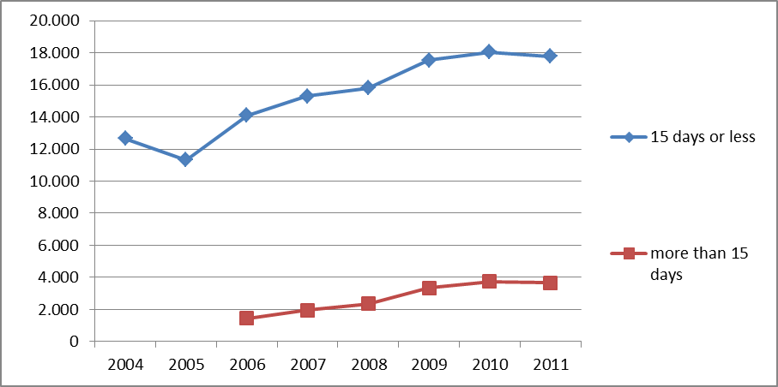
MATERNITY AND PATERNITY LEAVE
Maternity leave: 105 days (28 days before birth);
Paternity leave: 90 days (of which 15 paid; social security contributions are covered for the rest);
Fathers that have taken the paternity leave

Slide 6

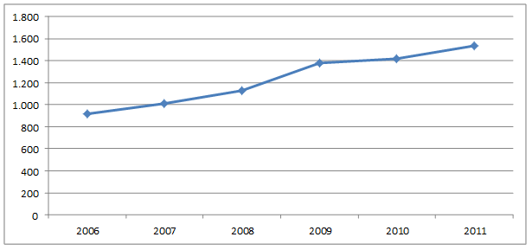
PARENTAL LEAVE
Parental leave: 260 days per family
Parental leave taken by fathers:
Almost 1/3 persons in survey in 2010 (20-49; representative sample) did not know that parental leave in Slovenia can be taken by any parent, not by mothers!
If father would take at least 3 months of parental leave, then 9 % women would decide to have another child
68 % of all persons in a survey in 2009 think that 1 year leave (maternity + parental) is long enough

Slide 7
CHILD ALLOWANCE
Child allowance: in 2010 79 % persons in survey;
2/3 – child allowance is low
1/3 – child allowance is high enough
In 2010 survey most people (55 %) preferred child allowance that is based on the family income
(25 % equal child allowance for all; 18 % only for families with low income)
new legislation (2 acts; impact assessment is needed)

Slide 8
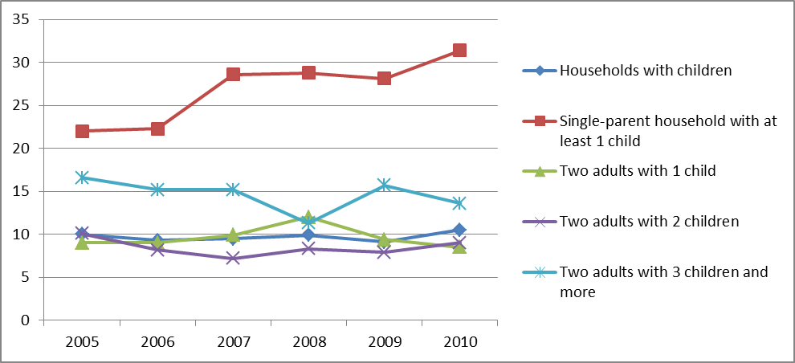
MATERIAL STATUS
Poverty: in 2010
10,5 % households with children lived in poverty;
12,6 % children lived in poverty
At-risk-of-poverty rate (in %):

Slide 9
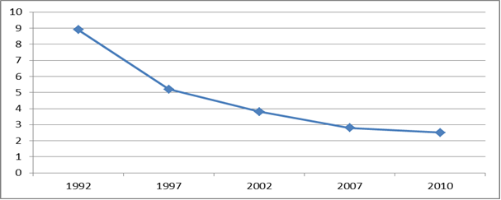

HEALTH
Most health indicators show positive overall health status of families in Slovenia
Especially data about Infant mortality rate
(the number of infant deaths (aged 0-365 days) per 1000 live births)

Slide 10

HEALTH
Provision of health care staff corresponds to the normatives at the national level regarding the number of patients per one personal physician
Reproductive health – poor data, no national database!
The number of children born out of in vitro fertilization is rising:
2005 3,8 % of all born children
2007 4,6 % of all born children
Leave for care of ill family member:
In 2011 80,6 % of women and 19,4 % of men used it.
Women between 20-44 years of age are most burdened category in this respect.

Slide 11
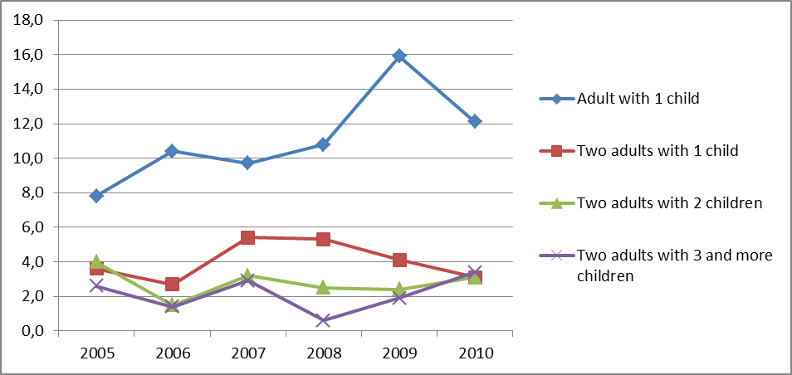
HOUSING
Housing is the most problematic area for Slovenian families!
Housing as financial burden – for large share of families housing costs represent heavy financial burden (in %):

Slide 12
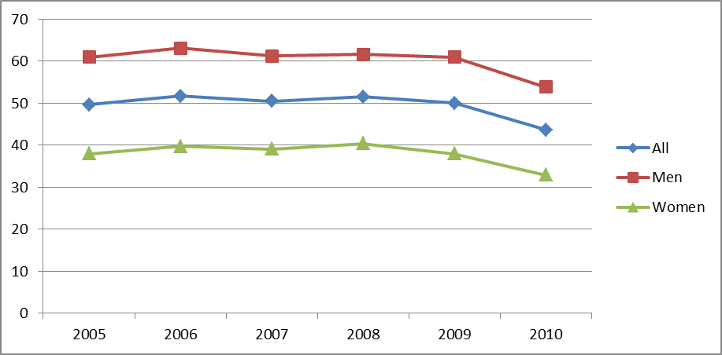
HOUSING AND ENVIRONMENT
Parents and adult children living together (children from 25-34 years old, in %):
Poor transport connections in some regions

Slide 13
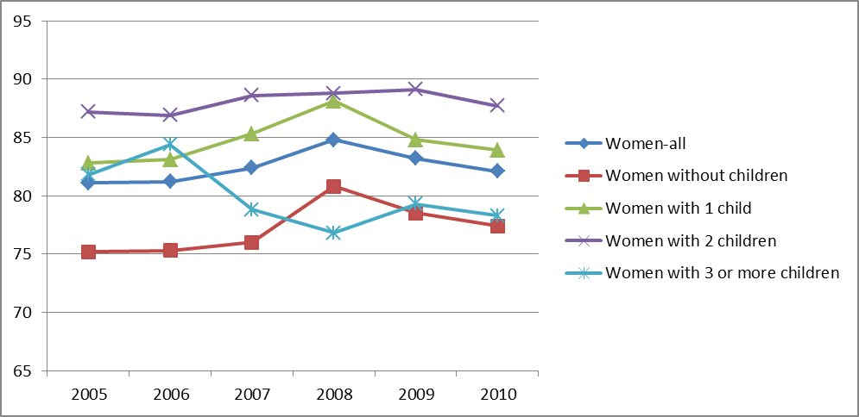
EMPLOYMENT AND LABOUR MARKET
High employment rate of women – also/especially when they have children
Double burdens for women – work and home obligations (unpaid and care work)
Young people and labour market

Slide 14
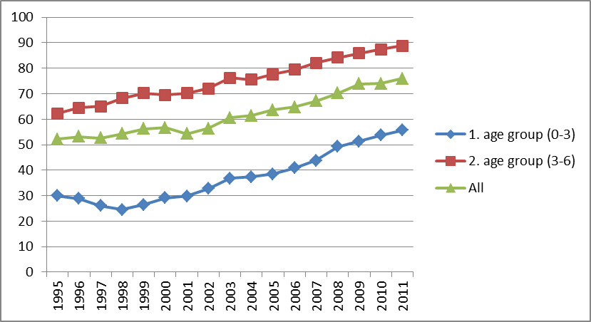
CHILDCARE
Barcelona targets for both age groups are nearly met
Good public kindergarten network
One of the biggest problems is preschool care when parents return to work after parental leave

Slide 15
THANK YOU FOR YOUR ATTENTION!
www.irssv.si

