Slide 1
Fathers and leave in the Nordic Countries: commonalities and differences
International Network on Leave Policies and Research
Ljubljana 13.-14.9.2012

Slide 2
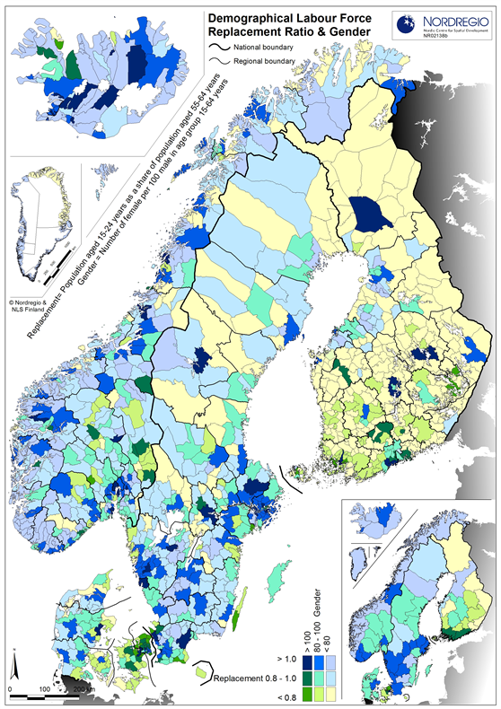
Population (million)
Sweden 9,3
Denmark 5,5
Finland 5,4
Norway 4,8
Iceland 0,3
Blue/green areas:
More young people and women
Yellow areas:
More old people and men

Slide 3
Total fertility rate
Source: OECD Family Database

Slide 4
Employment rate age group 20-44
Source: Eurostat

Slide 5
Fathers and leave
In the Nordic countries, the reconciliation of paid employment and family life has been supported by the welfare state since 1960’s. This may be one secret behind the high fertility rates.
Fathers were first given leave rights in 1970’s. During the past two decades, father’s quotas have been introduced to the leave schemes and campaigns designed to encourage more fathers to take leave.
In principle, the leave legislation is based on an idea of shared childcare responsibility, as well as (almost) equal capability of both parents to take care of a child.
In all countries, the employment rate of women is high and full-time employment is common. Still, the take-up of leave is not equally divided between mothers and fathers: mothers use majority of leave days.
The unequal sharing of parental leave has negative consequences for women’s position in the labour market as well as men’s position in the family, especially in case of parental separation.

Slide 6
History of parental leave schemes in the Nordic countries
Maternity leave Paternity leave Parental leave Father’s quota
Denmark 1960 1984 1984 1997-2002*
Finland 1964 1978 1985 2003
Iceland 1946 1998 1981 2001
Norway 1956 1977 1978 1993
Sweden 1955 1980 1974 1995
*introduced again in the industrial sector in 2007

Slide 7
Length of parental leave
(income-related benefit)
weeks

Slide 8
Length of paternity leave
(taken after birth when the mother is at home)
weeks

Slide 9
Length of childcare-related leave
(income-related + flat-rate benefit)
months

Slide 10
Level of benefits (2011)
 | Denmark | Finland | Iceland | Norway | Sweden
maternity leave | 100 %* | 70-90 % | 80 % | 80-100 % | 80 %
paternity leave | 100 %* | 70 % | - | 0 %** | 80 %
parental leave | 100 %* | 70-75 % | 80 % | 80-100 % | 80 %
father's quota | 100 %* | 70-75 % | 80 % | 80-100 % | 80 %
child care leave /flat-rate | - | 314 €*** | 0 | 3307 NOK (407 €) | 3000 SEK (344 €)
* with a ceiling (93 € per day or 490 € per week); full pay according to coll. agreements
** agreed in individual or collective agreements
*** + means-tested supplement max 168 € + 60-94 € for siblings under school age

Slide 11
Fathers’ share of parental leave use
Source: Nososco

Slide 12
Fathers use longer leave if…
1st child
High education of mother and father
Middle/high income, but not above ceiling?
Gender equality and/or child orientation?
Public sector, female dominated work place
Other fathers use leave at work
Extra benefit from employer
Individual leave rights (quota) + flexibility

Slide 13
Summary
The Nordic countries have different leave models and can learn from each other’s experiences.
In all countries, mothers take more leave than fathers. There is a clear gender gap in employment rate especially in the age group 20-44.
Iceland, Norway and Sweden have longer quotas for fathers and higher take-up of leave by men.
Also in Finland the take-up has increased as the father´s month has been made more flexible.
In the quota-countries, fertility has increased more!

