Slide 1

Policy and research developments in Australia
Gillian Whitehouse
Presentation for 9th annual LPR seminar
Ljubljana, Slovenia - 13-14 September, 2012
School of Political Science and International Studies

Slide 2
Outline of presentation
Recent policy developments in Australia
Policy evaluation contracted by the Australian government: outline of research plan
Selected findings to date
  Baseline patterns pre-implementation of the Paid Parental Leave scheme
  Uptake estimates in the first year
  Employer reactions
School of Political Science and International Studies

Slide 3
1. Recent policy developments – Paid Parental Leave scheme
Paid Parental Leave scheme commenced payments from 1 January 2011 (Paid Parental Leave Act given Royal Assent 14 July 2010; first applications accepted from October 2010).
Object of the Act is to provide financial support to primary carers (mainly birth mothers) of newborn and newly adopted children, in order to:
  allow them to take time off work to care for the child;
  enhance the health and development of birth mothers and children;
  encourage women to continue to participate in the workforce;
  promote equality between men and women and the balance between work and family life.
Provides 18 weeks ‘Parental Leave Pay’ [PLP] indexed at the National Minimum Wage (from July 2012, $AUD606.40 per week, $AUD10,915.20 for 18 weeks) – the payment is taxable.
PLP can be taken anytime during the first 12 months following the birth or adoption, and may overlap with any available employer-paid parental leave.
Scheme is government-funded, but payment is delivered by employers to eligible long-term employees (otherwise via the Family Assistance Office)
Operates alongside the ‘Baby Bonus’ which, from September 2012, provides $5000 to eligible families (those with an adjusted taxable income of up to $75,000) in 13 fortnightly instalments per birth or adoption, and has no work test restrictions. Parents may opt for either scheme, with PLP more attractive financially for working mothers intending to take more than 10 weeks leave.
School of Political Science and International Studies

Slide 4
1. Recent policy developments – Paid Parental Leave scheme, contd…
Scheme provides for pay (Parental Leave Pay) rather than leave: parental leave (unpaid) and job protection are provided in the National Employment Standards in the Fair Work Act.
  Scheme is thus primarily located in the welfare system (administered through the Family Assistance Office) with funding from government revenue; but it operates alongside the industrial relations system, with industrial relations legislation providing the entitlement to unpaid parental leave and job protection for leave takers.
Broad eligibility criteria – efforts to ensure flexibility and inclusiveness led to the explicit inclusion of part-time and casual employees, also contractors and self-employed. Restrictions include a work test (330 hours in 10 of the past 13 months), income test (individuals earning >$150,000 pa ineligible) and residency test (limited to Australian residents).
  Some mismatch of eligibility criteria compared with the statutory entitlement to unpaid leave which requires recipients to be with the same employer for the 12 months prior to the birth. Some parents may thus be entitled to Parental Leave Pay but not entitled to parental leave.
Targeted primarily at birth or adoptive mothers…an eligible mother can transfer some or all of her Parental Leave Pay to another primary carer (e.g. her partner) provided that person also meets the eligibility requirements.
School of Political Science and International Studies

Slide 5
1. Recent policy developments – Dad and Partner pay (DaPP)
Amendments to the Paid Parental Leave Act to include ‘Dad and Partner Pay’ (DaPP) passed by the Australian parliament 27 June 2012; payments to commence from 1 January 2013.
Scheme offers two weeks’ pay at National Minimum Wage, which can be taken anytime within the first year since the child’s birth or adoption.
Available to fathers and partners, including adoptive parents and same sex partners. Eligibility tests are the same as for PLP but not dependent on the birth or adoptive mother’s eligibility.
Must be taken while on unpaid leave, such as the unpaid parental leave available under the Fair Work Act (as for PLP, it is possible that some fathers/partners may be entitled to DaPP but not entitled to unpaid parental leave).
School of Political Science and International Studies

Slide 6
2. Policy evaluation contracted by the Australian government: research team
Australian Government Department of Families, Housing, Community Services and Indigenous Affairs has contracted a consortium led by Institute for Social Science Research (ISSR), University of Queensland (UQ), to conduct the policy evaluation. (A comprehensive evaluation is required under the Parental Leave Act.)
The consortium includes a team of research staff in ISSR as well as academics from across UQ and a number of Australian universities.
ISSR research team:
Bill Martin, Belinda Hewitt, Andrew Jones, Mara Yerkes, Laetitia Coles, Kristin Davis, Emily Rose, Mark Western, Ning Xiang
UQ and other university academics:
Marian Baird, Janeen Baxter, Luke Connolly, Dorothy Broom, Guyonne Kalb, Duncan McVicar, Lyndall Strazdins, Margaret Walter, Gillian Whitehouse, Maria Zadoroznyj
School of Political Science and International Studies

Slide 7
2. Policy evaluation contracted by the Australian government: outline of research plan
Phase 1 (2010-11) involved baseline data collection in order to inform subsequent evaluation of intermediate and ultimate outcomes of the scheme, conducted prior to its commencement. It comprised:
a Baseline Mothers Survey (BaMS) of 2587 mothers of a child born in late 2009, approximately 12 months prior to the commencement of PPL scheme payments, who were likely to have been eligible for PLP had it been available at the time (conducted in November/December 2010, and February 2011) – also surveyed were 1860 mothers who would not have been eligible for PLP had it been available at the time;
in-depth baseline interviews with 109 mothers from groups underrepresented in the survey (e.g. Indigenous mothers, single mothers, those in casual employment or self-employed);
21 baseline interviews with employers or employer representatives to collect information about current practices and attitudes to the new policy.
School of Political Science and International Studies

Slide 8
2. Policy evaluation contracted by the Australian government: outline of research plan, contd…
Phase 2 (2011-12) focused on intermediate outcomes associated with the implementation and initial operation of the scheme. It comprised:
a Policy Implementation study including interviews with 16 public servants involved in administering the new policy, and associated documentary analysis;
a Mothers Process Evaluation Study (MoPE) involving a survey of 901 mothers with a child born in mid-2011 and eligible for PLP, plus in-depth interviews with a subsample of 97 mothers and fathers (focusing on those who were casual or self-employed prior to the birth, single mothers, Indigenous mothers and fathers who took PLP)
an Employers Implementation Phase Evaluation Study (EIPE) involving a survey of a stratified sample of 501 employers who had made PLP payments to at least one employee, plus in-depth interviews with a purposive sample of 41 employers.
Phase 3 (2012-13) will focus on evaluating the intermediate, and (to the extent possible) the ultimate outcomes of the scheme. It will comprise:
a longitudinal survey of mothers of babies born in late 2011 (two waves of data collection);
a second cross sectional survey of employers;
a set of interviews and focus groups with beneficiaries and employers.
School of Political Science and International Studies

Slide 9
3. Selected findings to date
  3.1 Baseline patterns pre-implementation of the PPL scheme
  Background context – trends in use of employer-paid parental leave:
    45% of BaMS mothers working more than 10 hours per week prior to the birth reported usage of employer-paid leave in 2010-11, compared with 37% of a comparable group of mothers from the 2005 Parental Leave in Australia Survey (PLAS) (Whitehouse et al., 2012).
  Indicators of extent to which PPL scheme would expand, and enhance equity of, access to paid parental leave:
    58% of BaMS sample were PPL eligible cf 34% of sample who believed they had access to employer-paid parental leave (Phase 1 Report, pp.17, 19); majority of working women without access to employer-paid leave would be PPL eligible (p.19);
    Suggests increased access to paid leave among, e.g., Indigenous and single mothers…among those eligible for PPL, these groups had lower reported access to employer-paid leave than the sample as a whole (39% and 25% respectively, compared with 46% for the overall sample) (Phase 1 report, p.19).
  Sources (in addition to PLAS and BaMS datasets):
  Australian Government, Department of Families, Housing, Community Services and Indigenous Affairs (2012), Paid Parental Leave Evaluation: Phase 1, Occasional Paper No.44, Canberra, Commonwealth of Australia.
  Whitehouse, G., B. Hewitt, B. Martin and M.Baird (2012) Trends in paid parental leave usage in Australia: 2005-2010. Paper presented at Australian Institute of Family Studies conference, 25-27 July.
School of Political Science and International Studies

Slide 10
  3.1 Baseline patterns pre-implementation of the Paid Parental Leave scheme, contd…
  Eligibility mismatch between PLP and statutory unpaid leave:
    BaMS data indicate that 5% of PLP eligible mothers were not eligible for statutory unpaid parental leave on the basis of their work history; this was the case for 12% of single mothers (Phase 1 Report, p.17, 27).
  Return to work patterns – trends pre-PPL:
    PLAS (2005) indicated that among women who took leave and returned to work within 15 months, around 70% returned to the same job (same position with same employer); BaMS (2010-11) indicated that among women who took leave and returned to work within 13 months, 78% returned to the same job (Phase 1 report, p. 44).
  Sources (in addition to PLAS and BaMS datasets):
  Australian Government, Department of Families, Housing, Community Services and Indigenous Affairs (2012), Paid Parental Leave Evaluation: Phase 1, Occasional Paper No.44, Canberra, Commonwealth of Australia.
  Whitehouse, G., B. Hewitt, B. Martin and M.Baird (2012) Trends in paid parental leave usage in Australia: 2005-2010. Paper presented at Australian Institute of Family Studies conference, 25-27 July.
School of Political Science and International Studies

Slide 11
3. Selected findings to date
3.2 Uptake figures in first year
Just prior to International Women’s Day 2012, a government press release announced that over 150,000 applications for PLP had been received (http://www.jennymacklin.fahcsia.gov.au/node/1790 )
Half of the mothers who had received payments under the PPL scheme by January 2012 earned less than $43,000 in the year before the birth or adoption of their baby (http://www.jennymacklin.fahcsia.gov.au/node/1646 ), lending some weight to the anticipation that the scheme would allow those least likely to access employer-paid leave to access some paid leave.
The Phase 2 mothers survey [MoPE] indicated that most mothers eligible for PLP were also eligible for BB and that the majority chose to take PLP
  Those who took BB were more likely than those who took PLP to be single mothers, relatively low earners, working fewer hours, casual or self-employed, working for very small employers or to have resigned from their job at the time of the birth.
Phase 2 research also indicated that nearly all PLP recipients took the full 18 weeks available.
Most mothers received the full PLP payment, with only a very few families choosing to transfer some or all of their payment to the mother’s partner.
School of Political Science and International Studies

Slide 12
3. Selected findings to date
3.3 Employer reactions (primarily from the Phase 2 Employers Implementation Phase Evaluation Study [EIPE])
Employers reported few difficulties implementing the PPL scheme. Most agreed that:
  it was easy to register for PPL;
  it was easy to organise payments; and
  the information was accurate and easy to find.
School of Political Science and International Studies

Slide 13
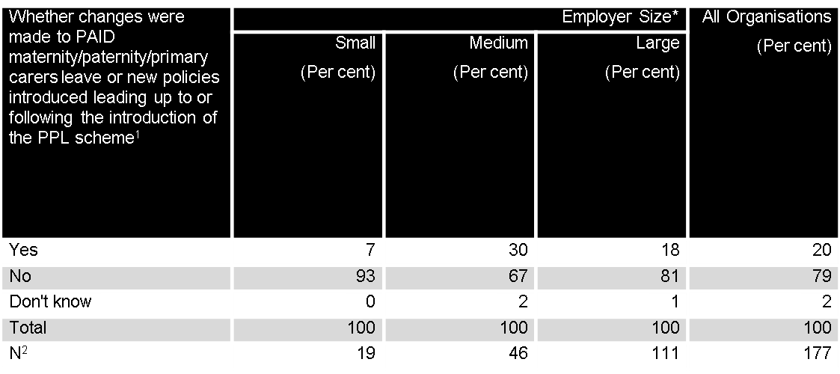
3.3 Employer reactions, contd…
¹ Chi-square test indicates that this is significantly different across employer Size at P<0.05.
² Number of employers who indicated that they offer paid maternity/paid paternity/paid primary carers’ leave.
* Weighted data.
Source: Marian Baird, Alex Heron, Mara Yerkes, Jane Dickenson and Gillian Whitehouse (2012) Employer Response to the New Paid Parental Leave Scheme in Australia: A catalyst for new employer policies? Paper presented at the inaugural Work Family Research Network conference, New York, 14-16 June.
School of Political Science and International Studies

Slide 14
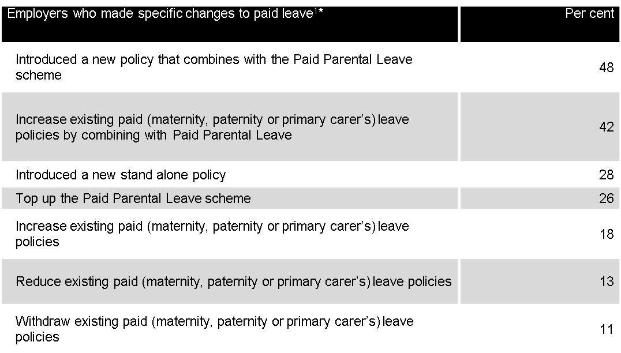
3. 3 Employer reactions, contd…
¹ 39 employers who indicated that they did make changes to paid leave policies were asked this question and could say yes to more than one of the above.
*Weighted data.
Source: Marian Baird, Alex Heron, Mara Yerkes, Jane Dickenson and Gillian Whitehouse (2012) Employer Response to the New Paid Parental Leave Scheme in Australia: A catalyst for new employer policies? Paper presented at the inaugural Work Family Research Network conference, New York, 14-16 June
School of Political Science and International Studies

Slide 15
Conclusions
Broadly positive outcomes to date, minimal implementation difficulties
Presence of scheme potentially contributing to changing culture around parenthood and employment (all major political parties now have schemes as part of their policy platforms)
Capacity to achieve ‘ultimate’ goals yet to be assessed
See you at the 2013 Community, Work & Family conference in Sydney…?
School of Political Science and International Studies

Slide 16

http://www.aomevents.com/CWFC2013

Slide 17
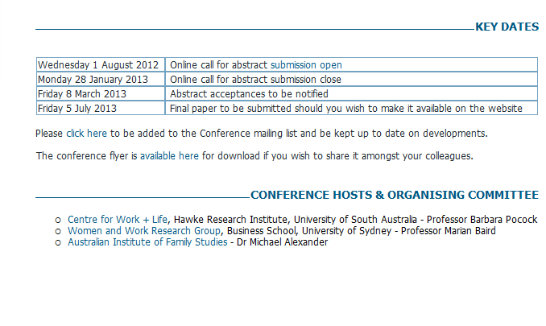
http://www.aomevents.com/CWFC2013

