Slide 1
The Workers with Family Responsibilities Convention, 1981
Issues and trends
Reiko Tsushima
ILO-Decent Work Technical Team for Central and Eastern Europe

Slide 2
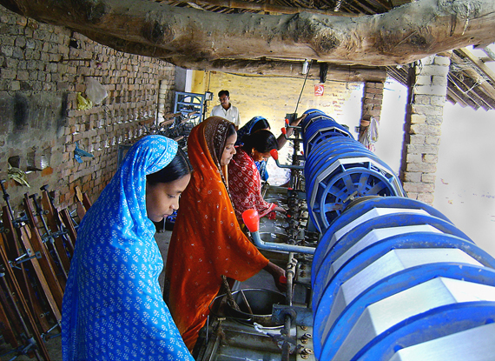
About the ILO
Founded in 1919
185 member States
Tripartite structure
Sets International Labour Standards
And supports implementation
Promoting opportunities for women and men to obtain decent and productive work, in conditions of freedom, equity, security and human dignity

Slide 3
International Labour Standards
189 Conventions & 202 Recommendations
Reporting on ratified Conventions (art. 22 of the ILO Constitution)
The two main ILO bodies involved:
  Committee of Experts on the Application of Conventions and Recommendations
  Standards Committee of the International Labour Conference

Slide 4
ILO Standards on work and family
International Labour Conventions on Hours of Work, Part-time Work, Holidays, Weekly Rest, Discrimination, Equal Pay
International Labour Convention No. 156 and Recommendation No. 165 on Workers with Family Responsibilities
International Labour Convention No. 183 and Recommendation No. 191 on Maternity Protection

Slide 5
The evolving policy response to the issue of gender equality
1919-1950: emphasis placed on protection of women workers: more “fragile” physically and socially than men - Night Work (Women) Convention (Revised), 1948 (No. 89)
1950- 1970: from the protection of women to the promotion of their employment prospects: R123 - Employment (Women with Family Responsibilities) Recommendation, 1965 (No. 123)
1970-today: equality implies according equal opportunities and treatment to women and men in all respects including coverage by protective legislation
  Work and family reconciliation measures should not only be for women (C.156, R. 165)

Slide 6
Redistributing responsibilities
Need to shift from the recognition of women’s double burden caused by work and family tension to its reduction and redistribution
  redistribution of responsibilities between households, the market and the State
  redistributing household/care work between men and women, in line with the change that has already taken place regarding paid work.
  Need to encourage alternative models of maternity, paternity and masculinity: give new meaning to fathers’ role in the family, and changing ideas about motherhood

Slide 7
Objective of the Convention
Establish equality of opportunity and treatment
  Between men and women WFRs
  Between WFRs and workers that do not have family responsibilities

Slide 8
Scope
Applies to all sectors of economic activity and all category of workers
    full time, part time, temporary, waged or non-wage, and self-employment; (but can be applied in stages)
Applies to all men and women workers with family responsibilities
  For dependent children
  Any other member of the immediate family who clearly need care and support

Slide 9
National Policy (1)
With a view of creating effective equality, make it an aim of national policy
  to enable WFRs to exercise their right to engage in economic activities
  without discrimination and, to the extent possible, without conflict between their work and family responsibilities

Slide 10
National Policy (2)
Take all measures compatible with national conditions and possibilities to
  Enable WFR to freely choose their employment (compatible with their needs)
  Take account of their needs in terms and conditions of work and social security
    Leave policies (maternity leave, paternity leave, parental leave, emergency family leave)
    Working time policies (duration, part-time, flexible WA, predictability of working time)
    Social security benefits (child and family allowances, tax breaks or reductions)
  Take account of their needs in community planning and development of community services (child care facilities and services)

Slide 11
Other measures
Information and education to generate broader public awareness
Measures to enable WRP to become and remain integrated in the labour force
Family responsibilities not a valid reason for termination of employment

Slide 12
Social partners
Employers’ and workers’ organizations shall have the right to participate in any manner appropriate to the national conditions, in devising and applying measures taken

Slide 13
Status of ratifications
Europe (23)
Albania
Azerbaijan
Bosnia and Herzegovina
Bulgaria
Croatia
Lithuania
Montenegro
Russian Federation
Serbia
Slovakia
Slovenia
Macedonia
Ukraine
  Finland
  France
  Greece
  Iceland
  Netherlands
  Norway
  Portugal
  San Marino
  Spain
  Sweden

Slide 14
Status of ratifications
Americas (10) Argentina Belize Bolivia Chile El Salvador Guatemala Paraguay Peru Uruguay Venezuela | Africa (5) Ethiopia Guinea Mauritius Niger Yemen | Asia (3) Australia Japan Republic of Korea

Slide 15
Some trends & issues from the supervisory process
National policies
Coverage
Terms and conditions of employment
Child care
Labour market integration
Collective bargaining and workplace measures
Education for the public

Slide 16
National Policy
WF issues should be integrated into all relevant policies, but tendency to use gender policy as a platform
Very few countries adopted an explicit or separate national policy on work and family
Restricting certain measures to women having children still widely prevalent- CEACR in conflict with principles of gender equality

Slide 17
Coverage
Dependent children widely reported, less so for other members of the family but improving
Increasing recognition of diverse HH composition: a spouse, de facto partners, child, grandparent, grandchildren, sibling of the employee or spouse or de facto partner (Australia)
Some countries categories of workers, eg domestic workers, agricultural workers, part-time workers are excluded, as a result of exclusion due to enterprise size thresholds (Japan, Korea, Ethiopia), hence exclusion from general protection as regards working time.

Slide 18
Terms of conditions
Most of the reported progress made relates to new statutory rights and obligations concerning leave entitlement and flexible working time arrangements
Need to ensure leave entitlements are available to men and women on an equal footing
Parental leave periods should be included in other relevant entitlements eg retirement benefits, seniority and severance pay
Increasing attention by CEACR to request information on the take up rate of WFR measures for men and women, emphasizing the need to address imbalance

Slide 19
Labour market integration: report points to women specific measures in ALMS or vocational training programmes, but a specific focus and measure on WF issues often missing
Collective bargaining and workplace measures regarding work and family reconciliation appear to be a phenomenon at the present stage largely limited to industrialized countries.
Education for the public, including statistics, campaigns, is increasingly asked for in the CEACR observations

Slide 20
Potential of C.156 and challenges
Comprehensive focus on WF issues
Creates a platform for diverse issues and Ministries to converge
Tool to bring workers and employers’ organizations on-board
WFR issues wider than the mandate of one Ministry
Inter-ministerial coherence, planning, monitoring and reporting often missing
Difficult for MoL to be aware of all that is going on
Gov always ask for cost implication how and where to finance it.
Employers generally buy-in, but insists on public provisioning of care as the main solution

Slide 21
Need…
The research community to assist in help build the knowledge of national policy makers on good practice, what is going on in their country, neighboring country
Gendered LM outcomes and link to different measures
Cost implication of all WF measures
To highlight the business case
Supply and demand surveys (child care)
Worker preference for WL measures

