Slide 1

Nordic Family Policy and Demographic Consequences
Presentation at 11th LPR Network seminar,
Tallinn 18-19th of September 2014
Ann-Zofie Duvander
Notes:
Perhaps one can today see it as general goal of family policy to facilitate combination of work and family, even if countries vary in how they think this is best done. How it is best done is not just a political question but also a question of policy efficiency, what policies work and what don’t?
When we say that policies work or not we are often interested in the outcomes and I will in this presentation talk about potential outcomes of policies. Demographic outcomes in the Nordic countries has often been of interest, probably as the fertility is still relatively high. Very hard to distinguish direct causal effects from policies, it is a whole research field, I will not talk about but here talk about association.
So after a brief general introduction to potential consequences I will not talk about fertility but union separation as associated with parental leave.

Slide 2
What are the outcomes of family policy in Nordic countries?
High female labour force participation and/or gender segregated labour market?
High male participation in childcare and gender equality?
High fertility and/or late childbearing?
High family dissolution?
High reconstitution of family and/or lone parenting?
Low poverty among children?
Notes:
Outcomes are often discussed and can be seen as both positive and negative.
These questions are investigated in both the research center I belong to and a Nordic project where I am involved.

Slide 3
Social Policy and Family Dynamics in Europe (SPaDE)
www.su.se/SPADE/
Demography unit
Department of Sociology, Stockholm University
Notes:
Support form Swedish research council since 2008, almost 20 members and many affiliated researcher. Try to develop and nuance methods of evaluating effects of policy in general but research has focused on family policy.
Demographic focus but also other outcomes and analyses.

Slide 4
Nordic Family Policy and demographic Consequences (NORDiC)
Trude Lappegard, Statistics Norway (PI)
(217915/F10) Research Council of Norway (217915
Aim:
”Whether and how Nordic family policy influences demographic behaviour and life-course earnings”
Notes:
Support from Norwegian Research council, administered frm Norway, Sweden and Iceland part.
Compare countries that are similar but with some differences, easier to sort out what is what, and the effect of policy changes.
Based on register data that are available in all countries. Can make very similar analysis.
”Whether and how Nordic family policy influences demographic behaviour and life-course earnings”
Three outcomes:
Continued childbearing, including parity-specific childbearing
Family stability, including both divorce from marriage and dissolution from cohabitation
Life-course earnings, including long-term individual earnings, gender-differences in earnings within couples, and gender pay gap at the aggregate level

Slide 5
Nordic Family Policy and
Union Dissolution
Trude Lappegard, Statistics Norway
Ann-Zofie Duvander, Stockholm University
Synøve N. Andersen, Statistics Norway
Ólöf Garðarsdóttir, University of Iceland
Gerda Neyer, Stockholm University
Ida Viklund, Stockholm University
(presented at PAA 2014 in Boston, EPC 2014 in Budapest)
Notes:
I will present preliminary analyses from a study where we compare the propensity of union dissolution in the three countries and relate that to the development on parental leave use.
We use register data in all countries to get comparable data, but ofcourse we still have many things to do to make data really comparable.

Slide 6
Research question
Is fathers’ parental leave use associated with union dissolution?
Does the association change over time?
Are there differences between Nordic countries ?
Notes:
In this study we ask whether fathers parental leave use is associated with union dissolution and in that case how?
There has been sparse research on this subject earlier, but a large interest and I often get questions.
Union dissolution has increased over time and one reason that union dissolution was low earlier was that women were economically dependent on their spouses.
When both women and men work it may that increasing divorce risks are, but also men’s lack of changing behavior in response to increasing female employment.
If this is true, we can expect to see a positive relationship between a more active father’s role in the family and union stability in the Nordic countries.

Slide 7
Focus
Three Nordic countries
  Iceland, Norway and Sweden
  Gender equality is an explicit policy goal
  A long tradition of promoting gender equality through family policy
The parental leave program
  Facilitates the combination of childrearing and female employment
  Encourages men’s participation in the domestic sphere and thus carries the potential to change gender relations within families
Notes:
We focus on Iceland, Norway and Sweden
In the Nordic countries gender equality is an explicit policy goal and there is a long tradition of promoting gender equality through family policies
We focus on the possible link between use of parental leave and union dissolution.
The parental leave program in the Nordic countries aims to
- facilitate the combination of childrearing and female employment
- it also encourages men’s participation in the domestic sphere. This policy hence carries the potential to change gender relations within families

Slide 8
Expected effects and mechanisms
Father’s investment in the relationship and the family
Achieve more equality in total time spent in paid and unpaid work
Facilitate mother’s situation
Competing roles of father and mother at home?
Difficult to be forerunner?
Notes:
We could imagine that in families where the father uses parental leave, the risk of dissolution could both be higher andlower.
So, why would fathers’ leave enhance union stability?
Fathers’ use of parental leave may be seen as an investment in the relationship and the family.
This may generate more equality in the family in general and more equality in time spent in paid and unpaid work.
The double working mother will have an easier situation.
BUT:
It may also be that when roles are changing it is not clear who takes on what and this may create competing roles athome.
Also, fathers who use leave may go against the norm, have to fight for leave from work and in general be frowned upon. Also mothers coming back to work early may have the same situatin. This may be hard and create tension.

Slide 9
Parental Leave Programs in the Nordic countries
Iceland
Norway
Sweden
One year
9
Notes:
The parental leave program provides parents the opportunity to be home with their baby for around one year.
This figure shows the development of parental leave program in the three countries from 1992 to 2012.
The leave period is divided in three. One quota for the mother, one for the father and one part that may be shared. The quotas means that the leave days cannot be transferred over to the other parent.
In Norway the father’s quota was introduced in 1993, in Sweden 1995 and Iceland 2000.
Have been extended in steps at different points in time.

Slide 10
Data
Administrative register data, Iceland, Norway and Sweden
Time period 1993 to 2011 (2012 for Sweden)
Sample
  Couples having their first common child
  Exclude:
    Couples where the child dies
    Either parent dies or emigrates
    Children born abroad
    Multiple births
Notes:
We use administrative register data on the entire population in each of the three countries for the period 1993 till 2011
We focus on the period where there has been a father’s quota as part of the parental leave program in each country.
The sample is restricted to
- Couples having their first common child
- Couples that are registered as cohabiting or married at t2 (where t1 is year of birth)
- We exclude couples where the child dies during t1 and t2 and if either mother/fathers dies or emigrate during this period

Slide 11
Methods
Discrete time hazard model
Start to measure dissolution risk when child is 18-24 months
Take into consideration that only dissolution date by year, including many sensitivity tests
Follow couples for max 12 years
Main explanatory variable: The father’s parental leave use
Notes:
We use discrete time hazard model, in which the main explanatory variable is the father’s parental leave use
Given that fathers often take their leave at the end of the total leave period for the couple, we measure leave use until 18 months after the child is born to capture the major part of the parental leave and how it is divided for all countries.
The clock then starts at t3.
We follow couples until union separation, t12 or 2011 – whatever comes first and sensor when either of the parents dies or move abroad

Slide 12
Parental leave use variable
“Regulation variable”
  No leave;
  Up to quota;
  More than quota
Notes:
Parental leave use can be measured in different ways, and we have played around with many. Remember that length and regulations are different so for has to think about how to measure in a way that comparable. We have used fathers’ proportion of all leave, one emphasizing gender equality, ans also one where we measure length in days. But for this presentation we focus on the regulations.
The quotas have increased gradually in Norway and also Sweden and we distinguish between three groups; fathers not taking any leave, fathers taking leave up to but not more than the father’s quota, and fathers taking more than the quota.
Motivated categorization on how it is considered by the parents, by the society and so on. The quota will be lost if not used and therefore it is to some degree accepted by employer and others to take the quota. Also a norm to take quota seem to be found in other studies. But to take more than quota may mean something else, that is to really want to share or engage in childcare.
So, to take more than one month in 1995 may be equivalent to more than two months in 2002 in the Swedish case.

Slide 13
Notes:
These figures are descriptive representations of fathers’ use of parental leave for couples first child, from the introduction of the father’s quota until today.
To sum up the highlights from the figures one should notice that in all three countries there has been an increase in the proportion of fathers taking long leaves
However;
- Iceland has the largest proportion of fathers using parental leave.
- Norway has the largest proportion of fathers not taking any leave
- Sweden has the largest proportion of fathers taking more leave than the father’s quota.

Slide 14
Results (still preliminary!)
Risk of union separation for couples with at least one child
Risk of union separation during different periods.
Notes:
The results are first shown as Kaplan-Meier survival estimates of union dissolution by use of parental leave.
Then we show the results from the hazard models, where the basic model show the same pattern as the Kaplan-Meier estimates and the full model control for several background variables.
Last we also run the models including an interaction term between father’s use of parental leave and period to see whether the relationship between parental leave use and union dissolution changes over time.

Slide 15
Risk of union separation for couples with at least one child. Iceland, Norway and Sweden. Odds ratios.
 | Iceland | Norway | Sweden
Father’s leave
No use | 1 | 1 | 1
Up to quota | 0,84 | 0,73*** | 0,87***
More than quota | 0,72** | 0,83*** | 0,93***
Number of obs | 25 764 | 931 694 | 1 477 566
Controlled for mother’s /father’s age, education, immigrant background, union status, number of children
Notes:
Here the fathers using no leave are the reference category and the other are related to this. If we start with Icleand we see that using up to quota has lower risk of separation, but only statistically significant lower for the ones using more than quota.
Remember we have all parents having children between 1993 and 2008 here but the numbers are very different for the three countries.
Norway and Sweden show a simlar pattern of U-shape. The ones having the lowest separation risk are the ones who use up to the quota. If fathers use more than that then risk is increasing, or more similar to the ones using no leave.
This is controlles for a number of background informatin, but not income.
We are interestedin this u-shape and wonder whether it has changed over time.

Slide 16


Risk of union separation for couples with at least one child. Sweden and Norway. Computed odds ratios, father’s use of parental leave and period.
Notes:
There is two interesting findings from these models when we compare the pattern over time.
First, in Sweden the difference between couple’s where the father’s uses leave or not have increased (or is at same level), while in Norway it has decreased.
Second, in both Sweden and Norway, the differences between father’s taking up to quota and father’s taking more than the quota have decreased with no differences in the last period. So, the u-share has disappeared over time.
Perhaos as taking leave has become more common and not so difficult anymore.

Slide 17
Discussion
Fathers’ use of parental leave is positively associated with union stability in the Nordic countries
  The relationship is not uniform
  Cannot conclude that more leave reduces union separation
  Indicates a complex relationship between gender roles and dissolution risk that needs more analyses!
Notes:
Our investigation show that fathers’ use of parental leave is indeed associated with union stability in the Nordic countries. However, the relationship is not uniform and we cannot talk about causality.
The fathers not taking leave may do so for many different reasons, one being that the relationship is shaky already before childbearing.
We cannot conclude the more leave the father takes, the lower the separation risk, first it looked like the opposite. But perhaps the forerunners had a harder time and now when parental leave is more accepted the “effect” of using leave is different.
There are differences between the countries that should be considered here.
For instance, in Iceland the introduction of the father’s quota was more radical both by giving fathers the opportunity of paid parental leave for the first time and by reserving a large proportion of the leave to fathers.
In Sweden a larger proportion of the fathers were already using parental leave when the father’s quota was introduced, while in Norway the father’s use of the father’s quota is dependent on mother’s employment which means that a larger proportion of fathers do not use any leave.
I think that the changing pattern over time is worth reiterating, a reform may have one outcome in the beginning but that outcome may change over time.

Slide 18
Risk of union separation for couples with at least one child. Iceland, Norway and Sweden. Odds ratios.
Notes:
The estimates from the full model show that the pattern from the Kaplan-Meier estimates holds in Iceland and Norway, while in Sweden the estimates change after adding control variables. Now it is couples where the father takes up to (and not more than) the quota that has the lowest dissolution risk.
These findings indicate that father involvement through use of parental leave increases union stability as suggested in the theoretical arguments.
However, it is only in Iceland we find a linear relationship between fathers’ use of parental and union dissolution and here it is only the estimate for father’s taking more than the quota that is significant.
In Sweden and Norway, couples where the father has taken the longest leave are more likely to dissolve their union than couples where he has taken just his stipulated quota.

Slide 19
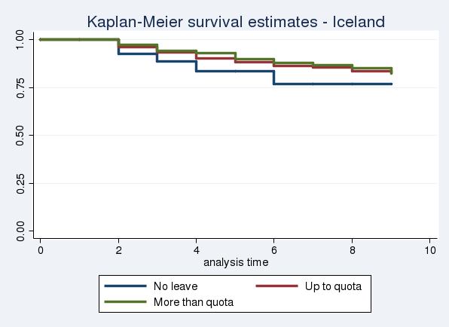
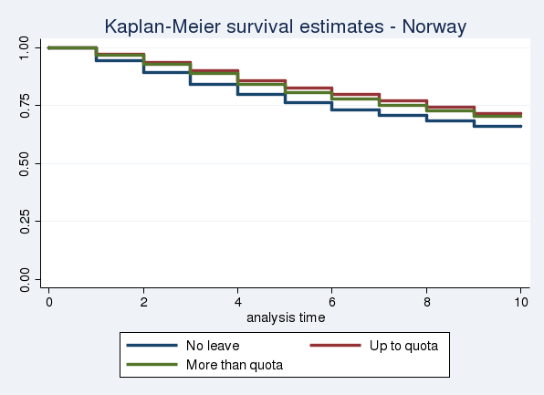
Kaplan-Meier survival estimates of union separation by use of parental leave. Iceland, Norway and Sweden
Notes:
The overall picture in these figures is similar: couples’ where the father has not taken any parental leave has lower survival estimates than couples where the father has taken leave.
This entails that the union dissolution risk is higher among couples where fathers do not take leave.
The pattern among couples where the father has taken up to the quota and where he has taken more than the quota is quite similar but there are country differences.
In Iceland and Sweden highest survival estimates are found among couples where the father has taken more than the father’s quota (the green line) while in Norway highest survival estimates are found among couples where the father has taken up to the father’s quota but not more.

