Slide 1
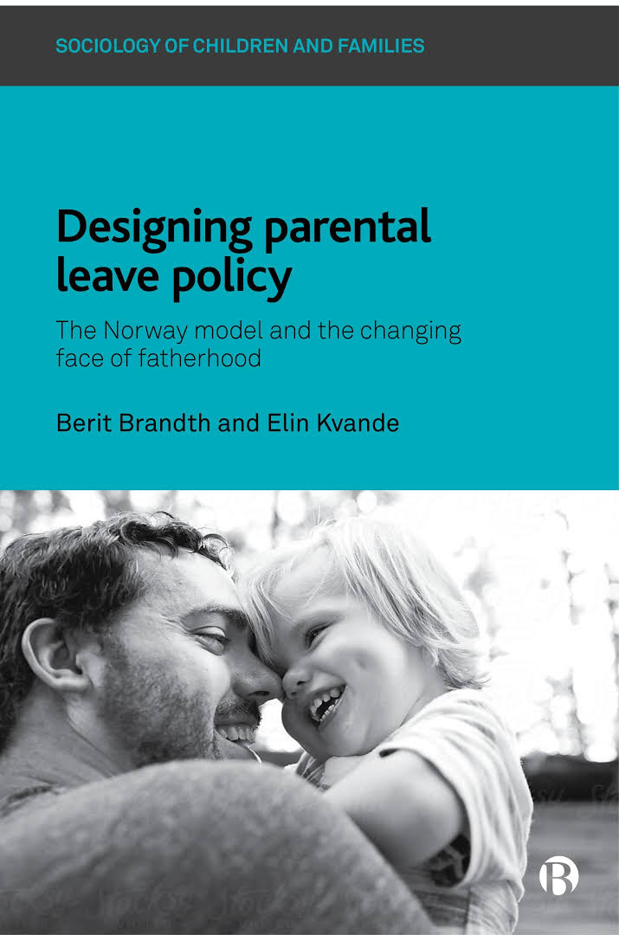
Book presentation
Norway: research from three studies conducted at various stages since the introduction of the father’s quota

Slide 2
Three interview studies conducted decades apart
1. Before the individual, non-transferable leave for fathers (father’s quota) was introduced (1980s)
2. Right after its introduction (1990s)
3. When the father’s quota had reached 10 weeks in length (2000s)

Slide 3
Leave development for fathers
From 12 weeks sharable leave (1977)
to 15 weeks father’s quota + 16 weeks sharable
Take up: from 1 % to 97%.
Father’s quota (1993): statutory, non-transferable, well-paid leave
Objectives: improve father-child relations and gender equality

Slide 4
Some of the questions
What does fathers’ take-up mean in terms of father-child relations and fathers’ care-giving practices?
How has the design of parental leave influenced fathering norms and -practices in Norway?
How may men’s care work change to produce «caring masculinities»?
How has working life adapted to the father’s quota?
How do immigrant fathers relate to the law and expectations directed towards fathers in Norway?

Slide 5
Three topical sections
Leave design
Fathers’ caregiving
Reconciliation of work and care

Slide 6
Thirteen chapters
Table of contents
1 Introduction
Part 1 The importance of leave design
2 Senses of entitlement to earmarked and shared p. leave
3 Decomposing policy design: outsider-within perspectives
4 Flexible use of the father’s quota: Problems and possibilities
Part 2 Caregiving – fathers in transition
5 Masculinity and childcare
6 Home alone on leave or with the mother present
7 Fathers experiencing solo leave: Changes and continuities
8 Immigrant fathers framing parental leave and caregiving
Part 3 Reconciling work and care
9 Changing fathers and work-life boundary setting
10 Negotiating parental leave and working life
11 Workplace support of fathers’ parental leave use
12 Managers: Irreplaceable in caregiving and replaceable at work
13 Conclusions
APPENDIX

Slide 7
Highlights – Part 1: Linking design and use
Culturally divergent understandings of the father’s quota and the shared parental leave help explain their different levels of take-up by fathers. While fathers’ sense of entitlement to the quota is strong, fathers feel much less entitled to the shared parental leave, which is culturally understood as mothers’ entitlement.
A second chapter also explores the processes of constructing these different outcomes in leave take-up. Immigrant fathers, «outsiders within», point at structural elements of the quota, that it is statutory, non-transferable and generously paid. This offers an obligation which is understood as a great possibility for them to become involved fathers
A flexible design (part-time, piecemeal, postponed) may increase take-up, but it affects their caring negatively because it facilitates the invasion of work into caregiving and produces fathers as secondary caregivers in the family

Slide 8
Highlights Part 2: Fathers’ caregiving
Taking leave alone has a great potential for developing caring fathers. It helps facilitate a move from being mothers’ helpers towards equal co-parenting.
When fathers’ leave practices include housework and «the third shift» as part of caring, they transgress previous gender boundaries
There is a development towards ‘‘caring masculinities’’ in which values and practices of care are integrated into men’s identities without degradation in masculine status.
Immigrant fathers frame their leave-taking so that it corresponds with ideals of masculinity in their homeland as well ideals of involved fathering in their new country.

Slide 9
Highlights Part 3:
Changing the «ideal worker» norm
Workplaces respect policies and handle the problems that leave might create
Leave has become a standard practice among employed fathers in Norway
Conflict between leave-taking and the ideal of the unencumbered worker has weakened. Even middle managers break the «career logic» to be available for their children
Leave seems to have changed fathers’ thinking about the importance of work in their lives. They employ several strategies to reduce time conflicts when the leave is over

Slide 10
Concluding remark
The book’s primary focus is not on gender equality as a direct result of parental leave use among fathers
Focus is on what leave means for fathers’ relationship to their children, for their practices as fathers and for their masculine identity
A change in these aspects may also mean a step towards increased gender equality in terms of dual caring/dual earning

