Slide 1




Leave use as a strategy to cope with the Covid-19 pandemic by parents of dependent children in six countries
Anna Kurowska & Ilyar Heydari Barardehi
ILNP&R Annual Meeting, New York, 21-22 June 2022

Slide 2
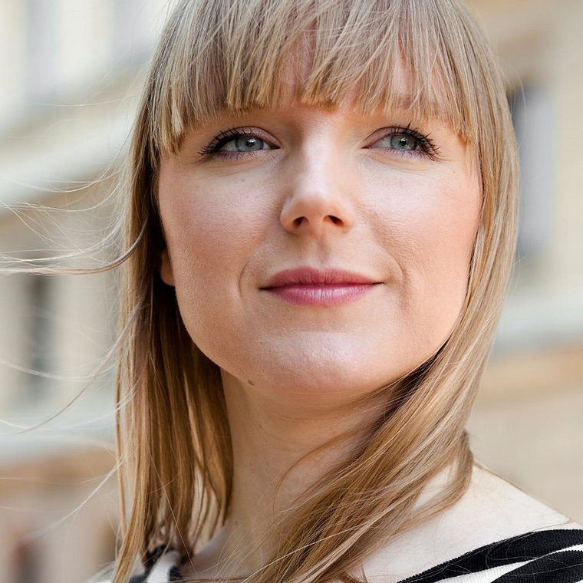













Introduction
Familydemic project
Online survey
6-9 2021
Six countries:
CA, DE, IT, PL, SE & US
Representative samples
2000-10 000 responsents by country
Syrvey: A. Kurowska (lead) & A. Doucet, A-Z Duvander, C. Engeman, S. Fuller, S.G. Gabel, R. Guetto, G. Kaufman, A. Matysiak, R. Petts, T. Reimer, D. Vignoli
Harmonization of the data (in progress): Tsegachew Degu, Ilyar Heydari Barardehi

Slide 3
Today’s presentation:
Preliminary descriptive findings for planned paper
Leave use as a strategy to cope with the Covid-19 pandemic by parents of dependent children
Planned cooperation also with: Andrea Doucet, Ann-Zofie Duvander, Cassandra Engeman, Sylvia Fuller, Shirley Gatenio Gabel, Raffaelle Guetto, Gayle Kaufman, Eleonora Miaci, Richard Petts & Thordis Reimer

Slide 4
Motivation & aims of preliminary analyses
Covid-19 pandemic → childcare & school closures, online & hybrid learning + risk of infection
Parents faced increase childcare needs → adopted some strategies
RQ: Have they used (parental) leaves as a coping strategy?
Preliminary analyses:
How often, for how long and for what reasons kids stayed at home during the pandemic?
What were the patterns of leave use across countries, genders and age of the youngest child over the 15 months of the pandemic (March 2020-May 2021)?
Have parents made changes to their parental leaves plans due to the pandemic?
Was the time the child was out of usual childcare/school arrangements positively related to the parental leave use during the pandemic?

Slide 5
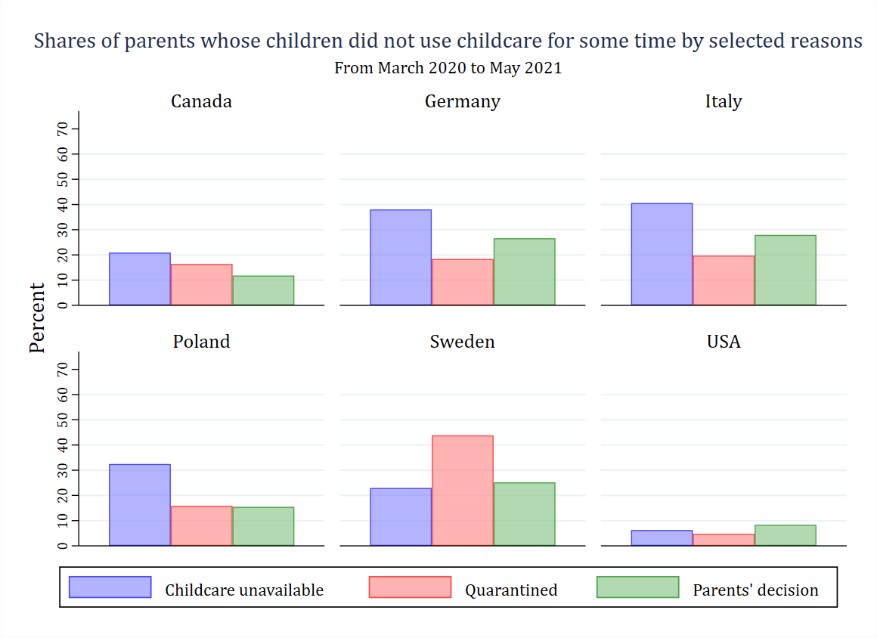
Children out of usual childcare arrangements

Slide 6
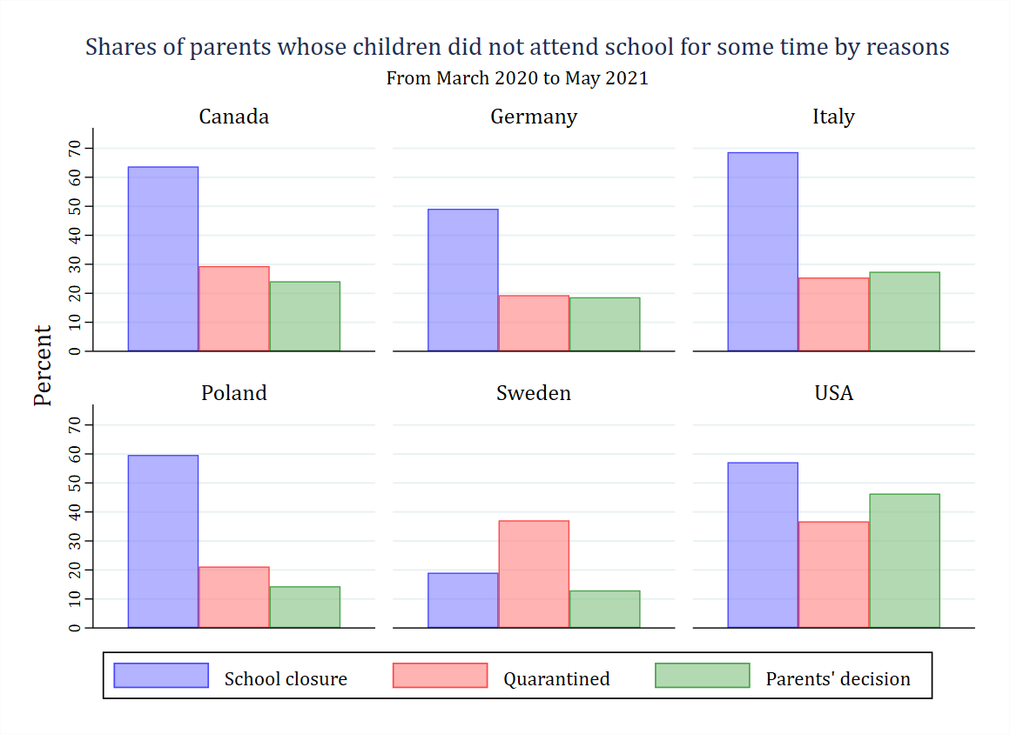
Children out of school

Slide 7
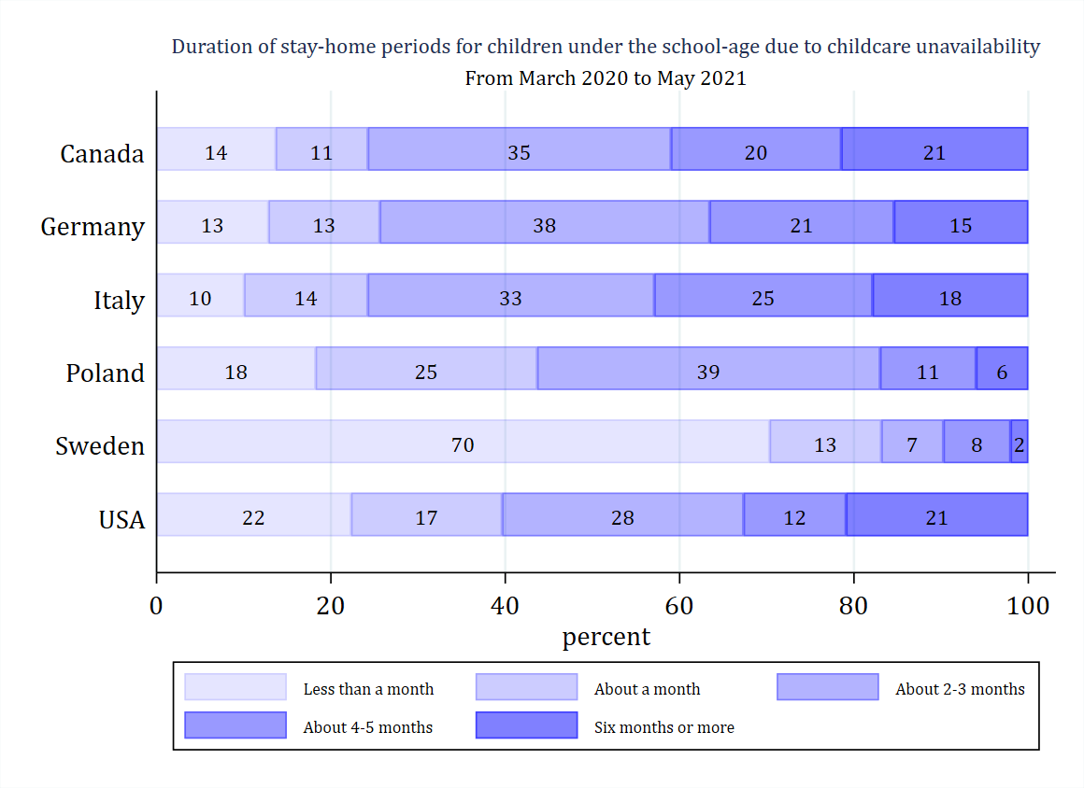
Time out of usual childcare arrangements (unavailability)

Slide 8
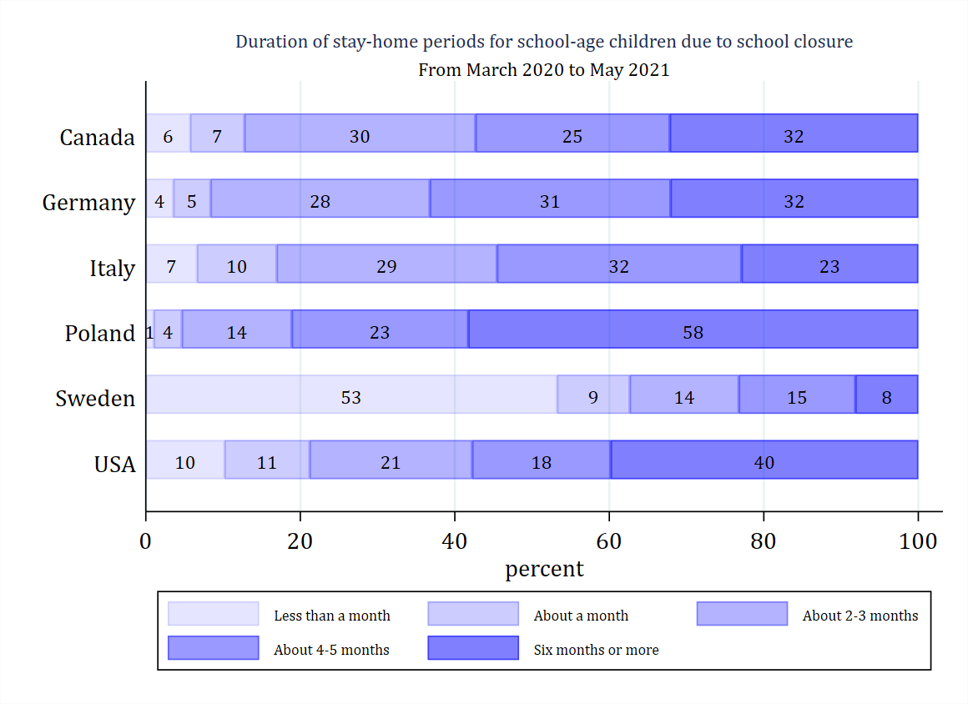
Time out of school (unavailability)

Slide 9
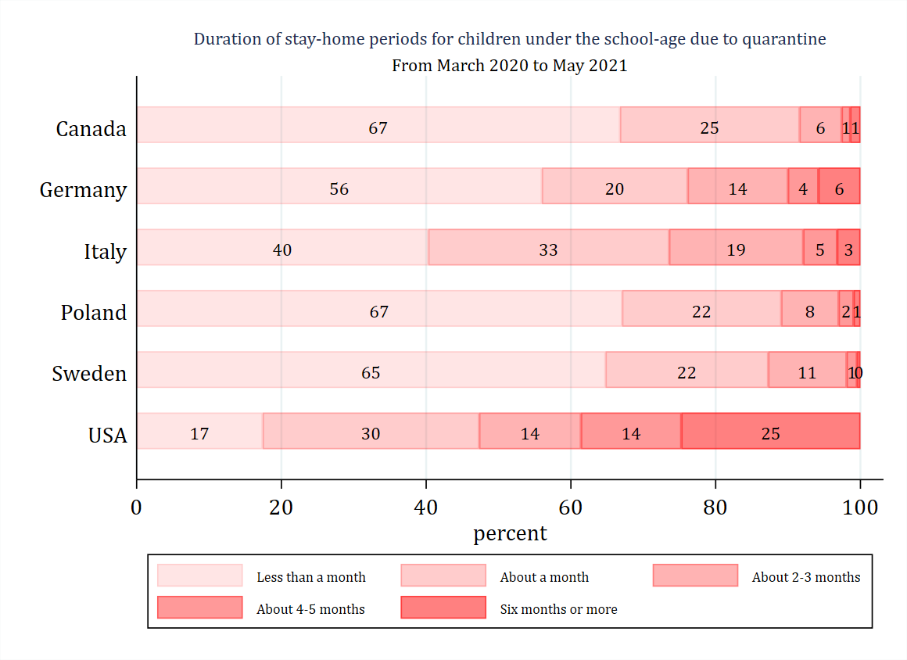
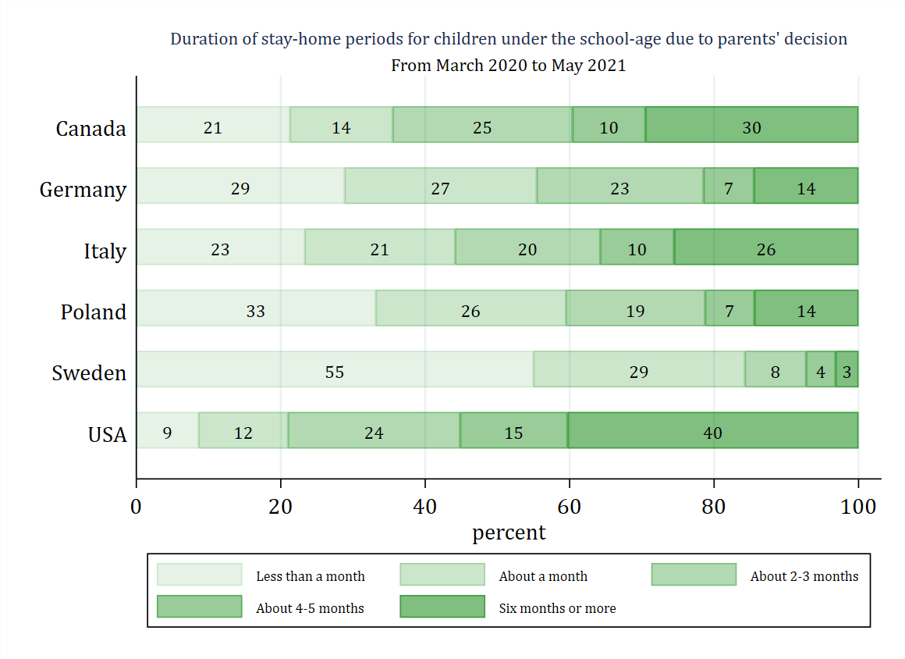
Time out of usual childcare – other reasons

Slide 10
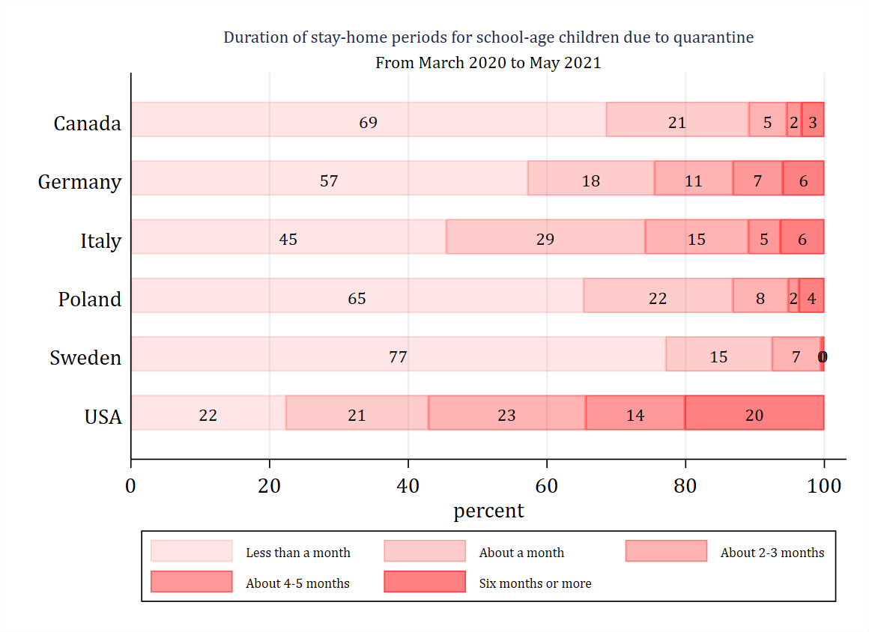
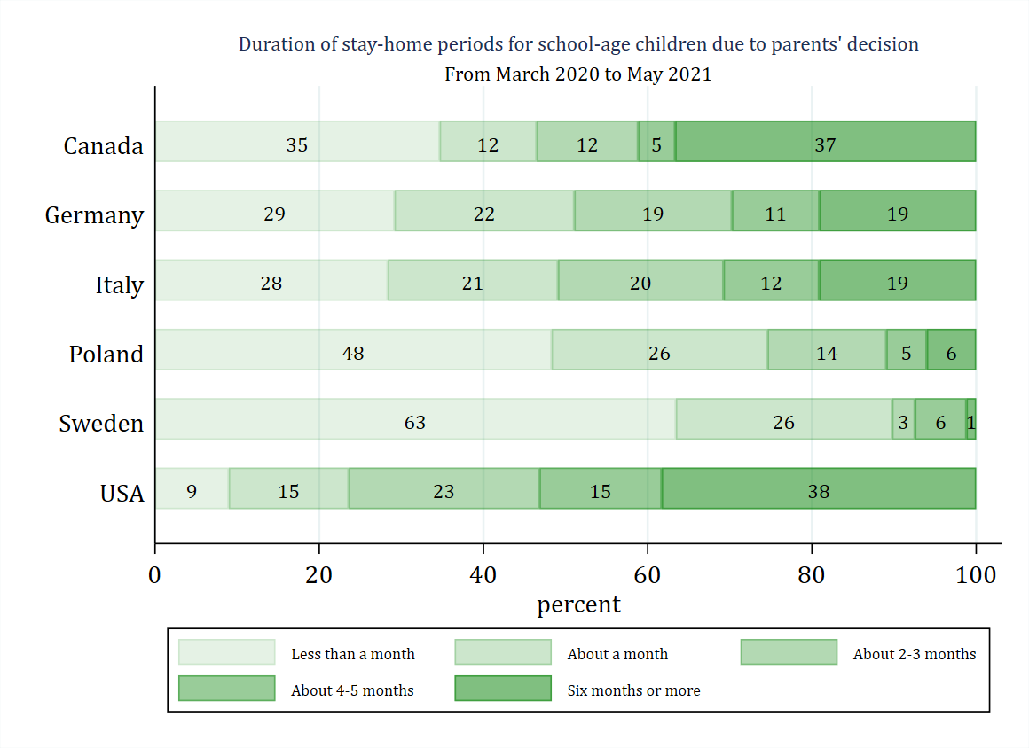
Time out of school – other reasons

Slide 11
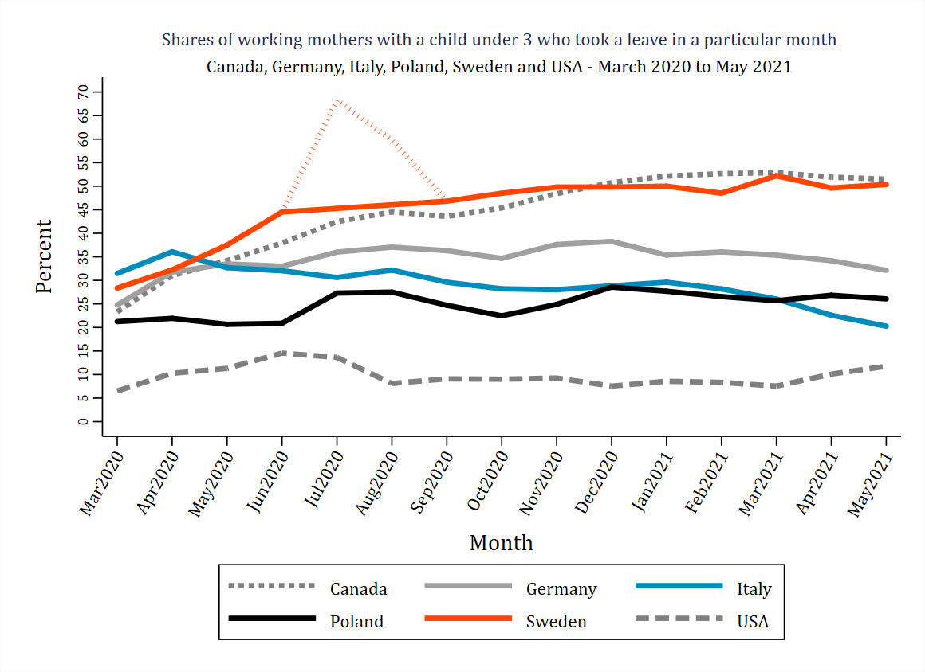
Patterns of leave use – mothers & child under 3
summer

Slide 12
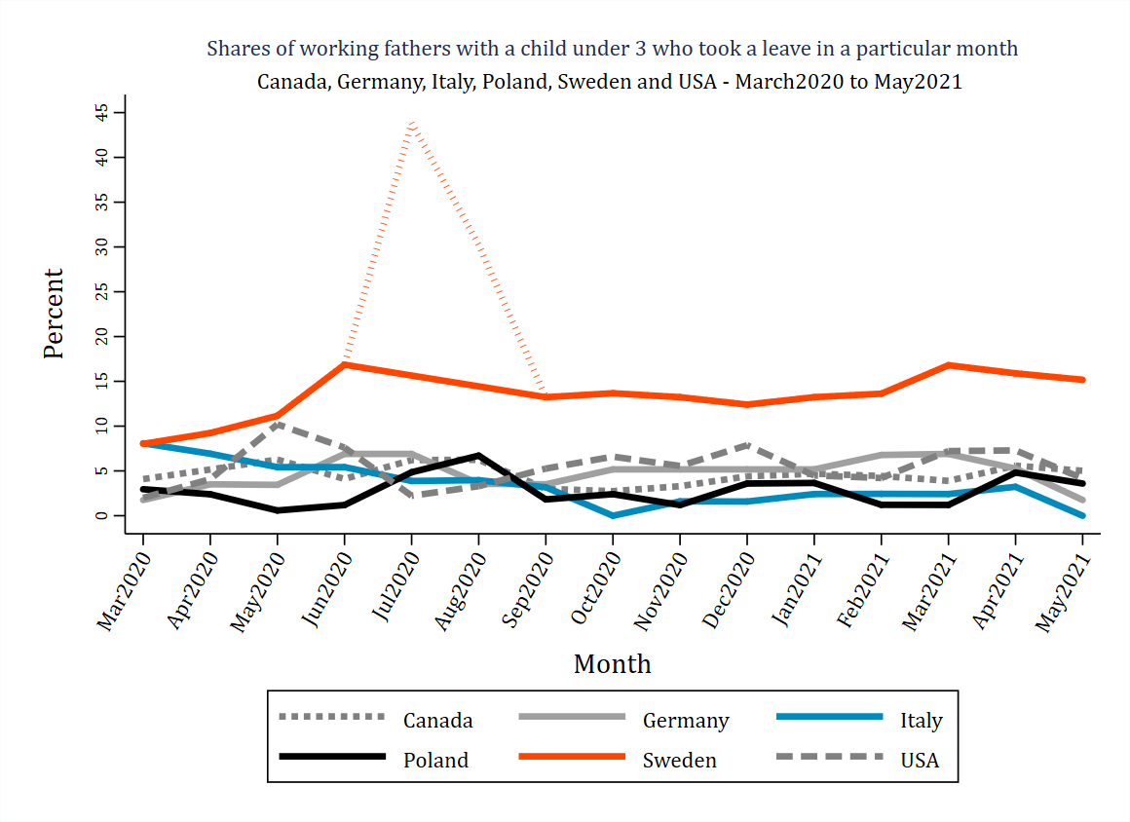
Patterns of leave use – fathers & child under 3
summer
summer

Slide 13
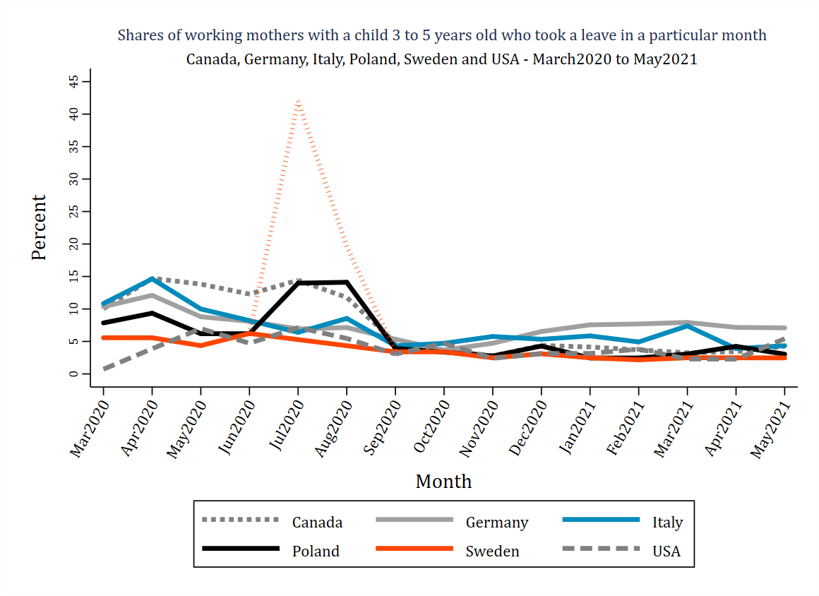
Patterns of leave use – mothers & child 3-5
summer

Slide 14
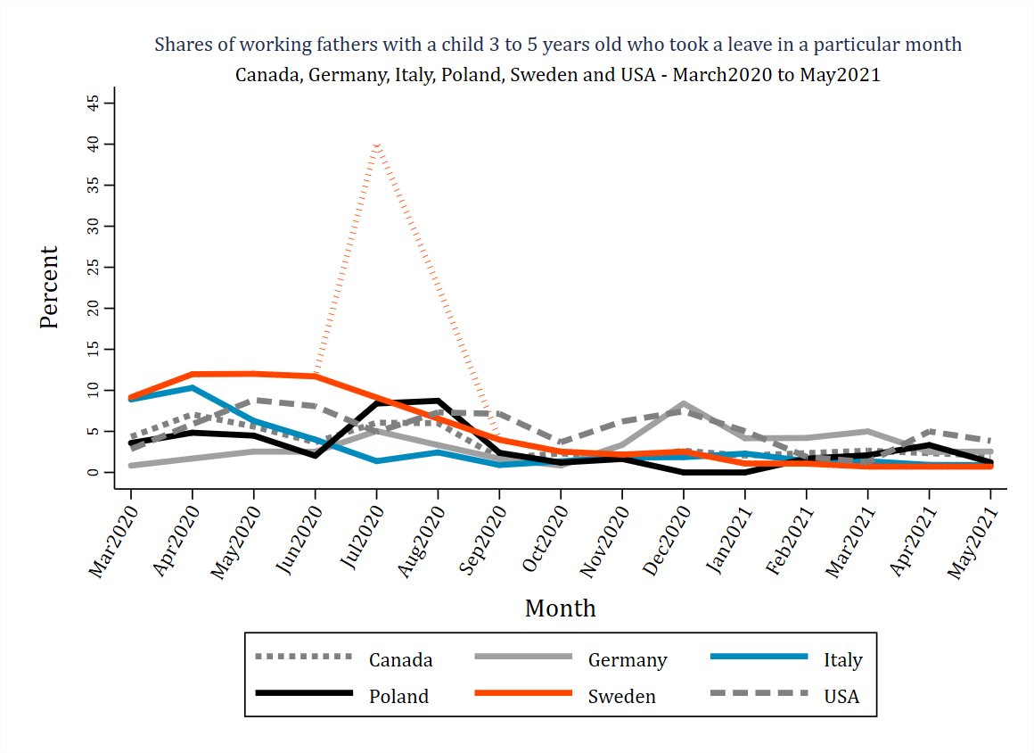
Patterns of leave use – fathers & child 3-5
summer

Slide 15
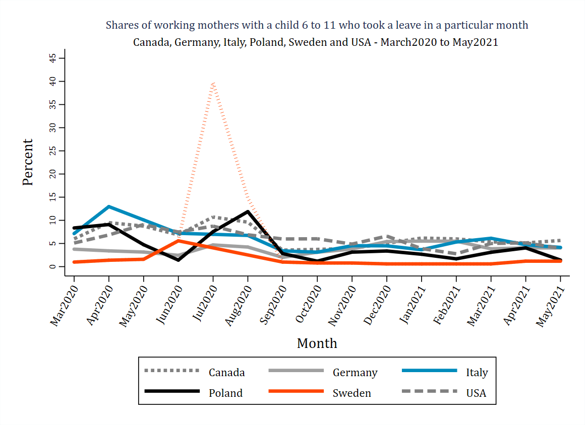
Patterns of leave use – mothers & child 6-11
summer

Slide 16
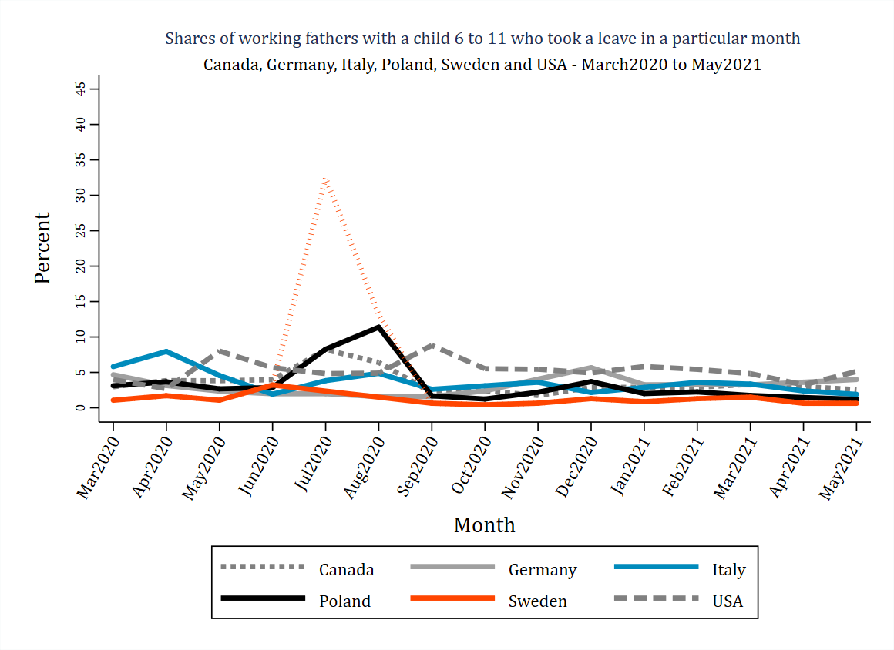
Patterns of leave use – fathers & child 6-11
summer

Slide 17
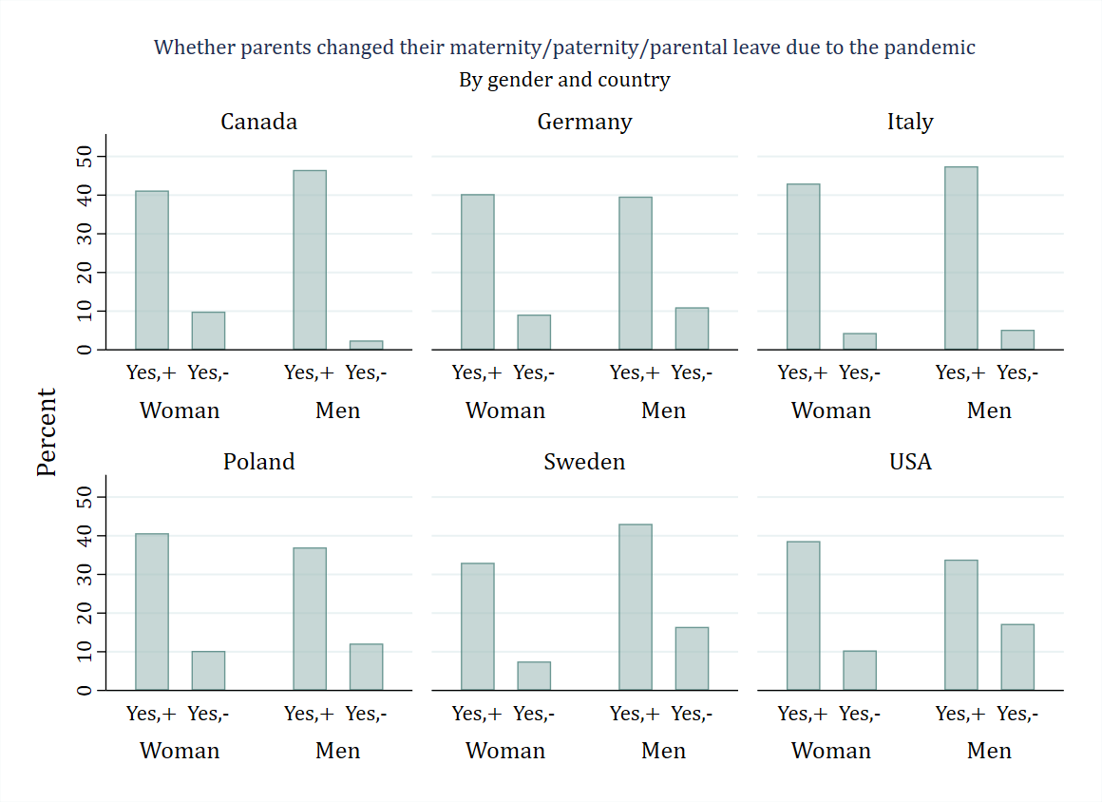
Changes to parental leaves due to pandemic
Logistic regression:
1 –positive change to parental leave plans;
0 - otherwise
Main explanatory variables:
Chstay – 1 if a child under 7 was out of childcare for some period;
Schstay – 1 if a child 7+ was out of school
Interactions :
Chstay* gender
Chstay*newborn
Chstay*schstay
Chstay*country
Other controls: edu, age, number of children, rel status,

Slide 18
Impact of a child at home on change to parental leave
Results:
Gender does not matter
Child <7 at home → higher probability of parental leave use/extension due to covid
but ….
… if together with newborn→ lower than if without it
… if togerther with child 7+→ higher than if without it
… if in IT or US → lower then in CA
…if in DE or SE → higher than in CA

Slide 19
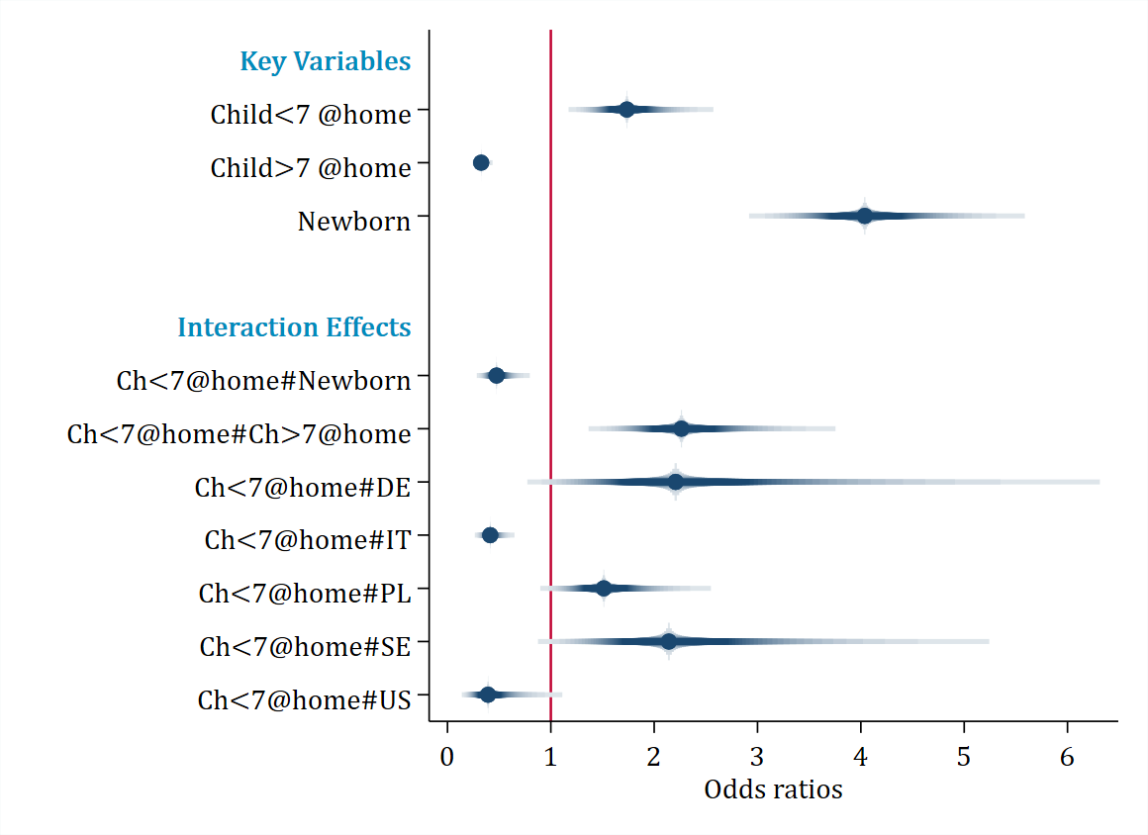
Impact of a child at home on change to parental leave
Results:
Child <7 at home → higher odds of parental leave use/extension due to covid
but ….
… if together with newborn→ lower than if without it
… if togerther with child 7+→ higher than if without it
… if in IT or US → lower then in CA
…if in DE or SE → higher than in CA

Slide 20
THANK YOU!
contact: a.kurowska@uw.edu.pl
Visit: https://familydemic.wnpism.uw.edu.pl/

Slide 21
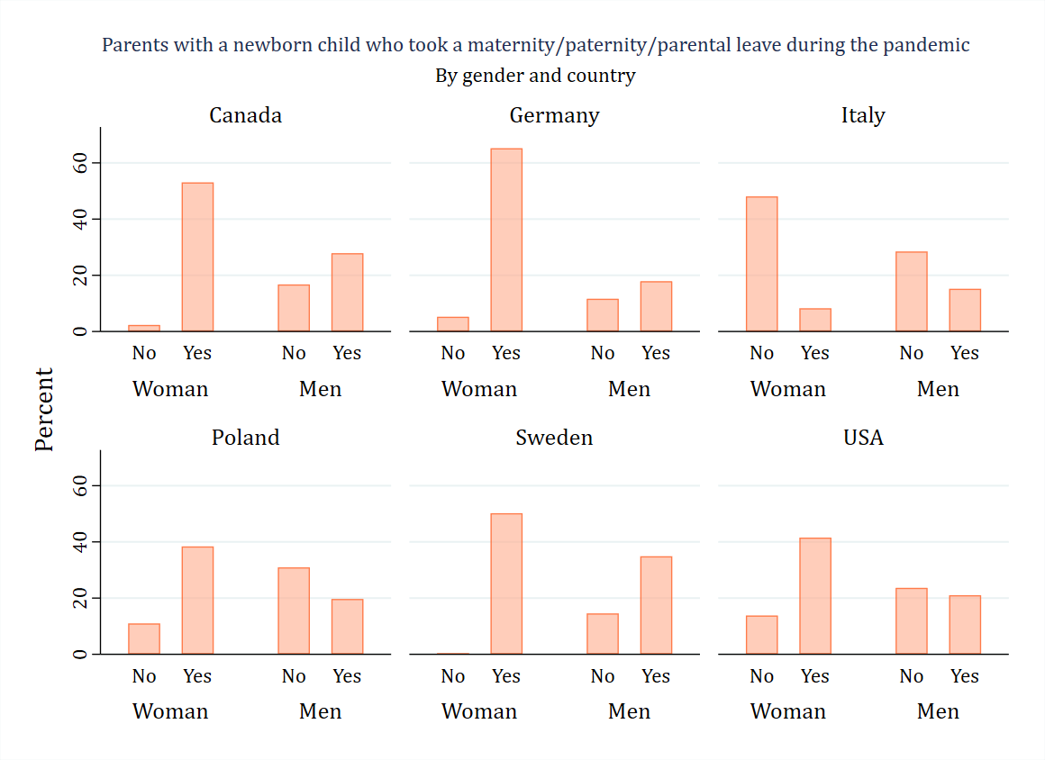
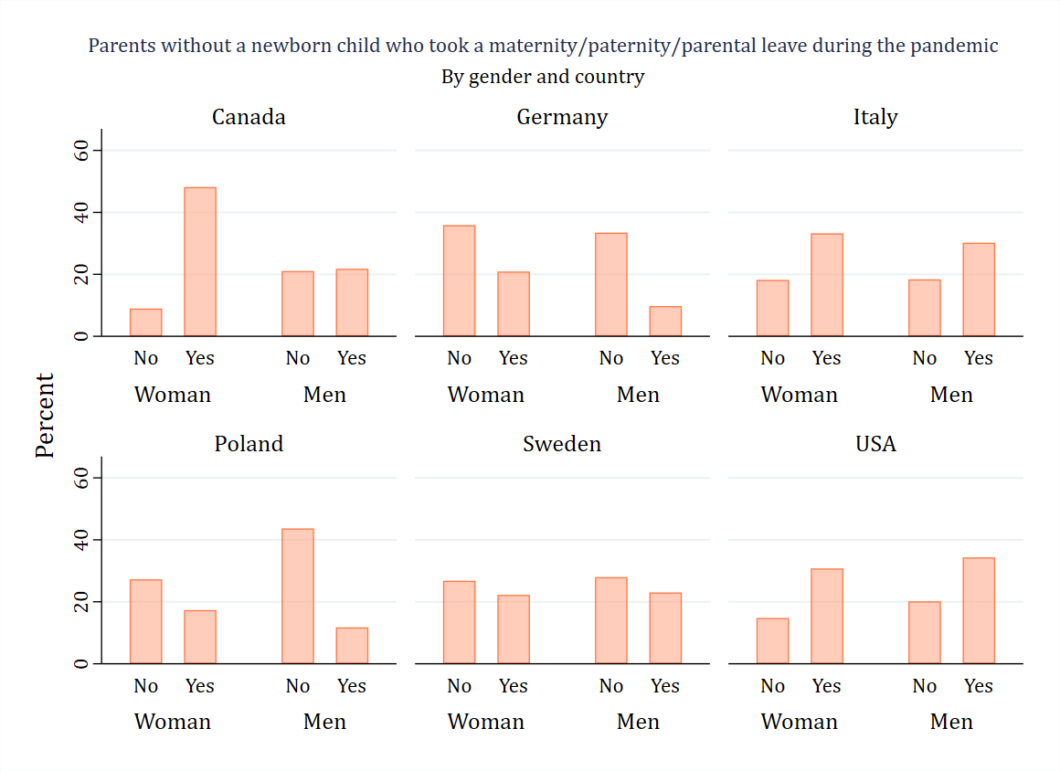
Use of parental leave by parents of (non) newborns
With a newborn
Without a newborn
Notes:
Additional slide

Slide 22
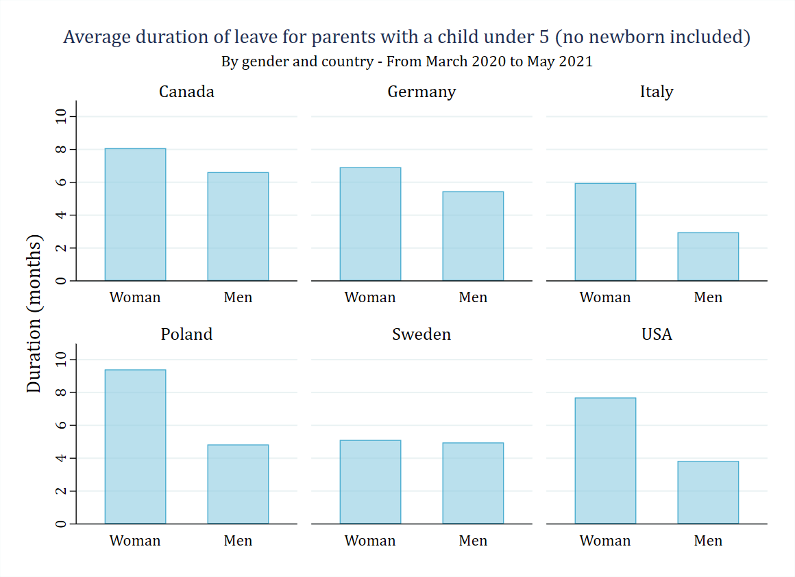
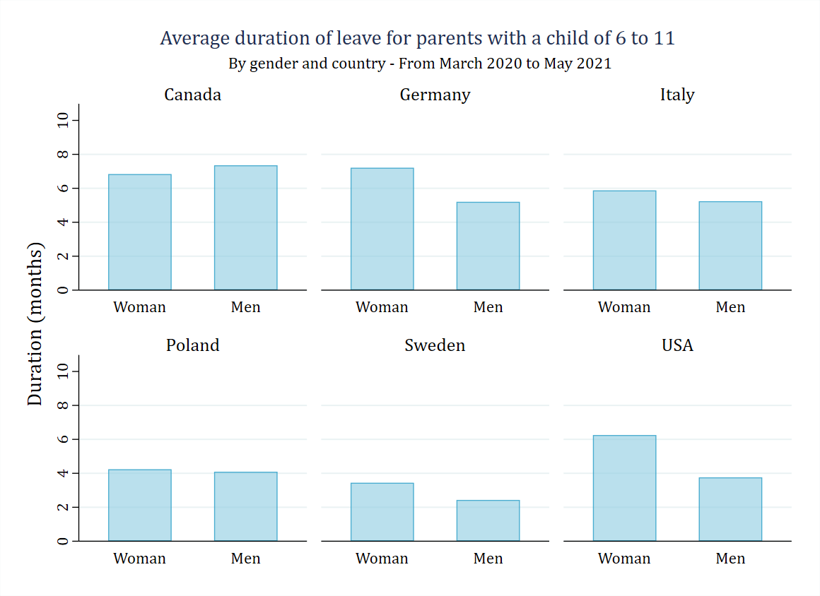
Duration of leave by gender and age of youngest child
Notes:
The numer of months is relatively long accross countries, genders and child’s age groups. Apart from the group of mothers of youngest children – which I do not show here, The longest average duration of leave is in Poland for mothers of 3-5 year olds and amounts to about

