Slide 1
Do unpaid parental leave schemes hurt mothers’ wages?
Evidence from Spain
Irene Lapuerta Méndez
Universidad Pública de Navarra
irene.lapuerta@unavarra.es
Marta Domínguez-Folgueras
Sciences Po
marta.dominguezfolgueras@sciences-po.fr
M. José González
Universitat Pompeu Fabra
mjose.gonzalez@upf.edu
International Network on Leave Policies & Research Annual Semminar
New York, June 21-22, 2022

Slide 2
Starting point:
Welfare states have developed diferent policies to protect women in the labor market and countries with more genorous family policies have smaller motherhood wage gaps. However, the effects of family policies depend on the combination of the tools used and their design.
Parental leave policies can have a positive effect on gender equality because they encourage mothers’ employment and father involvement in childcare but they can have backfire effects on women’s labour market outcomes, especially when leave of absence are long.
We contribute to this literature by:
Exploring the effect of long-term and unpaid parental leave on mothers’ wages.
Analysing a less explored characteristic in their design: flexibility in their use (full-time vs. part-time parental leave).
Notes:
We distinguish between the use of unpaid leaves on a full-time or part-time basis, as well as the duration of such leaves. It should be noted that part-time leave (i.e., the right to reduced working hours for parents caring for young children) is different from part-time jobs. Workers on part-time parental leave can apply for a return to full-time employment when they choose to do so, which part-time workers cannot do, and enjoy more labor rights (Férnandez-Kranz 2018). In the Spanish context, mothers can take unpaid parental leaves after the 16 weeks of paid maternity leave.

Slide 3
Mothers’ entitelments to parental leave in Spain (2022):
Type of Leave | Eligibility requiremets | Lenght | Retribución
Birth Leave (former maternity leave) | 180 days of contributions within the 7 years prior to the start of the leave or 360 days over the working life. | 16 weeks | 100%
(Breast)feeding Leave | Only employees. No contribution requirements. | Until the child is 12 months old | 100%
Parental Leave (full-time parental leave) |  | Until the child is three years old | Unpaid
Reduced working hours (part-time parental leave) |  | Until the child is three years old | Unpaid
Notes:
In comparative perspective, the Spanish parental leave system is very generous in terms of time but not very protective in terms of economic resources beyond the first stage of the child's life.

Slide 4
Theories on the potencial negative impact of using parental leave on mothers’ wages:
Deterioration on human capital (Mincer and Polachek, 1978): mothers' work experience suffers, especially with prolonged leaves of absence, since existing knowledge and skills depreciate due to lack of use, adaptability to new technologies and opportunities for training.
The low commitment stigma (Albrecht et al, 1999): it is related to existing social norms in the labor market, which define the ideal worker as an individual without additional responsabilities and focused exclusively on work. Employers may interpret taking leave as a sign of low commitment to work and discriminate against mothers who interrupt their careers in promotion or salary increase processes.
Family structure and resources: Mothers' work decisions depend on variables such as the number of children, partner’s earnings and couples’ time allocations to paid and unpaid work.
Notes:
There are two main theories on the potential negative impact of using a parental leave on mothers’ wages: the deterioration of human capital, and the low commitment stigma (Evertsson 2016).
In some sectors, employers can perceive motherhood as incompatible with skills deemed necessary for the job, as shown by Glass and Fodor (2018) in the case of finance. Human capital deterioration might be particularly acute for women taking long leaves as their work experience suffers, while existing knowledge and skills depreciate for the lack of use and adaptability to new technologies (Blau and Kahn 2016; Férnandez-Kranz et al. 2013; Fitzenberger et al. 2013; Kleven et al. 2019). If the career break is short, there is much more scope to make up for lost time in terms of training, and job prospects will not suffer to the same extent. Therefore, the motherhood penalty may be sensitive to the duration of the leave and the likelihood of catching up with productivity levels prior to maternity.

Slide 5
Hypothesis:
Hp.1. Length effects:
We expect a negative association between leave duration and women’ wages, because leave-taking entails a deterioration of human capital or because it is interpreted as a signal of low commitment by employers.
Hp. 2. Smaller effects of part-time vs. full-time parental leave:
We expect that the use of part-time leave is associated with a smaller penalty than the use of full-time leave of the same durarion because both the deterioration of human capital and the signaling effect are lower.

Slide 6
Data:
Continous Sample of Working Lives (MCVL, waves 2005-2012)
Longitudinal administrative register data with individual information from : (1) Social Security system; (2) municipal registry of inhabitants; (3) income tax registers.
Subsample: 135,622 women:
They were between 25 and 40 years old in 2005.
They worked as employees in the labour market.
Shorcomings:
It does not include the kinship relationship → we exclude women who live with several adults and for whom it is not possible to establish the mother-child relationship.
It does not identify periods of paid parental leave: maternity, paternity and (breast)feeding leave.
It does not contain information on couples, nor on care values or preferences.
Notes:
The source of information is the CSWL, which is an individual and longitudinal register data, stems from 3 different sources: Spanish Social Security System, Municipal Register and Income Tax Register.
It does not include a variable identifying the kinship relationship, so we exclude from the analysis those women who live with several adults and for whom it is not possible to establish the mother-child relationship.
It does not allow the identification of periods of paid parental leave (maternity, paternity and breastfeeding). These spells are considered as periods with social security employment.
It does not contain information on couples, nor on care values or preferences. So, that means we cannot contribute to the literature on relative resources or on other equally interesting lines of research on gendered social norms.

Slide 7
Method:
Panel data (longitudinal) -> monthly observations for each individual during the period 2005-2012.
Dependent variable: the natural log of the monthly contribution base to the Social Security System (= proxy of wage).
Statistical technique: lineal regression model with fixed-effects
Sample: 9,539,617 observations (a maximum of 96 per woman, if she remains during all waves)
Notes:
We have almost ten and a half million of monthly observations.
Our dependent variable is the natural log of the contribution base to the Social Security System, which is a proxy of wage with a ceiling of 2.813,40 in 2005 and 3.262,50 in 2012.

Slide 8
Results from fixed effects models predicted the motherhood wage penalty by number of children. Spain: 2005-2012.
 | Modelo 1 |  | Modelo 2
 | Coef. | Std. Err. | Coef. | Std. Err.
Childless | -- | (.) | -- | (.)
1 child | -0.052*** | (0.0016) | -0.044*** | (0.0016)
2 children | -0.118*** | (0.0024) | -0.101*** | (0.0024)
3 children | -0.160*** | (0.0046) | -0.138*** | (0.0047)
CNM* full-time leave |  |  | -0.012*** | (0.0027)
CNM* full-time leave squared |  |  | 0.0002*** | (0.0005)
CNM* part-time leave |  |  | -0.003*** | (0.0002)
CNM* part-time leave squared |  |  | 0.00003*** | (0.0000)
Model 1 and 2 controls for age, age squared, CNM of labor experience (and its square), % of working hours, firm size, sector of activity, CNM unemployed (and its square), type of contract and period.
Observations: 9,539,617.
*Cumulative number of months
Source: MCVL, 2005-2012.
Notes:
We find a negative association between parity and wages. Our results show that, in Spain, the motherhood penalty depends on parity. However, taking parental leave penalizes mothers too. We find that both types of leave have a negative impact on women’s wage growth during the period, even though we control for experience in the labor market and other variables such as age, percentage of working hours, firm size, sector of activity, type of contract, period and the cumulative number of months in unemployment.

Slide 9
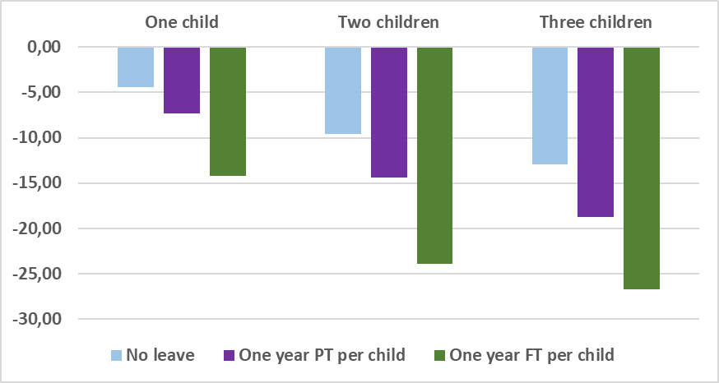
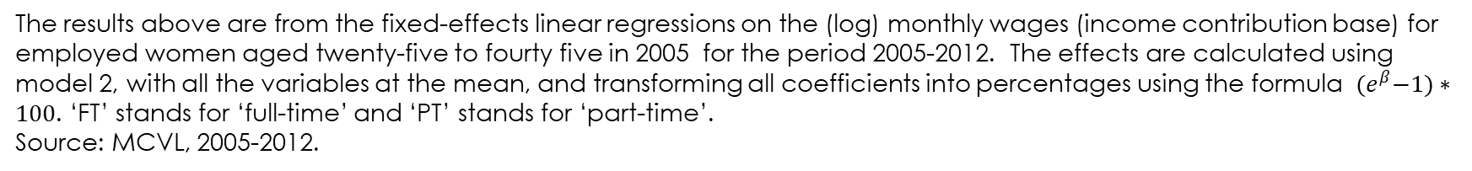
Predicted Values for the motherhood wage penalty by number of children and use of parental leave (1 year per child, full or part-time). Spain: 2005-2012
The results above are from the fixed-effects linear regressions on the (log) monthly wages (income contribution base) for employed women aged twenty-five to fourty five in 2005 for the period 2005-2012. The effects are calculated using model 2, with all the variables at the mean, and transforming all coefficients into percentages using the formula ${(e}^{β}−1)∗100$. ‘FT’ stands for ‘full-time’ and ‘PT’ stands for ‘part-time’.
Source: MCVL, 2005-2012.
Notes:
Figure 2 presents the predicted values for parity and policy use using data from Model 2, and converting the coefficients into percentages to facilitate interpretation. One child is associated with a 4.3 percent decrease in the women’s monthly wages, two children with a 9.6 percent decrease and three or more children with a 13 percent decrease, compared to the years when they did not have children. Taking 1 year of part-time leave per child adds to this penalty, reaching 7.3 percent for women with one child, 14.4 percent for mothers of two children and 18.7 percent for mothers of three children. In the case of full-time leave, the penalty is steeper. Taking 1 year per child is associated with penalties of 14.2 percent, 24 percent and 26.7 percent, respectively.

Slide 10
Conclusions:
Parental leave helps women to stay in the labor market, but it comes at a cost: we find that for equal lengths of both types of leaves, full-time parental leave has a higher cost than part-time leave.
However, this result must be interpreted with caution:
Women take part-time leave for much longer periods tan full-time leave. So, there may be some catch-up effect that would make the penalties of both types of leaves similar in the long run.
We are measuring a short period (up to seven years). So, it may be the case that penalties cancel out later in the mothers’ carrer. Some studies show that mothers might develop strategies to compensate for the reduction in working hours, which may, in turn, reduce the penalty in the long term (Webber and Williams, 2008).
Policy implications: the reform implemented in 2021 in Spain does not modify the unpaid leave policies. The positive effects that this reform might have on gender equality can be jeopardized by the negative impact of full- and part-time parental leaves on mothers’ wages. As a result, a revisión of the whole parental leave system is needed.
Notes:
Parental leave helps women to stay in the labor market, but it comes at a cost, at least in Spain. We find that a given period of full-time parental leave entails a higher cost than the same period of part-time parental leave.

Slide 11
Thank you very much for your attention!

