Slide 1
Effects of the COVID-19 pandemic on childcare and the take-up of parenting leave in Finland
International Network on Leave Policies and Research
Annual Seminar June 20-21 2022 New York

Slide 2
COVID-19 pandemic and gender equality
Gendered effects of the pandemic on
employment
care practices
work-family reconciliation
violence
(e.g. Blom & Dobrotić 2021; Hjálmsdóttir & Bjarnadóttir 2020; Vicari et al. 2022)

Slide 3
COVID-19 restrictions and recommendations in Finland
National lock down 16.3.–14.5.2020:
recommendation to keep children in home care / virtual school
ECEC and 1-3 grades open
recommendation to work from home
recommendation to avoid social contacts with 60+ old people
temporary benefit for parents who had to take unpaid leave from work
After the lock-down:
national recommendation to work from home continued until Feb 2022
local restrictions and recommendations according to epidemic situation; hitting especially employment in restaurants, transport, culture.

Slide 4
Take-up and lenght of parenting leave is related to
leave policies (eligibility, length, benefit, quotas)
childcare services (availability, quality, price)
cultural conceptions (”good mother/father”, ”child’s best interest”)
family-friendliness of working life & organisations
parent’s labour market position (education, occupation, health)
work situation & working conditions (flexibility, autonomy, burdening)
negotiations & division of labour between parents (power, values, attitudes)

Slide 5
Employment rate according to gender and education level in Finland 2019-2021
%

Slide 6
Change in employment rate according to quarter and gender, 1Q2020 – 1Q2022 in comparison to 2019
Women
Men

Slide 7
Working from home
In European comparison,
working from home was most common (48 %) in Finland during the first year of the COVID-19 pandemic
women in Finland were the more satisfied with working from home (77 % vs 56 % in EU27)
women in Finland experienced less negative consequences of the COVID-19 epidemic in income or work-family reconciliation; they less often had to change career plans or reduce working hours due to care responsibilities.
(Eurofound 2020; Eurobarometer 2022)

Slide 8
Experiences of work-family reconciliation in families with young children, before and during the COVID-19 epidemic in Finland

Slide 9
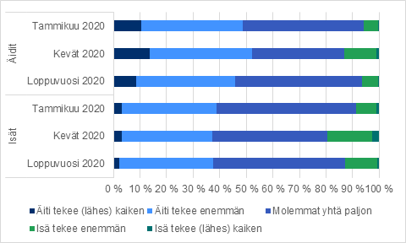
Division of labour in childcare between parents of young children, before and during the COVID-19 epidemic in Finland
January
Spring
December
Mothers
Fathers
January
Spring
December
Mother does (almost) all
Father does more
Mother does more
Father does (almost) all
Childcare is shared equally

Slide 10
Children born and fathers’ take-up of leave 2019-2021 in Finland
(1000)

Slide 11
Changes in the take-up of home care allowance* (2019 vs 2020) in Finland
According to register data, in comparison to spring 2019
both mothers and fathers of children under 3 used somewhat more often and longer periods of home care allowance (HCA) during spring 2020;
after the lock down children returned to ECEC and the use of HCA returned to the previous level.
* Home care allowance is paid to parents of children under 3 yrs as an alternative to attending ECEC services.

Slide 12
Change in parenting leave* plans due to COVID-19 in Finland
FinChildren survey 2020 with parents of 3-6 month-old babies (N=8977 mothers & 5843 fathers)
Fathers changed their parenting leave plans in one way or another more often (1/5) than mothers (1/7).
Changes were more common
in the capital region (worse epidemic situation)
among highly educated parents (mothers: longer leave / fathers: postponed leave)
fathers with one child vs more children
* maternity/paternity/parental/care leave

Slide 13
Changes in parenting leave plans, according to gender and education
%

Slide 14
Conclusions
The effects of COVID-19 on childcare and work-family reconciliation were relatively small and temporary as the lock down was relatively short; ECEC and schools were not totally closed.
The lock down period was somewhat more difficult for mothers than fathers even if fathers temporarily increased their share of childcare.
Change of parenting leave plans was more common in the capital area where the epidemic was more severe.
Both mothers and fathers used more HCA during the lock down.
During 2020, some fathers postponed their leave (as it can be taken until the child in 2 years old).
Changes in the division of care responsibilities as a pragmatic reaction to extraordinary circumstances instead of profound changes in care practices.
The welfare state i.e. leave policies and parental benefits acted as a buffer.

