Slide 1
Parental leave, take-up consequences and changing normative beliefs: Evidence from a survey experiment
Marie-Fleur Philipp¹
Joint with Silke Büchau¹, Pia Schober¹ and
C. Katharina Spiess²
1 University of Tübingen
2 Federal Institute for Population Research (BiB) and Johannes Gutenberg University Mainz

Slide 2
Motivation: family policies → social norms
Family policies convey normative assumptions about desirable work-care arrangements (Kremer, 2007; Orloff, 1996; Pfau-Effinger, 2004)
Normative policy feedback effects (e.g., Gangl & Ziefle, 2015)
  Preference adaptation
  Cultural diffusion
  Norm setting:
  → How may family policies influence social norms through the provision of short media-like information?
Frequent media coverage on parental leave policies and consequences of take-up – little research on its effects!
Notes:
The motivation for this study lies in the notion that family policies influence social norms because they convey normative assumptions of what is desirable regarding work-care arrangements.
The concept of normative policy feedback effects suggests different mechanisms of how this might happen:
Preference adaption through role exposure
Cultural diffusion over time through altered role perceptions
And norm setting (because policies function as legitimising normative anchors)
We focus on the latter mechanism and ask whether family policies might influence social norms through the provision of short media-like information.
This question seems particularly relevant given the frequent media coverage on parental leave policies and consequences of take-up and so far there is only little research on its effects.
But it might be crucial to know whether normative policy effects depend on the visibility of a policy e.g. in the media or how the discussion of policies in the media affects the strength and direction of normative policy feedback.

Slide 3
Previous studies
Quasi-experimental observational evidence that family policies can influence behaviour as well as attitudes and ideologies relating to the division of labour (Ellingsaeter, 2003; Gangl & Ziefle, 2015; Schober, 2014; Unterhofer & Wrohlich, 2017; Wray, 2020; Zoch & Schober, 2018)
  → Among the policy target population and among significant others
Survey-experimental evidence from the US and Germany suggests that the availability of more supportive work-family policies can increase personal preferences for more egalitarian work-care arrangements (Bünning & Hipp, 2021; Pedulla & Thébaud, 2015; Thébaud & Pedulla)
Notes:
There is some quasi-experimental observational evidence that family policies can influence behaviour as well as attitudes and ideologies relating to the division of labour.
These effects have been found both among the target population of a policy but also among significant others, so they are not tied to the actual take-up of a policy.
In addition, some survey-experimental evidence from the US and Germany suggests that the availability of more supportive work-family policies can increase personal preferences for more egalitarian work-care arrangements.

Slide 4
German context (e.g., Stahl & Schober, 2017)
Since 2000s, major family policy reforms aimed at promoting gender equality in paid work & childcare
→ from familialistic welfare-state model towards model of optional familialism
Parental leave reform in 2007:
Shorter but well-paid parental leave (12 months, 65% income replacement, capped at 1,800€ per month)
14 months of paid parental leave if both parents take at least 2 months
Notes:
Our study is set in the German context, where some major policy reforms aimed at promoting gender equality in paid work and childcare have moved the country from a familialistic welfare state model towards a model of optional familialism.
More specifically, we focus on a parental leave reform that has been introduced in 2007. It features a shorter but well-paid parental leave.
In addition, to increase paternal involvement in childcare, an individual “use-it-or-lose-it” entitlement of two months of leave for each parent has been introduced, so that parents can take up to 14 months of paid parental leave.
(((But it is still possible to take up to 3 years of partly unpaid parental leave until the child is 8 years old.)))
________
Reform 2007
Basic parental leave benefit of 300€, upper limit at 1,800€
3 years of (partly unpaid) parental leave can be taken until the child's 8th birthday, can also be split in several periods but becomes more complicated after the child's third birthday
Major reforms:
1996: all children aged 3 years to school age right of a half-day slot
2005: increase in day care provision for under-threes for parents in education or employment
2007: shorter but well-paid parental leave, two months reserved for each partner
2013: day care right for all children aged 1 year or over

Slide 5
Contribution
Evidence-based priming:
Parental leave entitlements
Consequences of take-up
Normative judgements of:
Parental leave take-up of mothers and fathers
We conducted a survey experiment in a large representative German panel and compare different priming conditions
We examine interdependencies of normative judgements with the economic situation of families by using vignettes
We explore heterogeneous effects across respondent groups
Notes:
Our contribution with this study is threefold:
First, we conducted a survey experiment in a large representative German panel and compare different priming conditions in which respondents received information on parental leave entitlements and consequences of take-up.
Second, we examine interdependencies of normative judgements with the economic situation of families by using vignettes.
And finally, we explore heterogeneous effects across respondent groups like parents vs. childless respondents.

Slide 6
Theoretical framework I: Priming effect
Social norm theory (Bicchieri, 2017): Information may change individuals’ normative beliefs
Human cognition theories (Evans & Stanovich, 2013; Petty & Cacioppo, 1986):
  Type 1: fast, automatic, default decision-making
  Type 2: more controlled thinking and reflective reasoning
  → Priming makes fast intuitive judgements less and reflective reasoning more likely.
Notes:
Our theoretical framework draws on social norm theory which assumes that information may change individuals’ personal normative beliefs, so what they think about how others should divide parental leave.
We further rely on human cognition theories that distinguish different levels of elaboration on which individuals process thoughts.
The theories distinguish Type 1 processes which include fast, automatic, default decision-making, from type 2 processes which involve more controlled thinking and reflective reasoning.
We assume that priming makes fast intuitive judgements less and reflective reasoning more likely.

Slide 7
Priming conditions
Condition #1: Maternal economic risks | Condition #2: Paternal wage penalties of leave take-up | Condition #3: Trends of leave take-up by fathers
Both parents entitled to parental leave & | Both parents entitled to parental leave & | Both parents entitled to parental leave &
Shorter maternal breaks from work mean higher wages for mothers in the longer term, which can reduce the risk of poverty in old age | Wage penalties after taking leave smaller for fathers than mothers | Increasing share (>1/3) of fathers taking parental leave but most take only 2 months.
→ Priming C1, C2 & C3 increase support for a less traditional division of parental leave in couples (H1).
Notes:
The experiment comprises three different priming conditions and one control group.
All groups were informed about parental leave entitlements, but the priming groups received additional information on maternal economic risks associated with long parental leave, on rather small or even absent paternal wage penalties related to leave take-up or on increasing trends of leave take-up by fathers.
On the whole, we expect that all three priming conditions increase support for a less traditional division of parental leave in couples compared to the control group.
___________________
((...because the priming might lead to more reflective reasoning by highlighting long-term economic consequences and changing take-up trends among fathers and by perhaps even correcting false beliefs. As a consequence, individuals' normative beliefs regarding the division of parental leave might change towards more egalitarian divisions.))

Slide 8
Theory II: Moderation by economic resources
Relevance of relative economic resources for division of labour in couples (Becker, 1991; Lundberg & Pollak, 1996)
Priming effects may vary by economic relevance of the priming information
Condition 1: Maternal economic risks more relevant for couples where women earn less than the partner → stronger effects (H2a)
Condition 2 & 3: Paternal wage penalty and paternal take-up trends more relevant for couples where women earn more than the partner → stronger effects (H2b)
Notes:
We further take into account parents’ relative economic resources because they matter for the division of labour in couples and the priming effects may vary by the economic relevance of the priming information.
Condition 1 on maternal economic risks might be more relevant for couples where women earn less than the partner because they are financially dependent and more vulnerable and therefore this condition might have stronger effects for this income constellation.
Condition 2 and 3 on paternal wage penalties and paternal take-up trends might be more relevant for couples where women earn more than the partner and a more egalitarian division of parental leave would be economically efficient and might therefore show stronger effects for this income constellation.
((C1: Long leaves are less likely to be recommended to these mothers as they are the main breadwinners and in addition they are financially less dependent and less vulnerable than women who earn less than their partner. So, the priming with information on maternal economic risks might be more relevant for couples with a rather traditional income constellation and the priming effects might therefore be stronger.))
((Condition 2 on rather neutral consequences of leave take-up for fathers' wages counteracts any fears of negative career consequences and this might be more relevant in constellations where the mother earns more and a longer paternal leave would make sense from an economic perspective.
Similarly, Condition 3 on increasing take-up rates among fathers signals that a longer paternal leave is normatively accepted, which should have stronger effects in couples where a shorter maternal and longer paternal leave would be economically efficient.))

Slide 9
Theory III: Subgroup differences by parenthood status
Effect heterogeneity of policy information priming:
Likelihood of reflective reasoning on information depends on personal relevance or previous knowledge/reflection (Ellingsaeter et al. 2017).
  Personal relevance: childless > parents
  Previous reflection: childless > parents
→ All three priming conditions increase support for a less traditional division of parental leave more strongly among childless respondents compared to parents (H3).
Notes:
The priming effects might also differ by respondents’ parenthood status because the likelihood of reflective reasoning on information depends on the personal relevance and the previous knowledge or reflection on the issue.
The priming information is probably more personally relevant for childless respondents because some of them might still have children at some point, whereas most parents are already past the short period of parental leave.
Moreover, childless respondents probably have not thought about parental leave a lot before and might be more open to changing their normative beliefs compared to parents who were probably already better informed.
Therefore, we expect stronger priming effects among childless respondents compared to parents.

Slide 10
Data & Method

Slide 11
Survey experiment: GESIS Panel
Priming:
C1, C2, C3 or control group
→ Effects of priming on normative beliefs of division of parental leave
(moderated by the couple income constellation described in the vignettes)
4 vignettes
4 vignettes
Division of parental leave
Division of parental leave
Sample:
5,362 vignette evaluations nested in 1,548 respondents
2019 2020
Notes:
The data for this study stems from a survey experiment that has been implemented in two waves of the German GESIS Panel in 2019 and 2020.
In both waves, respondents received four vignettes describing a hypothetical couple expecting their first child and had to indicate how they should divide their parental leave. In the second wave, they additionally received the priming or were allocated to the control group.
_____________
(((This design thus allows to investigate the effects of priming with parental leave policy-related information on normative beliefs regarding the division of parental leave and how these effects are moderated by the couple income constellation.)))

Slide 12
Method
OLS regression models with lagged dependent variables and cluster-robust standard errors
  Design weights to account for non-representative sampling design
  Dependent variables
  Normative judgements of:
  Mother’s months of paid leave [0-12]
  Father’s months of paid leave [0-12]
  Mother’s relative share of couple’s leave [0-100%]
Means wave 1
8.3 months
5.4 months
60 %
Notes:
We applied OLS regression models with lagged dependent variables and cluster-robust standard errors.
We have three dependent variables measured at both waves and capturing respondents' normative judgements of parents' division of parental leave. So we consider judgements on mothers’ and fathers’ absolute length of parental leave and the mother’s relative share of parental leave.
((At wave 1, mothers were assigned 8,3 months of parental leave while fathers were assigned 5,4 months. In sum, respondents thus supported a division of parental leave where the mother takes 60% of the couple's total leave length. We did not find significant differences across the experimental groups at wave 1.))
In the results section, the focus will lie on the dependent variable for mother's relative share of leave. Please keep in mind that we did not measure respondents’ actual leave taking behaviour but what they considered desirable.

Slide 13
Independent variables
  Vignette dimensions:
  Mother’s relative earnings share: 40% or 60%
  Couple’s absolute net household income: 2,350€ or 3,700€
Respondent characteristics:
Parenthood status: childless/parent
Control variables on respondent level: Respondent’s age in years, immigration background, tertiary education, attitudes regarding division of paid work and gender essentialism
Notes:
We controlled for the vignette dimensions and included two variables capturing the mother’s relative earnings and the couple’s absolute net household income.
Moreover, we included respondents’ parenthood status as well as various respondent-level control variables.

Slide 14
Results

Slide 15
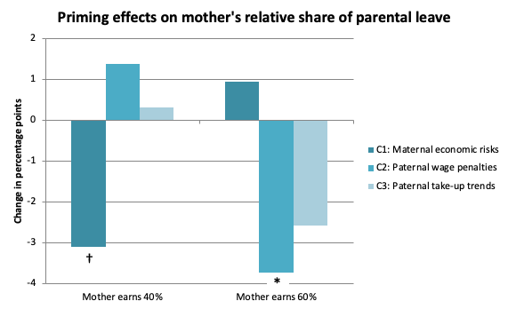
Effects by relative income subgroups
H2a and H2b (partly) supported
Notes:
I start directly with the results for the relative income subgroups because we did not find any significant priming effects in the full sample.
This bar chart shows the change in normative judgements regarding the mother’s relative share of parental leave across the two waves relative to the control group.
We find significant effects of C1 and C2 depending on the income constellation.
For couple constellations where the mother earns less than her partner, the priming on maternal economic risks significantly decreased the mother’s relative share of parental leave, leading to a more egalitarian division. The other two priming conditions did not show any significant differences to the control group for this income constellation. This is in line with our Hypothesis 2a.
If the mother earns more than her partner, the second priming condition on paternal wage penalties has a significant negative effect on the mother’s relative parental leave share.
The effect of C3 on paternal take-up trends points into the same direction, but against our expectations, it is not significant. Hypothesis 2b is thus only supported with respect to C2.
In short, these results suggest that priming with family policy-related information has the potential to alter normative judgements when the information provided matches the couple's relative income constellation.

Slide 16
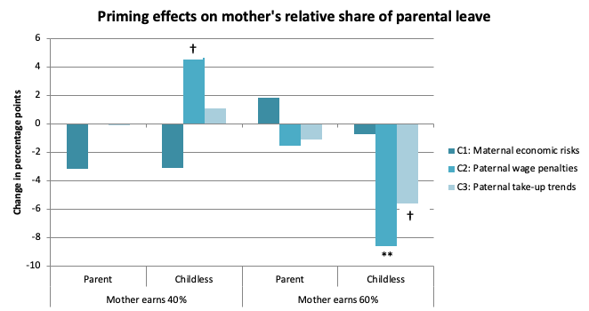
Parents vs. childless respondents
H3 partly supported for C2
Notes:
This bar chart now shows the results for the subgroups of parents and childless respondents.
We see that for parents, the effects are rather small and not significant.
At the same time, we do find some significant effects of C2 and C3 for childless respondents.
If the mother earns less than her partner, C2 increases support for a more traditional division of parental leave. But if the mother earns more than her partner, C2 increases support for a lower maternal share of parental leave. It seems like the priming has increased the salience of the relative income constellations and that childless respondents, more so than parents, consider this aspect more strongly after the priming; and this effect of C2 is significantly different for childless respondents compared to parents.
For C3, we find that it significantly reduces mother's share of parental leave if she earns relatively more than her partner; but the effect of C3 for childless respondents is not significantly different from the effect among parents.
In general, these findings suggest that priming with policy-related information has stronger effects among respondent groups to whom the policy might be personally relevant and who did not engage in this topic a lot before. Our hypothesis was thus partially supported for C2, although the direction of the effects was not completely in line with our expectations.

Slide 17
Contribution, limitations & implications
+ Experimental evidence for norm-setting effects of family policies
+ Priming effects on parental leave norms:
strongly dependent on relative earnings in couples
stronger effects among childless women and men
- Small effects, probably due to short information priming
Future studies should measure prior knowledge/reflection
→ Repeated exposure to brief media report-like information has the potential to alter gendered work-care norms
Notes:
To sum up, this study provides novel experimental evidence for norm-setting effects of family policies
We do find priming effects on parental leave norms, however, they are strongly dependent on the relative income constellation in couples
Moreover, we find that these priming effects are stronger among childless women and men.
Of course, this study is not without limitations:
The effects that we find are rather small, which might be related to the fact that it was a rather short and not very intense information priming; but previous priming survey experiments in this field also found rather modest effect sizes
Regarding the heterogeneous effects by parenthood status, we cannot really entangle whether the stronger effects among childless respondents are due to higher personal relevance or little previous reflection on parental leave; so future studies should ideally measure respondents’ prior knowledge or reflection in order to differentiate the underlying mechanisms.
Nevertheless, the findings of this study indicate that evidence-based policy-related information might have the potential to shape gender and care cultures among the wider public over time, if it is repeatedly diffused. So, these insights have practical implications for policymakers and media, as they point to the relevance and potential of the availability, accessibility, and diffusion of such policy-related information.

Slide 18
Thank you for your attention!
Contact: marie-fleur.philipp@uni-tuebingen.de
Thanks to our funders:
DFG, Project number: 430968755
„Family policy information, gender ideologies and
normative judgements of the gender division of labour“
Notes:
Thank you very much for your attention! We look forward to your feedback and comments.

Slide 19
GESIS Panel: Priming conditions

Slide 20
GESIS Panel: Example vignette
We would like to ask you to give us your opinion on family life and parental leave by means of some case studies. Imagine you live in a partnership. You both work full time (approx. 40 hours per week) and become parents. Both of you are in a similar situation with regard to the family-friendliness of your employer and also your career.
Based on the parental allowance regulations, both of you can receive parental allowance together for up to 14 months. Each of you is entitled to 2 months of parental allowance, which cannot be transferred to your partner. This means that if one of the partners does not take parental leave, 2 months are forfeited and only a maximum of 12 months of parental allowance can be drawn. These 12 months can be taken by both parents (mother or father).
In the first case, you earn 1410 euros net per month. Your partner earns 940 euros net per month. Based on the online parental allowance calculator of the Ministry of Family Affairs, you would receive 863 euros per month and your partner 635 euros per month in parental allowance.
Please enter how you would divide the available months between you:
I would take ____ months paid parental leave.
Partner would take ____ months paid parental leave.
I do not know (98)

Slide 21
GESIS Panel: Example priming C2
Reconciling family and work is a major challenge for many families. Since the introduction of parental allowance in 2007, both parents can receive up to 14 months of parental allowance together. Each of them is entitled to 2 months of parental allowance, which cannot be transferred to their partner.
Many people assume that longer parental leave has negative consequences for fathers' careers and that mothers' careers are less affected. So far, scientific studies show that fathers do not experience adverse wage developments when they have taken parental leave. Meanwhile, for mothers, their wages either decrease or increase more slowly when they have taken longer parental leave.

Slide 22
GESIS Panel: Random allocation?
Characteristics at Wave 1 | Control |  | Condition 1 |  | Condition 2 |  | Condition 3
 | Mean | SD | Mean | SD | SD | SD | Mean | SD
Female | 0.46 | 0.50 | 0.48 | 0.50 | 0.45 | 0.50 | 0.51** | 0.50
Partnered | 0.67 | 0.47 | 0.64† | 0.48 | 0.66 | 0.47 | 0.62** | 0.49
Parent | 0.66 | 0.47 | 0.69 | 0.46 | 0.72** | 0.45 | 0.69 | 0.46
Tertiary educational degree | 0.50 | 0.50 | 0.47 | 0.50 | 0.51 | 0.50 | 0.49 | 0.50
Immigrant background | 0.14 | 0.35 | 0.12 | 0.33 | 0.17* | 0.38 | 0.17* | 0.38
Age | 48.97 | 14.23 | 48.18 | 14.61 | 49.40 | 14.03 | 49.47 | 14.92
Ideology gender division of paid work | -0.02 | 1.01 | -0.04 | 1.04 | 0.03 | 1.03 | 0.07* | 0.99
Ideology gender essentialism | 0.04 | 1.05 | -0.01 | 1.02 | 0.00 | 0.96 | -0.01 | 0.99
N (vignettes) | 1,319 |  | 1,357 |  | 1,279 |  | 1,407
Note: Descriptive statistics are weighted. The significance refers to the results of weighted Wald tests of the null hypothesis that values in the control group and the respective treatment group are equal. Source: German GESIS Panel v39. † p < 0.1, ∗ p < 0.05, ∗∗ p < 0.01, *** p < 0.001.
Significant differences between treatment and control groups by gender, marital status, parenthood status, migration background and age
But: effects are robust to the inclusion as controls

Slide 23
Results: Main priming effects
 | Mother’s length of leave (in months) | Father’s length of leave (in months) | Mother’s relative share of leave (%)
Experimental conditions (ref: control)
C1: Maternal economic risks | -0.109 | 0.160 | -1.119
 | (0.148) | (0.147) | (1.048)
C2: Paternal wage penalties | -0.207 | 0.122 | -1.218
 | (0.153) | (0.150) | (1.058)
C3: Paternal take-up trends | -0.154 | 0.159 | -1.157
 | (0.146) | (0.144) | (1.030)
Vignette: Net household income of 3,700€ (ref: 2,350€) | -0.160** | 0.218*** | -1.321**
 | (0.059) | (0.059) | (0.428)
Vignette: Mother earns 60% (ref: 40%) | -1.341*** | 1.323*** | -9.698***
 | (0.131) | (0.130) | (0.955)
Lagged DV/Division of leave in Wave 1 | 0.308*** | 0.311*** | 0.308***
 | (0.020) | (0.021) | (0.021)
 | (0.141) | (0.142) | (0.990)
Constant | 7.297*** | 2.159*** | 53.480***
 | (0.321) | (0.251) | (2.324)
N | 5,362 | 5,362 | 5,357
R² | 0.183 | 0.184 | 0.184
Note: GESIS Panel v39, own calculations, standard error in parentheses. We controlled for respondents’ gender, marital status, age, tertiary education and immigrant background as well as for their gender ideologies towards the gender division of paid work and housework and gender essentialism. Models including control variables are shown in Table A2 in the appendix. † p < 0.1, ∗ p < 0.05, ∗∗ p < 0.01, *** p < 0.001.

Slide 24
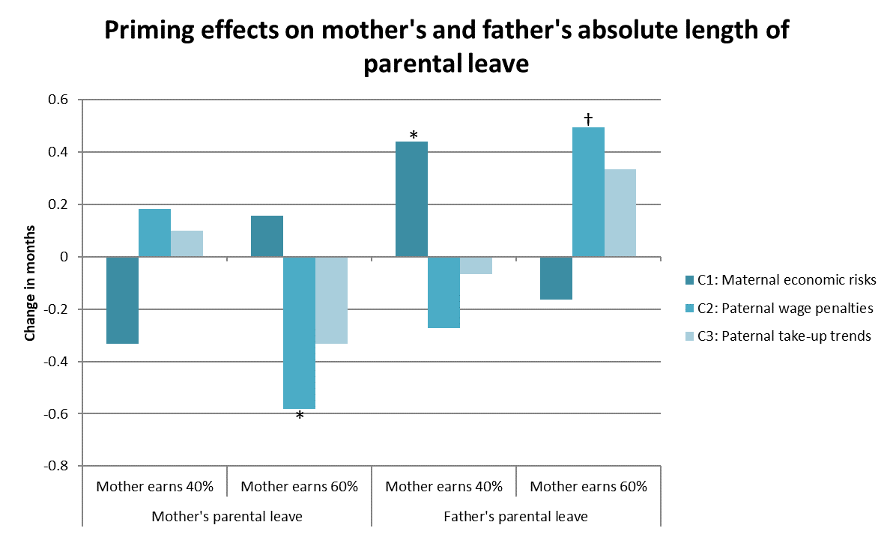
Results

