Slide 1
A Patchwork System: National, State, and Local Leave Policies within the United States

Slide 2
Leave Policies within the United States
Unique Focus on Family Leave
Single public policies that provide leave for a variety of reasons:
Childbirth and care of newborn child up to the age of 12 months
Placement/care of an adopted or foster child
Care of a seriously ill child, spouse, or parent
Serious health condition that prevents employee from working
Public policies are individual entitlements to all eligible workers
Including same-sex parents (even if they are not a legal adoptive parent)

Slide 3
National Leave Policies
Family and Medical Leave Act (FMLA)
Established in 1993
Provides unpaid, job-protected leave to eligible workers
Eligibility based on size of employer and number of hours worked within the past year
Only about 60% of workers eligible to take leave under FMLA
Paid family leave legislation was introduced in 2021 under President Biden’s Build Back Better plan, but support faded and is not actively being considered anymore

Slide 4
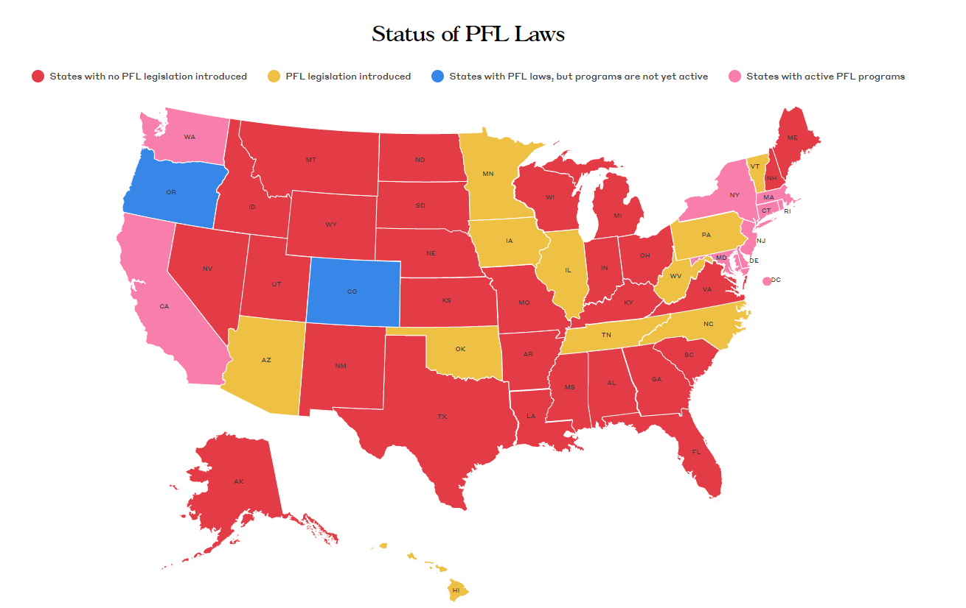
State-Level Paid Family Leave Policies
Notes:
11 states + Washington, DC have passed state-level paid family leave policies. These policies provide between 5-52 weeks of paid leave depending on state and reason for taking leave. Wage replacement ranges from 60% to up to 100% for low-wage earners in some states.

Slide 5
Local Leave Policies
As of 2018, 22 of the largest 44 US cities provided paid family leave to municipal employees
San Francisco Paid Leave Ordinance
Requires employers within city limits to provide supplemental benefits (so employees receive full pay) for workers who take leave under California’s state-level PFL policy
First city policy to provide full pay to workers
Has increased take-up rates, particularly among fathers

Slide 6
Employer Leave Policies
Limited public leave policies means that most US workers rely on employers for access to leave
Currently, 23% of workers have access to paid family leave
Access to employer-based leave varies widely by:
Size/profitability of employer (e.g., 72% of Fortune 500 companies in the US have paid parental leave policies)
Industry (technology companies more likely to offer paid parental leave than other industries)
Job type (professional, full-time, salaried more likely to have access to leave)
Worker gender (access to maternity leave more common than paternity leave)
Notes:
Overall, the patchwork of policies in the US means that workers in the US take much shorter leaves than workers in many other countries with more robust leave policies. On average, mothers take 11 weeks of leave for the birth of a child and fathers take only 1 week.
On the bright side, there has been increased momentum in recent years, with more states, cities, and companies adopted paid family leave policies. Whether this momentum continues and expands to the federal level remains to be seen.

