Slide 1
Social Policy for Optimists: the social sustainability perspective as applied to parental leave policies
Alison Koslowski, University College London

Slide 2
Context
EU Cost Action CA21150 – Paid Parental Leave Policies and Social Sustainability - https://www.sustainability-at-leave.uni-hamburg.de/about.html
  Working group 1: the development of a new theoretical framework that captures the relevance of paid parental leave policy design for the sustainability of societies and advances the focus in PPL research
  Reading group & edited book project with Ann-Zofie & Andrea
Sociology for Optimists, Mary Holmes, https://sk.sagepub.com/books/sociology-for-optimists

Slide 3

Using parental leave policy as a focus point

Slide 4
UN Frameworks
United Nations (1987) Our Common Future: Report of the World Commission on Environment and Development (The Brundtland Report)
United Nations. (2015). Transforming our World: the 2030 Agenda for Sustainable Development
United Nations. (2019). Global Sustainable Development Report 2019 (The Future is Now - Science for Achieving Sustainable Development)
United Nations (2023). Global Sustainable Development Report 2023.

Slide 5
Social sustainability
Core principle of sustainability: meeting the needs of the present without compromising the ability of future generations to meet their own needs.
Three (or four) pillars: environmental, economic, social, (cultural)
Social sustainability is a quality of society. It signifies the relationship between nature and society, mediated by work, as well as relationships within society. Social sustainability is achieved if work within a society and the related institutional arrangements (1) satisfy an extended set of human needs and (2) are shaped such that nature and its reproductive capabilities are preserved over a long period of time and the normative claims of social justice , human dignity and participation are fulfilled(Griessler and Littig, 2005).
Social Sustainability: concepts and benchmarks, 2020, European Parliament, Box 2
Magnus Boström (2012) A missing pillar? Challenges in theorizing and practicing social sustainability: introduction to the special issue, Sustainability: Science, Practice and Policy, 8:1, 3-14, DOI: 10.1080/15487733.2012.11908080

Slide 6
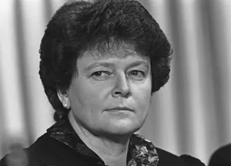
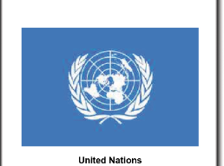
1987 & the ‘social’ is already deemed to be core to the solution to the environmental crisis, but social scientists haven’t got on board?

Slide 7
Social sustainability requires a shift to social policy for optimists
A paradigm shift away from a social problem approach
Being optimistic does not imply a lack of critical ability (!)
Three aspects of social sustainability requiring optimism
A status quo approach: appreciation of what is
The long view: faith in the future
The connectedness of things: integration and balance

Slide 8
1.Appreciating what we have
A social science gratitude practice (!)
  We are really bad at this, usually taking a social problem perspective
Understanding the counterfactual (no parental leave policy)
Understanding the value of what is: parental leave policy in the UK and barriers to reform

Slide 9

2. Faith in the future

Slide 10
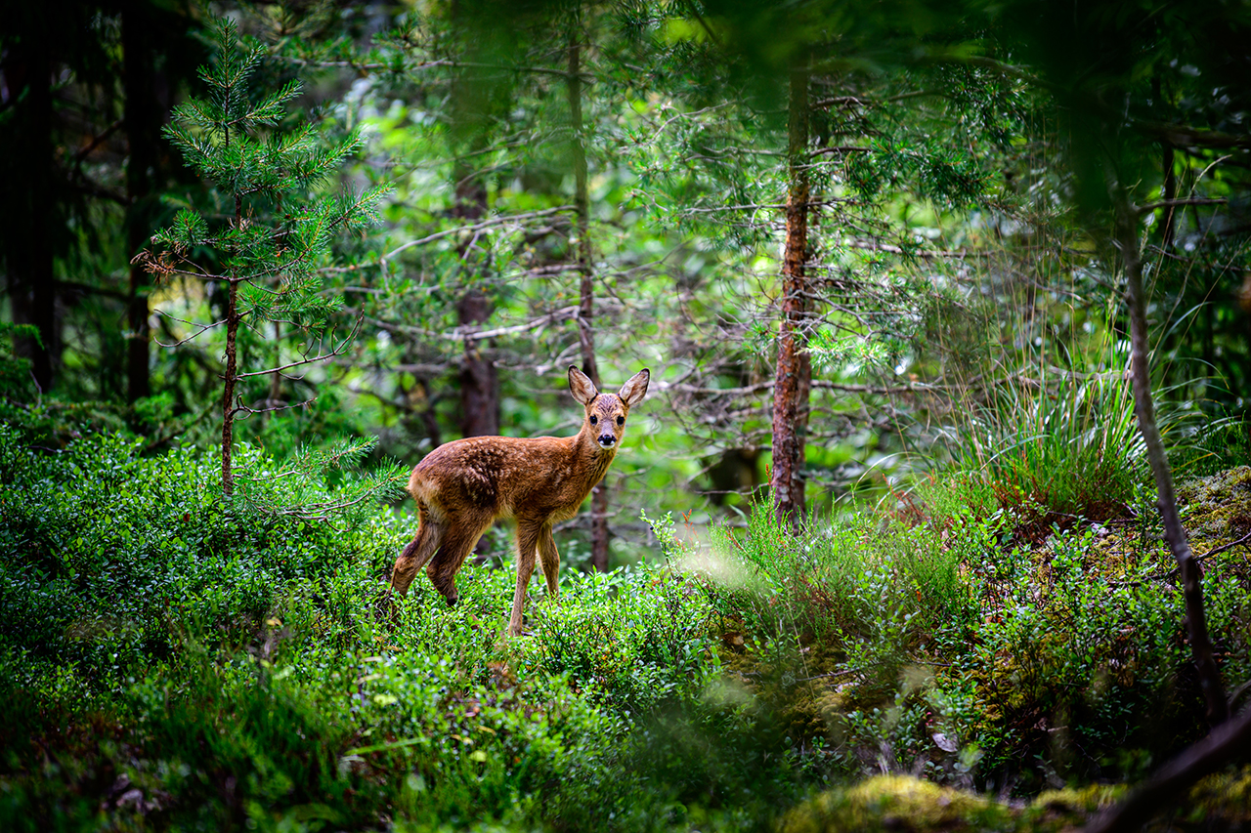
3. The connectedness of things

Slide 11
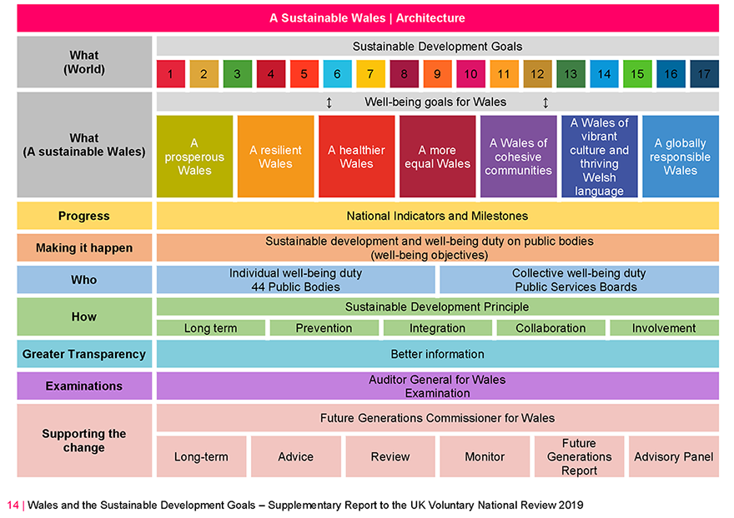
Well-being of Future Generations (Wales) Act 2015

Slide 12
Concluding thoughts
A potentially useful paradigm shift for habitually gloomy social scientists?
Transformation rooted in appreciation for what is
The mechanism of a well-being duty for current and future generations
Ethics of care
Social sustainability is that which doesn’t break us

