Slide 1
The gender dimension of different types of leave in Belgium
21st International Network on Leave Policies and Research Annual Seminar
Bernard Fusulier (UCLouvain) and Laurène Thil (HIVA - KU Leuven)
JUNE 17, 2024
Université TÉLUQ (CANADA)

Slide 2
Presentation
The report
Methodology and data
Main results and synthesis
Conclusions and recommendations

Slide 3

The report
Report commissioned by the (Belgian) Institute for the Equality between women and men
Published online in 2023
Update a report from 2018 on the gender dimension of parental leave, time credit and career breaks
Report available in French and in Dutch

Slide 4
Methodology and data
The statistical data was provided by the Office National de l'Emploi (ONEM) for the period 2004 to 2022.
For the types of interruption, the available data cover the period from 2014 to 2022.
The number of users is given as an annual average. As we have no information on the duration of leave per person, we use an average over the year of the number of people who took a specific leave.
We therefore do not present the exact number of people who took leave, as the same person often took leave over several months.

Slide 5
Methodology and data
The analysis was carried out using the following variables: gender, type of leave and reason for interruption.
Types of leaves: parental leave and other thematic leave, such as leave for medical assistance, leave for palliative care and leave for family carers + time credit systems (for the private sector) and career breaks (for the public sector)
In addition, the temporary measures available during the COVID-19 pandemic are also presented.

Slide 6
Main results
Parental leave
Duration for a child up to 12 – very flexible:
4 months - full-time
8 months – part-time
20 months – 1/5 time
40 months – 1/10 time
Both parents can take parental leave at the same time.
There is no difference for same-sex couples (since 2006) or adoptive parents.

Slide 7
Main results
Parental leave
The break allowance paid by the ONEM is a flat-rate amount and is not calculated on the basis of the parents' earnings : 879€/month
There is an increase in the allowance for single-parent families: 1 498€/month
Interestingly, there are also regional differences. In Flanders, a scheme called "Vlaamse aanmoedigingspremie" (Flemish incentive bonus) is paid under certain conditions to parents working in the private or social profit sector who take parental leave. The Flemish Government grants this bonus in addition to the break allowance provided by the ONEM.

Slide 8
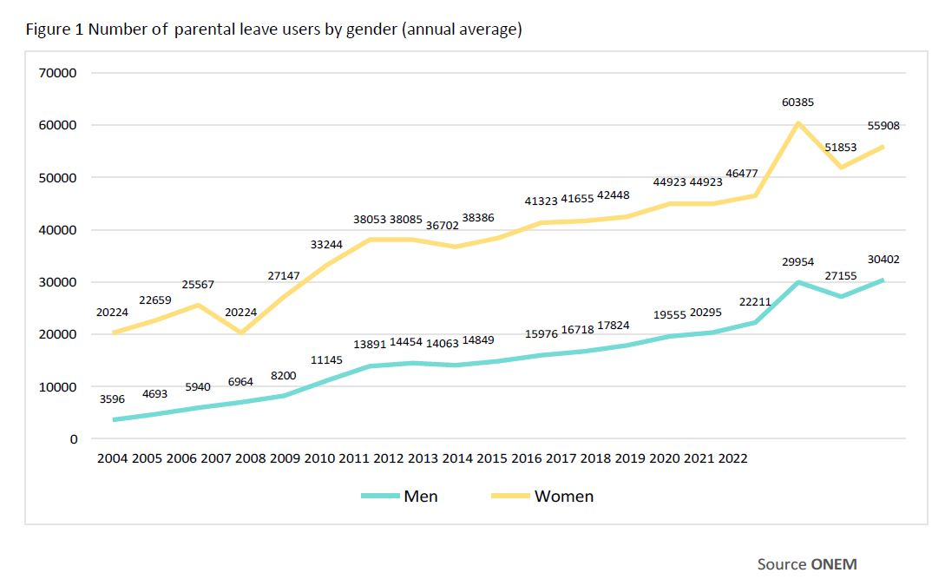
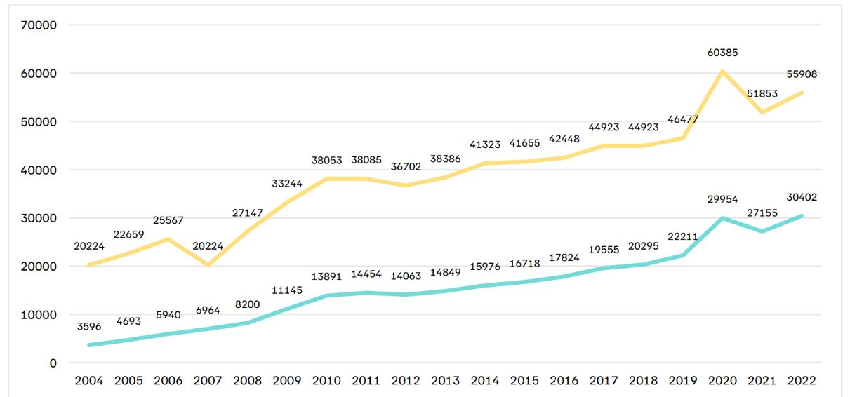
Main results
Parental leave
Notes:
The number of users of parental leave has been rising steadily since 2004 (with a peak in 2020 during COVID-19). It has risen from 20,224 users in 2004 to 55,908 in 2022, and from 3,596 users in 2004 to 30,402 in 2022 (Figure 1). The increase is particularly marked for men, with more than 8 times as many fathers taking parental leave in 2022 as in 2004. The number of women has more than doubled over the same period. In 2004, 85% of those taking parental leave were
women, compared with 65% in 2022.
This growth in the number of users shows the extent to which parental leave has become an essential tool for parents in reconciling their private and professional lives.

Slide 9
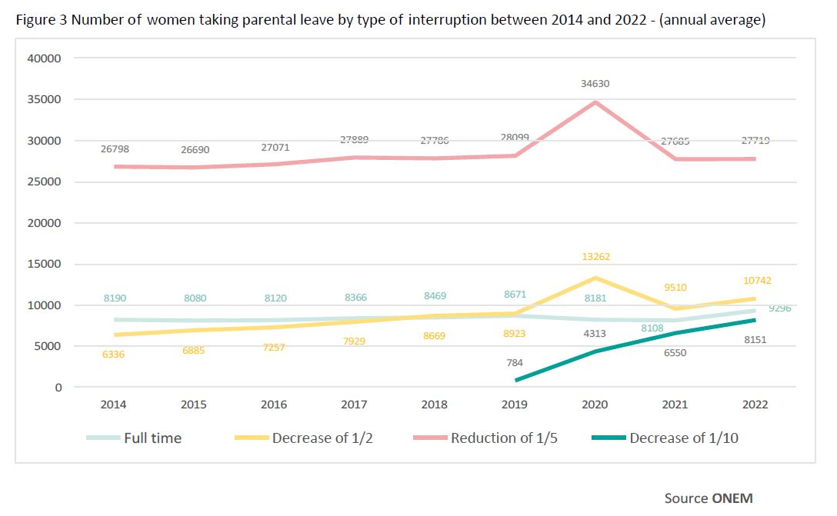
Main results
Parental leave
Notes:
The most popular formula for women is also the 1/5 benefit reduction formula, which peaked in 2020 during the COVID-19 pandemic. The 1/10 benefit reduction is more recent, but there has been a sharp increase in the number of women using this formula, rising from 784 in 2019 to 8,151 in 2022. The half-time benefit reduction formula also peaked in 2020 and remains more widely used than the full-time formula and by 1/10 in 2022 (Figure 3).

Slide 10
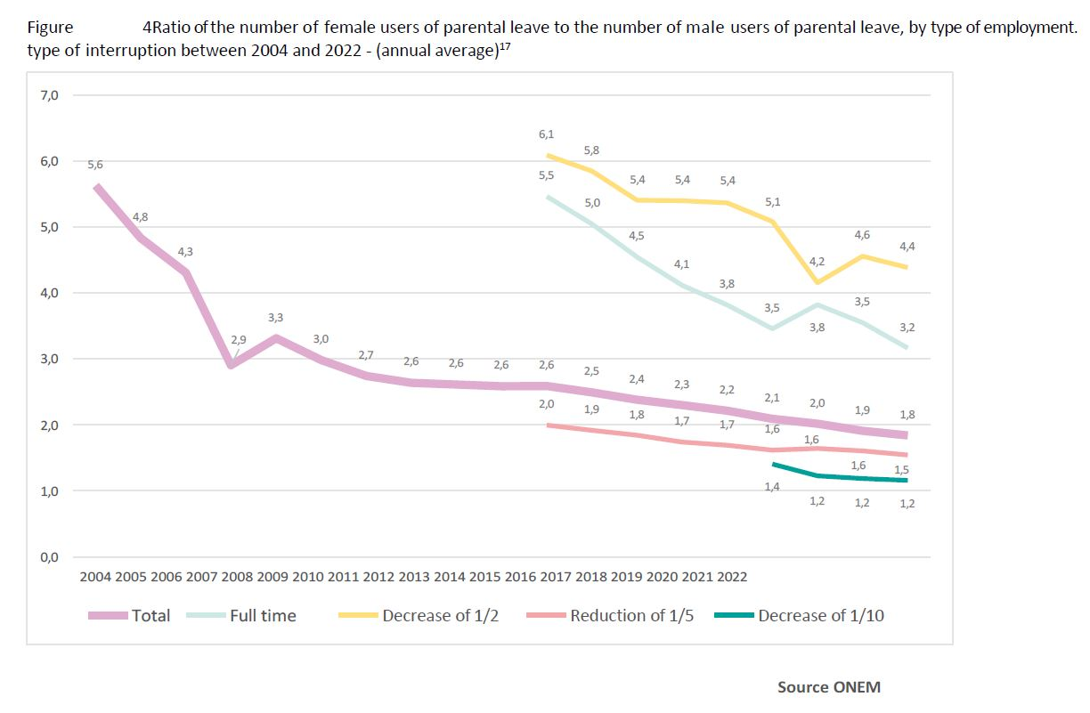
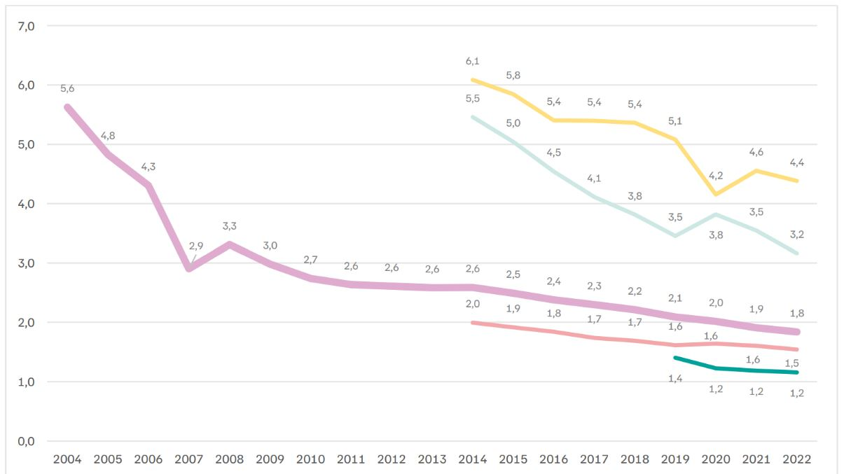
Main results
Parental leave
Notes:
Despite the significant increase in the number of users, progress towards a more egalitarian distribution of parental leave between men and women is slow. Parental leave is still predominantly taken by women, with almost twice as many women taking it as men in 2022. It should be noted, however, that the number of female users was more than 5 times greater than the number of male users in 2004 (Figure 4). This may represent a move towards more egalitarian parental norms. If we look at the breakdown by type of interruption, the gendered aspect is even more obvious.
In 2022, women will be more than 4 and 3 times more likely to use the full-time and half-time reduction options respectively. The 1/5 and 1/10 formulas are more equal.

Slide 11
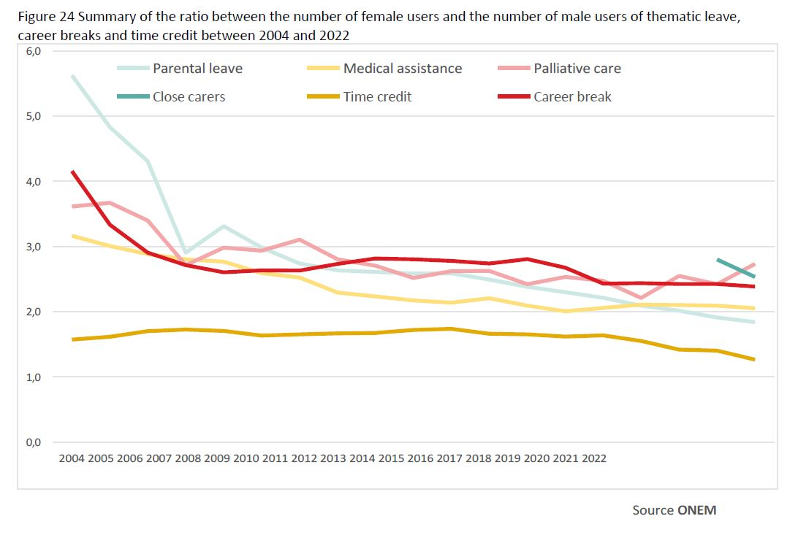
Synthesis
The trend is slow towards greater equality
Notes:
Although all of these schemes are available to both men and women, Figure 24 shows that more women take all of the thematic leaves, career breaks and time credits. In 2022, they were almost 3 times more likely to take palliative care leave, 2.5 times more likely to take leave for family carers, more than 2 times more likely to take a career break, 2 times more likely to take leave for medical assistance and almost 2 times more likely to take parental leave.
Time credit is the most egalitarian scheme.
In addition, if we compare the use of time credit and career breaks by type of scheme, we see that women are still more numerous in the general scheme (particularly for care), while the proportion of men is increasing in the end-of-career scheme. The still dominant view of work and family often assigns women a predominant role based on caring for a third party.
Nevertheless, for most thematic leaves (with t h e exception of palliative care and medical assistance leave) and career breaks, the curves show a steady reduction in the gap between women and men, which would tend to show that social norms are slowly changing.

Slide 12
Synthesis
The confirmed success of flexibility
The Belgian system of thematic leave and career breaks is highly complex
The most popular formulas are the 1/5 formula for men (parental leave, medical assistance, family carer, time credit and career break), while half-time is also popular with women (medical assistance, family carer and career break).
One exception is palliative care leave, which is used full-time by both women and men.
Finally, the introduction of the 1/10 break for parental leave from 2019 is gaining in popularity, particularly among men.
Notes:
Very complex: different conditions for access, but also different durations, assimilation rules, formulas or amounts of allowances, as well as numerous exceptions depending on the sector (private/public) or type of contract.
So men prefer shorter breaks, which are less restrictive and have less impact on their careers and pay.

Slide 13
Synthesis
Summary by leave
Parental leave
Parental leave is the most popular thematic leave, with 86,310 male and female users in 2022. In 2022, it was still taken by almost twice as many women as men, but the curve shows a steady narrowing of the gap. The most popular formula for women and men is to reduce benefits by 1/5. However, it should be noted that the 1/10 reduction is becoming increasingly popular with both men and women.
Corona parental leave
The use of corona parental leave was cyclical, and this measure was used by 68,992 people at its peak in June 2020. It was taken between 2 and 3 times more often by women, and mainly in the form of a 1/5 reduction in benefits.

Slide 14
Synthesis
Summary by leave
Leave for medical assistance
Medical assistance leave is the second most popular thematic leave, with 20,578 users in 2022. Its use is growing rapidly, with +707% for men and +423% for women between 2004 and 2022. It was taken 3 times more by women in 2004 compared with 2 times more in 2022.
Palliative care leave
Palliative care leave was taken by 328 people in 2022. Its use remains very strongly gendered with 2.7 as many women as men in 2022. The increase is greater for men (+151%) than for women (+89%). However, the gap between men and women has been widening since 2019. The most popular option for both men and women is complete interruption. The number of male and female users remains low.

Slide 15
Synthesis
Summary by leave
Leave for family carers
Caregiver leave is the most recent of all thematic leaves. It was taken by 272 people in 2022. It was used almost 3 times more by women than men in 2021, compared with 2.5 times more in 2022. There was a 153% increase in the number of women.
Time credit
Time credit is the most popular measure, with 88,809 users in 2022. However, since 2015, there has been a steady decline in the number of beneficiaries, with -80% for women and -37% for men.
The general scheme is mainly used by women, with 4 times as many women as men in 2022. A 1/5 reduction in benefits is the most popular for both women and men. While the end-of-career time credit scheme was relatively gender-balanced in 2014, the difference has widened in recent years.
Notes:
Time credit: The proportion of male users (end of career) has risen from 48% in 2014 to 61% in 2022, while the proportion of female users has fallen from 52% to 39% over the same period.

Slide 16
Synthesis
Summary by leave
Career break
There has been an almost continuous decline in the number of women users since 2004, while for men there was some stagnation between 2004 and 2018 and then a decline until 2022.
Under the general scheme in 2022, there will be almost 3 times as many female users as male users. It is mainly used via a 1/5 reduction in benefits for men, while for women, the most popular formula was half-time between 2014 and 2017, and since 2018 it has been the 1/5 reduction that has been the most successful.
Under the end-of-career scheme in 2022, there are twice as many female users as male users. The most popular formula is the 1/5 reduction in benefits for men and since 2021, the 1/5 reduction has also been the most popular for women.

Slide 17
Conclusions and recommendations
Towards greater simplicity and transparency
Enhancing the financial value of thematic leave
Encouraging fathers to take parental leave
Pay particular attention to single-parent families
Access to parental leave for the self-employed
Informing and raising awareness
Life-course time credit and end-of-career time credit
Impact of time credit reform on gender equality
A semantic and symbolic change

