Slide 1


Onur Şahin, Mara Yerkes, Lianne Aarntzen, Esther Kluwer, Chantal Remery, Belle Derks
Utrecht University
Fathers’ Intentions & Use of Paternity Leave in the Netherlands
LP&R Annual Seminar 2024

Slide 2






Slide 3

Paternity leave in the Netherlands
Historically low paternity leave in NL: two days, unpaid
‘Birth leave’ (Geboorteverlof) introduced in 2019: partners of mothers = five days fully paid leave; paid by employer
Supplemental birth leave: 1 July 2020; five weeks paid at 70% (government payment)
Notes:
The length of leave is equivalent to the number of working hours per week per partner/father. For example, a full-time job of 38 hours per week gives a leave entitlement of 38 hours (i.e., one week).
Supplemental birth leave (Aanvullend geboorteverlof) is also available. The length of supplemental birth leave is five times the number of working hours per week, up to a maximum of five weeks. For example, a full-time job of 40 hours per week gives a supplemental leave entitlement of five weeks.
The first week is paid by the employer at 100 per cent of earnings, with no upper limit on payment.
The weeks of supplemental leave are paid by the Employee Insurance Agency at 100 per cent of earnings up to a maximum of 70 per cent of the daily wage, which is set annually by the government, and is €274.44 in 2024.
Payments are taxed.
Flexibility
The first week of leave must be taken within four weeks after the birth of the child.
The weeks of supplemental leave can be taken flexibly over a longer period (e.g., one week of leave can be taken one day a week for five weeks). The supplemental leave must be taken within six months following the birth of the child.
Eligibility (e.g., related to employment or family circumstances)
Male and female employees who are the partner (by marriage, civil union or co-habitation of a woman giving birth) or who acknowledge the child.
Self-employed partners/fathers are not entitled to birth leave.
Employees in same-sex relationships are eligible if they have a relationship with the birth mother (by marriage, civil union or co-habitation) and legally recognize the child.
Fathers or partners whose child was born on or after 1 July 2020 are eligible for the supplemental weeks of leave as long as they have taken the first week of birth leave.

Slide 4
Paternity leave in the Netherlands: uptake
In 2021:
  90% of eligible fathers took birth leave
  one-third of fathers took 5+ weeks
  Leave mostly concurrent with the mother (Statistics Netherlands, 2022; Rossing and Vissee, 2022)
In 2023:
  nearly 90% of eligible fathers took birth leave;
  53% of fathers took the full six weeks of leave
  81% of fathers took leave concurrent with the mother (Statistics Netherlands, 2024)

Slide 5

Our paper
Fathers’ resources in terms of leave possibilities have increased
Capabilities to use resources can differ
Focus on two relational aspects shaping uptake of supplemental leave:
  Family-supportive line managers [supervisors]
    Importance of supportive line managers (e.g., Den Dulk et al., 2018)
    Fear of professional repercussions inhibit leave-taking behavior (e.g., Samtleben et al., 2019)
  Gender essentialist beliefs of fathers and mothers
    Gender ideology often overlooked as predictor of leave-taking behavior (e.g., Pizarro & Gartzia., 2024)

Slide 6

Our study:
‘Resilient together’
Couple-based longitudinal data across three time points
Intervention focused on increasing explicit coordination of care and housework among couples
T1: Experimental condition (intervention); T2: 1 month later (boost in experimental condition); T3: 4 months post-birth
384 fathers and their partner at T3 (197 control, 187 experimental condition)
Average age of babies at T3: 20 weeks
Notes:
T1:
546 control group
417 intervention group
Mean age fathers = 31.92, SD = 3.47
Reported by fathers:
Uptake of partner leave, perceived family-supportive supervisor, essentialist beliefs
Reported by mothers:
Essentialist beliefs

Slide 7
Theoretical grounding
Contribution to work-family capabilities literature (e.g., Hobson, 2014; Javornik and Kurowska, 2018; Koslowski and Kadar-Satat, 2018; Yerkes, Hoogenboom and Javornik, 2020)
How leave-taking behavior is shaped by contextual (e.g., organizational) and individual (e.g., essentialist beliefs) factors
Hypotheses:
1) Difference between intention and actual uptake is smaller when:
A) fathers have a more family-friendly supervisor
B) fathers’ beliefs are less essentialist.
2) Fathers with more family-supportive supervisors (intend to) take more additional leave
3) Fathers with more essentialist beliefs (intend to) take less additional leave

Slide 8

Preliminary findings

Slide 9

Ceiling effect
Notes:
73% of the dads in our sample took all 25 days of supplemental leave. Some dads took more than 25 days, dependent upon what employers offered.
We note that despite our best efforts, the majority of respondents participating in our study have tertiary education (degree with a university of applied sciences degree or university degree). No difference in leave uptake across educational groups. Of the 386 fathers, 75 had a vocational education, and 11 a primary or secondary education.
Even with the bias in our sample, we find no differences in leave uptake by educational background. This also doesn’t change if we look at relative income levels. Whether the man or woman earns more or they earn about the same, the average days of supplemental leave is nearly the same.

Slide 10
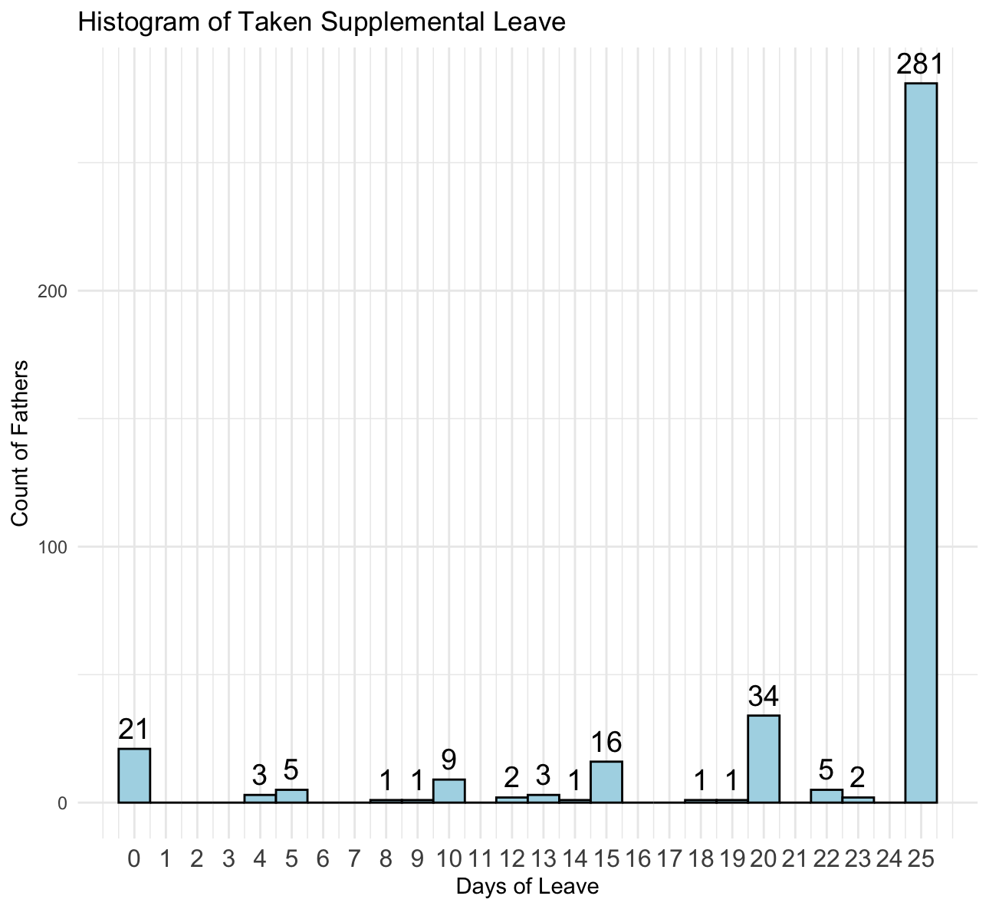
Leave uptake
Notes:
Although we expected quite some variation in the uptake of leave, we’ve actually found it quite difficult to model fathers’ uptake of leave for one reason: the majority of fathers in our study have take the maximum amount of supplemental leave available – 25 days (as shown here). 281 of 386 fathers (73%)
This also means that we’ve had to rethink our multinomial analyses, with only 21 fathers having taken no leave and a further 84 fathers having taken between 1-25 days.

Slide 11
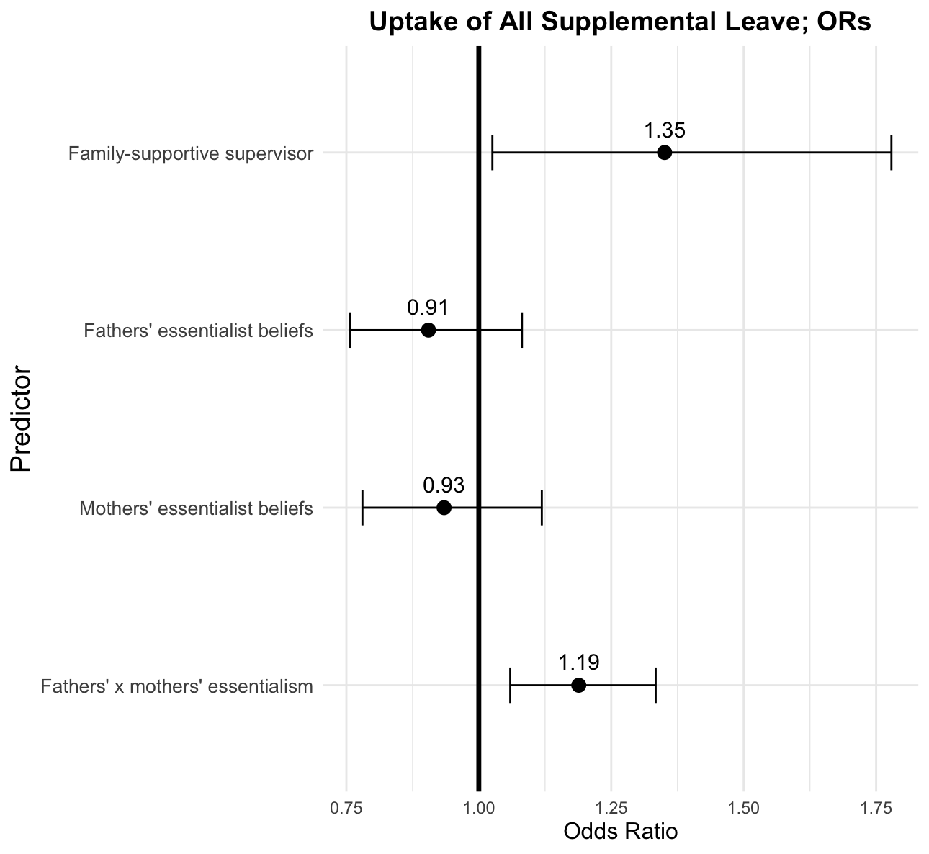
Importance of organizational context
Notes:
With all of these caveats in mind: and knowing that our postdoc has run both multinomial models as well as linear probability models (binary logistic regressions), our results remain largely the same: having a family-supportive supervisor increases the likelihood that fathers in our study used all of their supplemental birth leave. The chance that fathers took all 5 weeks of supplemental birth leave was greater if they reported having a family-supportive supervisor (Compared to fathers who took no supplemental leave or anything less than the full 5 weeks supplemental birth leave).
Not all supplemental leave taken: N = 107
All leave taken: N = 286

Slide 12
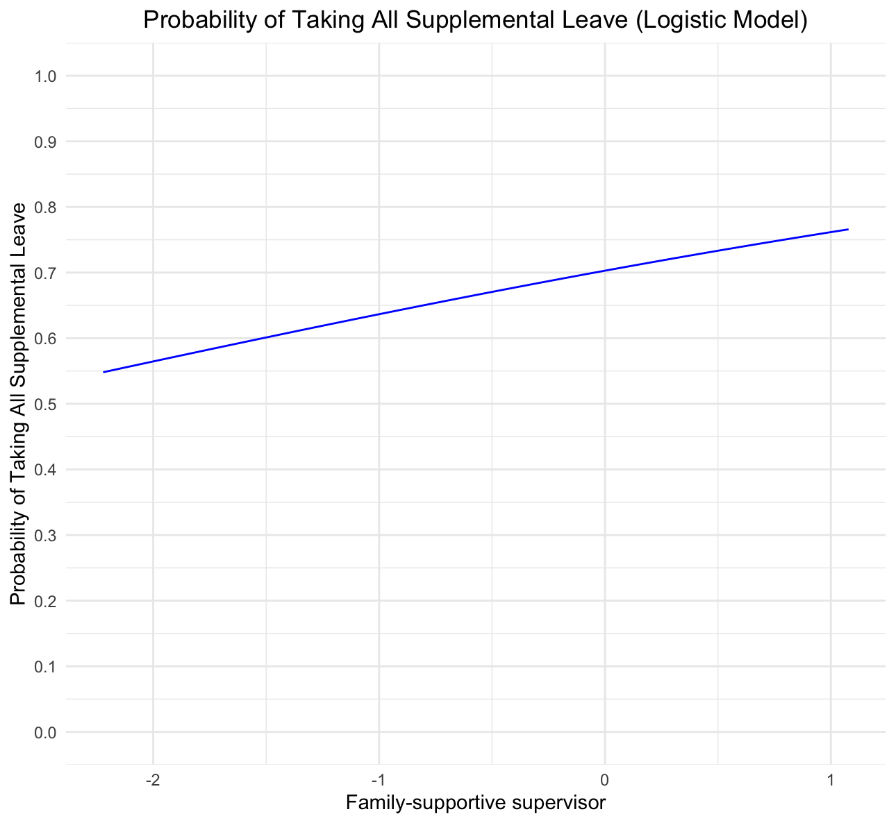
For the linear minded…
Notes:
Looking here at the predicted probabilities of taking all of the supplemental leave, the more supportive line managers/supervisors are, the greater the probability that fathers take all five weeks of supplemental leave, keeping all else constant.

Slide 13
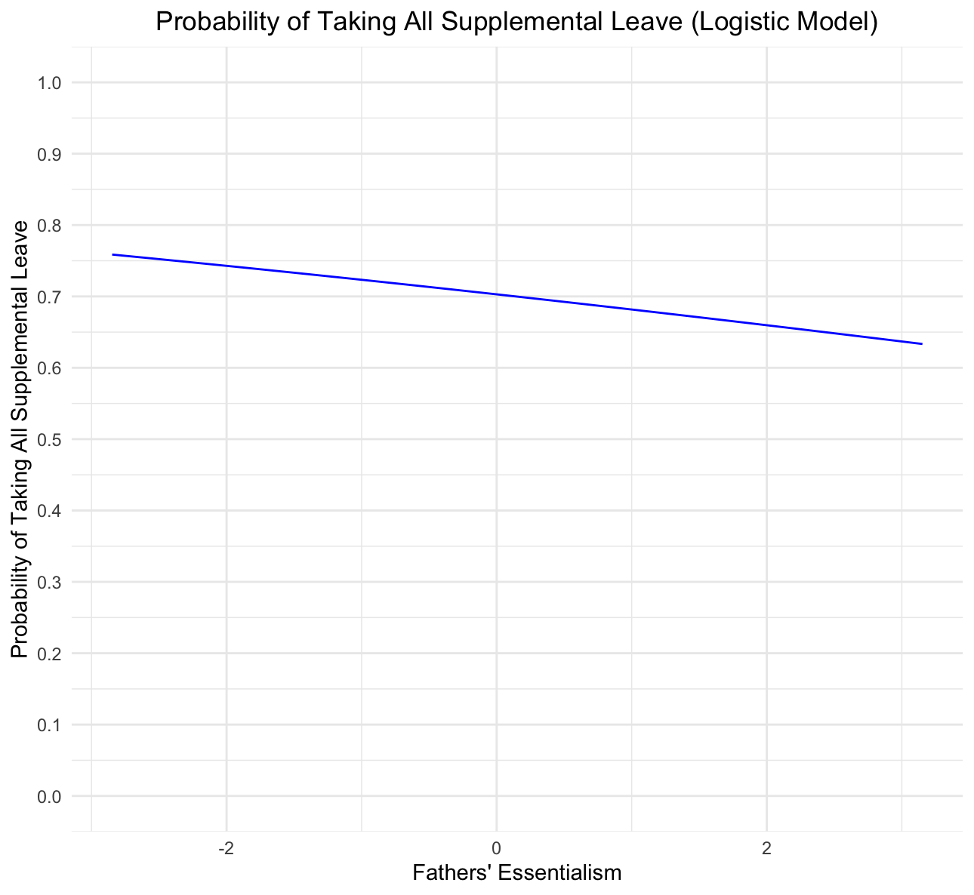
Essentialist beliefs? No
Notes:
If we look at essentialist beliefs, we see that the probability of taking all of the five weeks of supplemental leave gets smaller the more essentialist fathers beliefs are. But this is not significant.

Slide 14

Mothers’ essentialist beliefs? No.
Notes:
Similarly, mothers essentialist beliefs show that the probability of taking all of the five weeks of supplemental leave gets smaller the more essentialist MOTHERS beliefs are. But again, this is not significant.

Slide 15
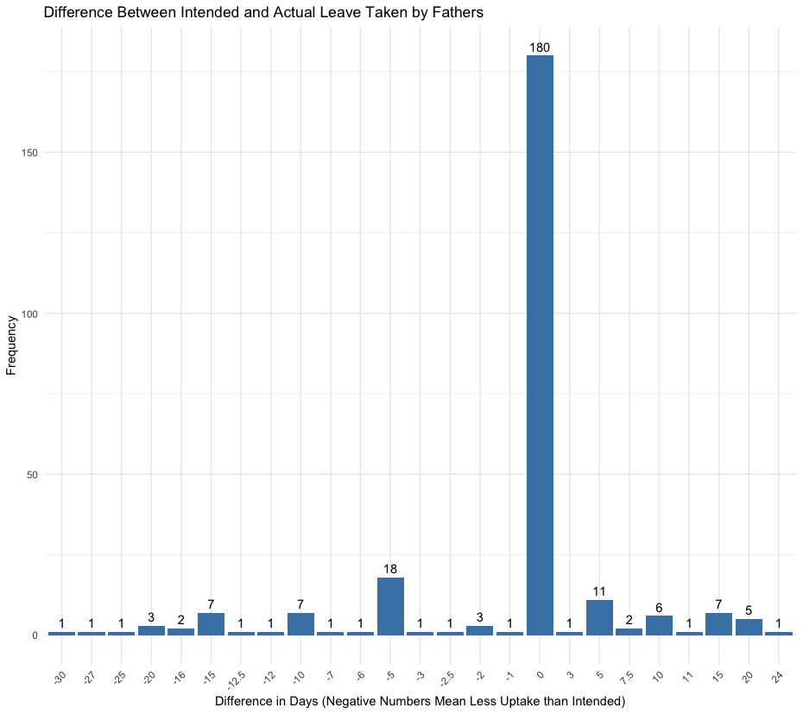
Mind the gap?
Notes:
I also just wanted to show that we don’t see much of a gap between fathers’ intentions and fathers’ behaviour in the Netherlands.
If we look at what fathers intended to do in terms of leave uptake, compared to what they end up doing, what we see is that most fathers manage to take the amount of leave they plan on, with a small amount of fathers taking more than planned and a small amount taking less than planned (negative numbers = less uptake than planned). But neither having a family-friendly supervisor NOR essentialist beliefs of either the mother or father matter for the gap between intended and actual leave taken.

Slide 16
Summarizing…
Fathers in our sample maximizing (supplemental) birth leave
Organisational context matters for taking leave (yes/no)
  But not a driver of supplemental leave duration
Gender essentialist beliefs not a driver of leave uptake
  But gendered norms remain evident in planning and performance of household work, care and paid work
Notes:
Even if we limit the sample to fathers whose babies are a maximum of 20 weeks old, we maintain the same results.

Slide 17

Next steps and discussion
Potential T4 measurement to account for full period of potential leave-taking
Consideration of other drivers of leave-taking
Thoughts on leave uptake (Y/N) versus duration?
Notes:
Need for T4: some fathers taking leave part-time (e.g., 1 day a week, or initially 1-2 weeks and then 1 day a week). So can still take remainder of leave.

Slide 18

Thanks for listening!

