Slide 1
PATERNITY LEAVE-TAKING AND U.S. FATHERS’ PARTICIPATION IN HOUSEWORK
Richard J. Petts, Ball State University
Daniel L. Carlson, University of Utah
Chris Knoester, The Ohio State University
This study was generously supported by the American Sociological Association Fund for the Advancement of the Discipline (2020) and the National Science Foundation under Grant Nos. 2148610 and 2148501. Any opinions, findings, and conclusions or recommendations expressed in this material are those of the authors and do not necessarily reflect the views of the National Science Foundation.

Slide 2
Benefits of Paternity Leave
Numerous studies suggest that paternity leave-taking provides benefits to families and society including:
  Increased father involvement in parenting tasks
  Greater coparenting support from fathers and more stable and satisfying parental relationships
  Stronger father-child relationships
  Greater gender equality by promoting more equitable divisions of paid and unpaid labor
Less is known about how paternity leave-taking may influence father involvement in housework
  Extent research largely mixed, suggests weaker influence relative to childcare
Research Question: Is paternity leave-taking associated with U.S. fathers’ shares of, and time spent in, housework?

Slide 3
Why might paternity leave-taking increase fathers’ housework?
Time Availability Theory
  Leave provides more (dedicated) time at home, facilitating more equitable divisions of domestic labor
Socialization/exposure to domestic labor routines
  Fathers may gain greater awareness of domestic needs
  Fathers may gain greater confidence in, and experience with, performing housework
    Could lead to long-term engagement in housework

Slide 4
Evidence on Paternity Leave-Taking and Housework
Paternity leave-taking may promote father engagement in housework
  Consistent with theories and research on leave-taking and father involvement in childcare
  Housework may be a way for fathers to promote equity in the household as mothers breastfeed and focus more on childcare
  Some support from the literature (e.g., Datta et al., 2012; Meil, 2013; Meil et al., 2023; Patnaik, 2019)
Impact of paternity leave-taking on housework may be limited
  Expectations for father engagement in housework is less than for childcare
  Gender gaps in housework larger than childcare (8 vs. 6 hours/week); housework may be viewed as unmasculine
  Evidence from literature mixed
    Some find no association (e.g., Schober, 2014)
    Some find association due to selection effects (e.g., Doucet & McKay, 2020; Lee, 2023)
    Conflicting evidence regarding length of leave (Almqvist & Duvander, 2014; Bünning, 2015; Meil, 2013) and housework tasks (Kotsadam & Finseraas, 2011; Meil, 2013)

Slide 5
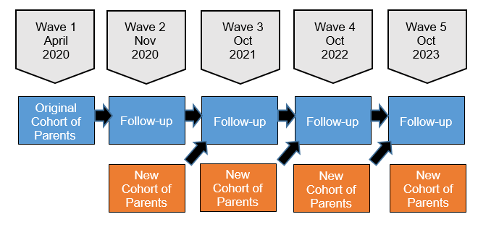
Study on Parents’ Divisions of Labor During COVID-19 (SPDLC)
Study objective: Assess changes in parents’ divisions of labor throughout and after the COVID-19 pandemic, identify factors that drive these changes, and consider the consequences of these changes for gender inequalities and parents’ well-being.
Population: Partnered US parents with at least one biological child in home
Data Collection: Online survey administered via Prolific
Study Design: Longitudinal Panel with Repeated Cross-Sections
Sample:
  Pooled cross-sectional data from Wave 1 – Wave 4 (N = 4,551 unique parents)
  Focus on:
    Different-gender partnerships
    Fathers were working when youngest child was born
    Youngest child is 3 years old or younger
    No missing data on key variables
    N = 1,654

Slide 6
Key Variables: Paternity Leave-Taking
Paternity Leave-Taking
  Defined as taking time off work for the birth of their youngest child, regardless of how leave was taken
Length of Paternity Leave
Length of Paternity Leave | %
None | 25%
Less than a week | 7%
One week | 16%
Two weeks | 22%
3-4 weeks | 20%
More than a month | 10%

Slide 7
Key Variables: Fathers’ Participation in Housework
Routine housework tasks included in SPDLC:
  Preparing and cooking meals; Laundry; Shopping for groceries and other household needs; Washing dishes; House cleaning
Fathers’ Shares of Housework
  Mean of total shares of housework (1 = mother does it all; 3 = shared equally; 5 = father does it all)
Fathers’ Housework Time
  Total hours spent in housework tasks in week prior to survey (top coded at 95th percentile)

Slide 8
Other Variables
Respondent gender (mother or father)
Father age
Father has college degree
Father race/ethnicity
Marital status
Number of children
Age of youngest child
Whether reside with extended family members
Work status (mother & father)
Essential work status (mother & father)
Flexible schedule (mother & father
Work from home status (mother & father)
Household income
Relative earnings
Fathers’ shares of childcare
Survey wave

Slide 9
Fathers’ Shares of Housework, by Paternity Leave-Taking
Leave-Taking
Length of Leave

Slide 10
Fathers’ Housework Time, by Paternity Leave-Taking
Leave-Taking
Length of Leave

Slide 11
Fathers’ Shares of Housework by Task and Leave-Taking

Slide 12
Conclusions
Paternity leave-taking is positively associated with U.S. fathers’ shares of, and time spent in, housework
Positive association between paternity leave-taking and fathers’ housework is similar for most tasks (cooking, cleaning, dishes, laundry)
  No association between paternity leave-taking and grocery shopping
  May be due to this task being perceived as more masculine during the pandemic
Longer leaves are positively associated with fathers’ shares of housework, but largely unrelated to fathers’ time spent in housework
  Time may become more constrained after returning to work post-leave
  But exposure to housework during leave (regardless of how much time on leave) may have lasting effects on parents’ divisions of housework over the long-term

