Slide 1

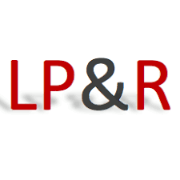


International Network on Leave Policies & Research
Annual Seminar
CHALLENGES OF LEAVE POLICIES AND SOCIAL SUSTAINABILITY
12-13 June 2025
Vilnius, Lithuania
Varieties in terminology use among academic comparative studies of leave policy
Authors:
Gerardo Meil (Universidad Autónoma de Madrid)
Pedro Romero-Balsas (Universidad Autónoma de Madrid)
Gerlinde Mauerer (Universität Wien)
Nadav Perez- Vaisvidovsky (Ashkelon Academic College)

Slide 2
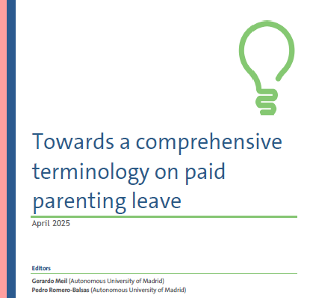
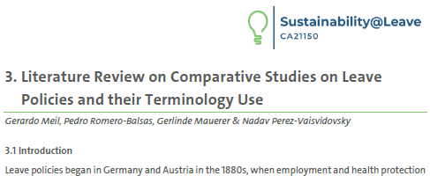

Presentation based on a report published in CA21150 Sustainability@Leave working group 4 (PPL terminology)

Slide 3


Heterogeneity of terminology in leaves for childcare
The pluralization of objectives has been institutionalized in very different ways
Even though the EU has approved Directives establishing minimum leave rights, no clear convergence neither in its design, nor in their concrete application in everyday life has been identified (Finch 2021; De la Porte et al., 2023; European Commission et al., 2024)
High complexity of leave design makes the analysis of patterns and dynamics of change over time and particularly comparison among countries very difficult and challenging (Moss & Deven, 2020; Dobrotić, 2023)

Slide 4

Research questions
How do comparative studies deal with different leave terminology?
How does the use of different types of terminology affect the results of the analysis?

Slide 5

Data and methodology
Dataset of 54 papers comparing any type of parenting leave across at least three countries
Publication dates range from 2010 to 2025
Based on the literature review made by WG2 and WG3 of the CA2115 and searching tools
Content analysis
Creation of a template with keywords: gender, quotas, bonus, length, income replacement, discrepancies, regulation and consequences

Slide 6

Results
(a common umbrella term?)
The most commonly used generic term is leave or leaves
Since it is not a precise term some adjectives are used. For instance, “parenting leave” (Dobrotic, 2023) or “paid leave for infant caregiving” (Earle et al, 2023)
A much more common term used to describe the traditional trilogy of leave types (maternity, parental and paternity leave) is “parental leave” (Bueno and Oh, 2022; Dearing, 2015; Dearing, 2016; Dobrotic and Blum, 2020; Kaufman and Grönlund, 2021; Olsson et al, 2023)

Slide 7

Results
(Level of conceptual definition)
When parental leave is not the central focus of the empirical quantitative analysis—for example, when it is part of an independent variable—what is included (or not) under the term “parental leave” (Musick et al., 2020; Fuwa & Cohen, 2007; Geist & Cohen, 2011; De Rose, 2019) is often insufficiently explained.

Slide 8

Results (Only one parent’s leave)
“Father-specific leave” (De la Porte et al., 2023) or “Fathers exclusive leave” (Olsson et al, 2023) , which includes paternity leave and paid earmarked parental leave.
“Fathers’ leave” (Engeman & Burman, 2022), which covers five different provisions for fathers: paternity leave and nontransferable parental leave, mothers transferable leave, transferable parental leave (part of the leave considered as a family right) and bonus leave.
3) “Paid leave reserved for fathers” (Earle et al., 2023).

Slide 9


Results
(Lenght and/or income replacement?)
Some studies prioritize the length of leave in comparative analyses when there is some level of income replacement—for example, by measuring the total amount of leave used (of any type) (Lammi-Taskula, 2022), or by assessing whether the available length meets a certain threshold (De la Porta et al., 2023; De la Corte Rodríguez, 2024; Addati et al., 2024).
Another approach considers the length of leave, regardless of whether it is paid or unpaid, and is more common in quantitative studies (Fuwa & Cohen, 2007; Hook, 2010; Geist & Cohen, 2011; Meil, 2013; De Rose et al., 2023).
A more differentiated approach involves distinguishing between well-paid, paid, and total leave used (Blum, 2023), or using a similar classification (Dobrotić, 2023).

Slide 10

Results (implications)
Parental leave is often considered as a leave that can be taken by parents, although it also includes periods of non-transferable time among parents. While quotas and bonuses are considered as parental leave , paternity and maternity leave are not, even though they function as equivalent.
Studies that consider quotas as equivalent to maternity and paternity leave (Olsson et al, 2023; Earle et al, 2022; Addatti et al, 2022)
But other consider quotas as equivalent to parental leave (Blum, 2023; Dobrotic, 2022).

Slide 11
Conclusions
Lack of a common umbrella term for all types of parental leave for childcare in comparative academic studies
Different general terms are used—such as leave, parental leave, parenting leave, or (paid) leave for infant caregiving—but they carry slightly different meanings and vary in their level of conceptual clarity.
This has implications for decisions regarding what is compared (e.g., length, generosity, actual use) and how it is measured (e.g., bonuses, non-transferable portions, maternity, paternity leave, etc.)

Slide 12
International Network on Leave Policies & Research
Annual Seminar
CHALLENGES OF LEAVE POLICIES AND SOCIAL SUSTAINABILITY
12-13 June 2025
Vilnius, Lithuania
Varieties in terminology use among academic comparative studies of leave policy
Authors:
Gerardo Meil (Universidad Autónoma de Madrid)
Pedro Romero-Balsas (Universidad Autónoma de Madrid)
Gerlinde Mauerer (Universität Wien)
Nadav Perez- Vaisvidovsky (Ashkelon Academic College)
Thanks for your attention!
☺

