Slide 1
Taking the longer and optimistic view: how social scientists can contribute to more sustainable outcomes
Alison Koslowski
A.koslowski@ucl.ac.uk

Slide 2
The puzzle
Why have social scientists (mostly) been slow to engage with sustainability?
SDGs have been in place and capturing imagination of policymakers but not academics
A few pockets of interest, but not really in parental leave research

Slide 3
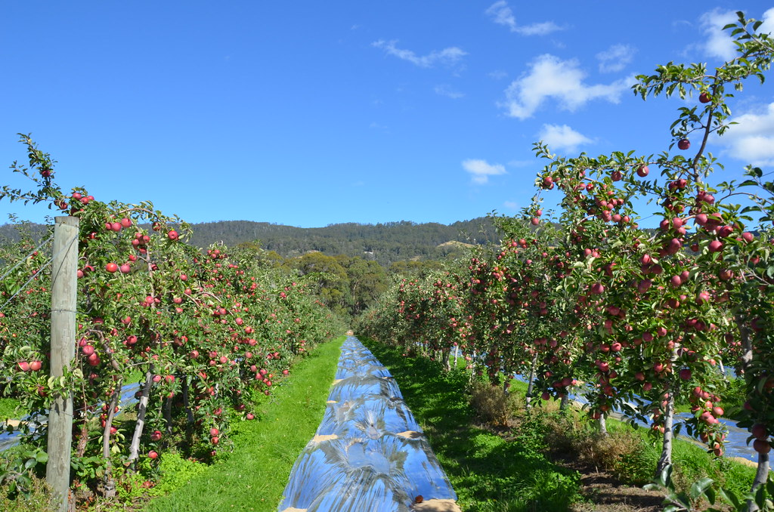
Where do we see sustainability in action?

Slide 4
A proposed solution: the case for optimism
Current social science is generally myopic (mirrors politics)
A longer term view involves planning for the future – need to have faith in the future (optimism)
Part of this is understanding what we need to maintain / sustain

Slide 5
Social sustainability in social policy practice
Explicit reference to social sustainability in public governance relatively rare
Well-being of Future Generations (Wales) Act 2015

Slide 6
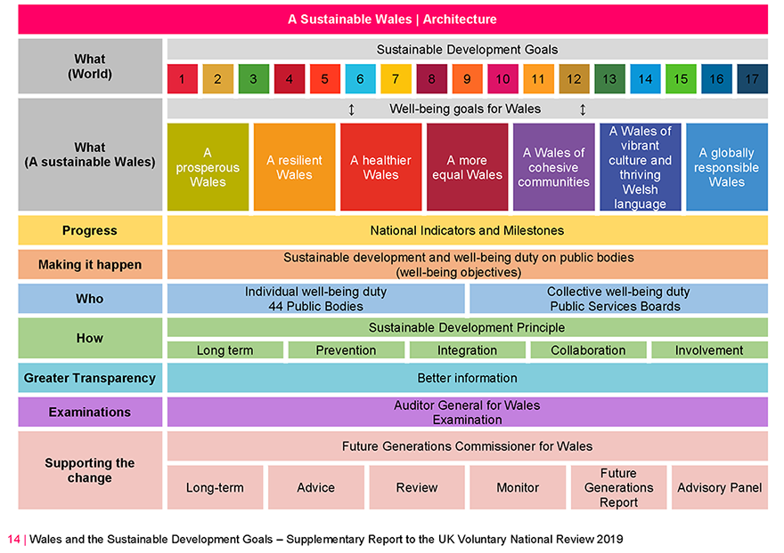
Well-being of Future Generations (Wales) Act 2015

Slide 7
Applying the sustainable development principle to parenting leaves
Long term
Prevention
Integration
Collaboration
Involvement

Slide 8
Concluding thoughts
New angle might help to address research gaps (e.g. mothers and child perspectives
Transformation rooted in appreciation for what we want to preserve for the future
Introducing the mechanism of a wellbeing duty for current and future generations
Applying a ‘sustainable development principle’ to parenting leaves

