Slide 1
Swedish parental leave turns 50
Which groups have gained and which have been left out?
Ann-Zofie Duvander
Stockholm University and Mid Sweden University
Åsa Lundqvist
Lund University

Slide 2

Today’s presentation
A Swedish Patchwork – 50 years of parental leave (with Åsa Lundqvist, Lund University)
Summarizing the parental leave policy over the past 50 years
Analysing which groups of parents have gained from the reforms and which have not
Periodization
  1) Expansion, Flexibility, and (In)Equality, 1975-1991
  2) Parental Insurance During the Crisis Years, 1990s
  3) Expansion and Risk Management, 2000-2010
  4) Limitations for Some and Flexibility for Others, 2010-2024.

Slide 3
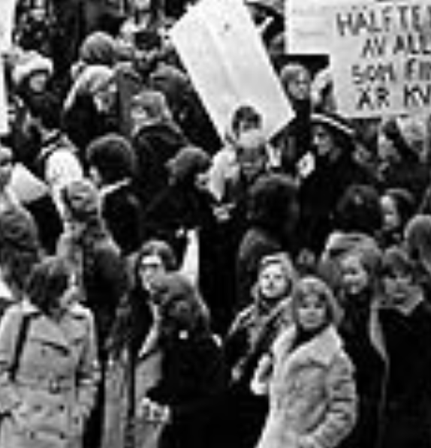
Introduction
Parental leave policy – 50 years old!
Goal: levelling out economic inequalities and creating gender equality
  Enabling both women and men to combine paid work with childcare responsibilities …
  … and to protect families from income loss and, thereby reduce economic inequalities between households with and without children
From the outset, gender and economic equality were goals of the policy
These goals are still in place – but much have happened

Slide 4
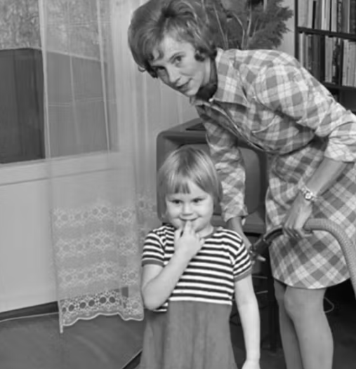
Context
Long history of family policies before 1974:
  1930s: fighting poverty through means-tested population policies
  1940/1950s: Towards general benefits (child allowance, 1948); maternity leave (1954); social and justice-based arguments
  1960s: Labour market shortage; critique of traditional gender relations; women’s movement → towards an inidvidualized and dual earner/carer family model

Slide 5
The Introduction of the Parental Leave, 1974
The gender-neutral parental leave reform provided an income-based compensation with a guaranteed level for all parents, regardless of income and previous employment
Length: 180 days (six months) with 90 per cent of the income
10 daddy days in connection with the birth of the second child
Important to note: not entirely individualised from start, based on mother’s work

Slide 6
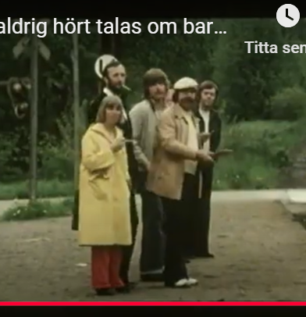
Expansion, Flexibility, and (In)Equality, 1975-1991)
Gradual extension, from 6 months in 1974 to 15 months in 1989 (extended almost every year)
1978: Special parental leave (särskild föräldrapenning) – increasing flexibility
1986: Speed premium benefit – extended protection of the income
Increased focus on gender equality – inequalities remained (2,5% in 1974 -10% in 1989)

Slide 7
Who gained from the reforms, and who did not?
Gained
  All new fathers, who gained the opportunity to stay home with their children
  Working mothers - opportunity to take temporary leave of while maintaining job security
  The speed premium benefitted those who could afford to reduce working hours after the first child, two-parent (cohabiting) families
Disadvantaged
  Mothers without a gainful employment
  Increased risk for women who decreased their working hours – especially if they became single, divorced or widowed and when retiring low pension

Slide 8
Parental Leave During the Crisis of the 1990s
Reduced compensation levels in parental leave (90-75-80%);
Nominal level of child allowance reduced; increased poverty and ill-health; restructuring of the welfare state
Continued focus on gender equality
Father’s low use of parental leave sparked intense debates – gender equality high on the political agenda (with focus on fathers)
1995 – first reserved month (”daddy month”)

Slide 9
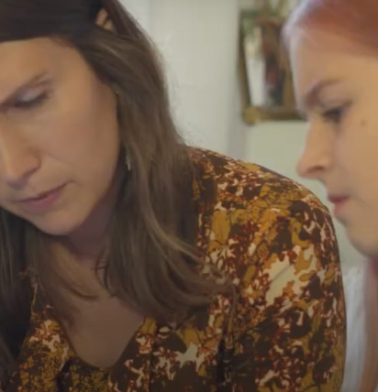
Which parents gained from the reforms, and which did not?
Gained
  Employed fathers who now had protected right to parental leave
  Before 1995, mostly fathers with high income, high education and public employment used the insurance. After 1995 – differences between groups of fathers decreased
  New norm – 4/5 of all fathers use the parental leave
  The children – who could spend more time with their fathers, access to two parents
  Parents who shared responsibility for childcare
Disadvantaged
  Mothers and fathers without income prior to becoming parents
  Lone mothers (both economically and in relation to time)

Slide 10
Expansion and Risk Management, 2000-2010
Facilitate for parents to (better) combine work and family life
Expansion in family policy field:
  Maximum fee and guarantee of ECEC
  Leave extended to 16 months (8+8) and a second reserved month (2002)
  Possible for someone other than a father to use the daddy days (temporary parental benefit at the birth of a child)
  Flat rate leave – from 60 to 120 SEK per day.
  The role of collective agreements and ceiling increase
Increased focus on freedom of choice
  The introduction of the gender equality bonus; cash-for-care

Slide 11
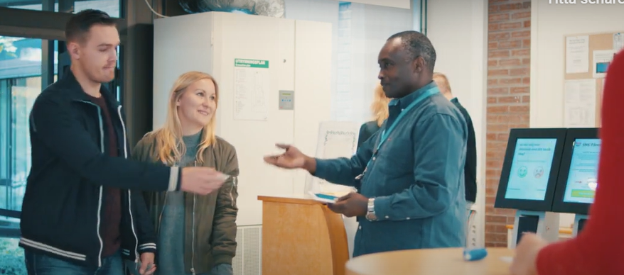
Who gained from the reforms, and who did not?
Gained
  High income and high educated parents (mostly fathers) gained by higher ceiling and collective agreements
  Parents with a permanent employment
  Low income parents gained from the increased flat rate but parental leave benefit are deducted from social assistance
Disadvantaged
  Lone parents without a stable income disadvantaged both in terms of time and in relation to increased emphasis on flexibility
  Leave use patterns diverged

Slide 12
Limitations for some and flexibility for others 2010-2024
Flexibility in different directions:
  Double days are introduced in 2012 (30 days and today 60 days): parents can be on parental leave at the same time
  Age restrictions for all
  Limitations in the number of days for foreign-born children
A third reserved month was introduced in 2016
Opens up for others than parents to use leave
  In 2016, it became possible to transfer days to a cohabiting partner, and since 2024 it is possible to transfer 45 days to anyone

Slide 13
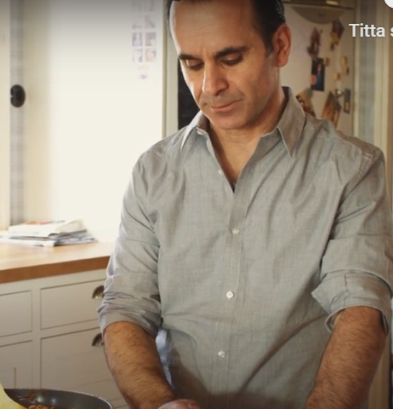
Who gained from the reforms, and who did not?
Slow increase in gender equality (2016 – 75% (2016) to 70% (2022) used by mothers)
Gained
  Parents who can afford to use the ”double days”
  The possibility to transfer days – rainbow families and lone parents
  Employers – can control the workforce more with age restrictions
Disadvantaged
  All parents who want to be on leave later in the child’s life
  Migrant families – reduced rights to the parental leave days

Slide 14
Consequences and future challenges
Increased gender equal parenting
But the goals set up in the 1970s –to promote gender-equal parenting and economic equality for families with and without children—remain in part unmet.
Gender equality has consistently been a priority in policies
Economic equality has not been a prioritized agenda to the same extent
Differences between parental groups have become more pronounced

Slide 15

Challenges for the future
Conditional gender equality?
Income loss or basic security?
Freedom of choice or/and gender equality?
Parental leave and declining birth rates

Slide 16
Thank you!
English extended summary
https://www.sns.se/en/articles/a-swedish-patchwork-50-years-of-parental-insurance/
A crazy proposal – about the Swedish parental insurance
https://www.youtube.com/watch?v=ccUUZBexLPE

Slide 17
Share of parents who share equally (40-46%) first 2 years for children born 2005-2021

