Slide 1



Fathers’ use of parental leave in Finland – does the quota matter? Johanna Lammi-Taskula, Finnish Institute for Health and Welfare (THL) Anneli Miettinen, Social Insurance Institution (Kela) Johanna Närvi, Finnish Institute for Health and Welfare (THL) Miia Saarikallio-Torp, Social Insurance Institution (Kela) International Leave Policies and Research Network Annual Seminar 2025, Vilnius

Slide 2
Parental leave reforms to promote fathers’ childcare responsibility
2003
Introduction of the fathers’ quota:
last 2 weeks of Parental leave + 2-4 weeks of bonus leave (’Fathers’ month’).
2013
9 weeks of ’Paternity leave’ (3 weeks together with the mother, 6 weeks independently after Parental leave)
More flexibility and no need to take shareable Parental leave.
2022
6,4 months of Parental leave per parent, with a 4-month non-transferable quota.

Slide 3
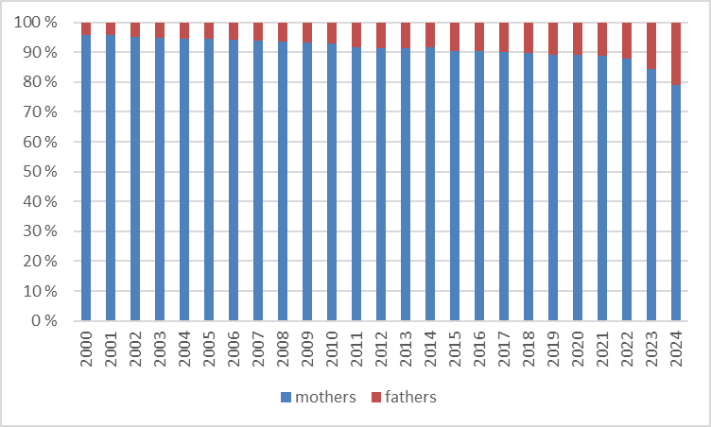
Distribution of parental leave uptake between mothers and fathers
4 % 6 % 8 % 10 % 12 % 16 % 21 %
Kela, Parental benefit days by gender, Statistical database

Slide 4
Gender role attitudes in Finland 2002-2022 (ISS)
%
Mesiäislehto, Lammi-Taskula & Närvi (forthcoming) in the Routledge Companion to Gender and the Family (eds Naomi Finch, Linzi Ladlow and Patrizia Kokot-Blamey)

Slide 5
Support for different ways of sharing parental leave in Finland 2012-2022 (ISS)
%
Mesiäislehto, Lammi-Taskula & Närvi (forthcoming) in the Routledge Companion to Gender and the Family (eds Naomi Finch, Linzi Ladlow and Patrizia Kokot-Blamey)

Slide 6
Impacts of the 2022 leave reform
Mean number of parental leave days, fathers
2021: 42 days
9–12/2022: 81 days
The share of fathers who did not take any parental leave, %
2021: 18,9 %
9–12/2022: 14,9 %
Child’s birth cohort
Mothers
Fathers
Saarikallio-Torp & Miettinen (2025): Muuttiko perhevapaauudistus vanhempainvapaiden jakamista perheissä?
[How did the family leave reform in 2022 change the division of parental leaves in families?]
Kela seminar on family leave reform, 20.5.2025

Slide 7
Impacts of the 2022 leave reform
 | 2021* |  | 9–12/2022*
Father took parental leave | % | Mean number of parental leave days | % | Mean number of parental leave days
…at the same time when the mother was taking her leave (max 18 days) | 73 % | 16 days | 71 % | 16 days
…indepedently from the mother | 57 % | 39 days | 73 % | 79 days
* Child’s birth cohort
Saarikallio-Torp & Miettinen (2025): Muuttiko perhevapaauudistus vanhempainvapaiden jakamista perheissä?
[How did the family leave reform in 2022 change the division of parental leaves in families?]
Kela seminar on family leave reform, 20.5.2025

Slide 8
Impacts of the 2022 leave reform
Each parent can transfer max 10,5 weeks to the other parent
84 % of fathers had transferred at least some parental leave days to the mother (71 % had transferred all 10,5 weeks).
2 % of mothers had transferred at least some parental leave days to the father.
In families where the father had transferred the maximum to the mother, the majority of the fathers also used parental leave themselves; on average 11,3 weeks.
4 % of families divided parental leave equally between two parents.
Saarikallio-Torp & Miettinen (2025): Muuttiko perhevapaauudistus vanhempainvapaiden jakamista perheissä?
[How did the family leave reform in 2022 change the division of parental leaves in families?]
Kela seminar on family leave reform, 20.5.2025

Slide 9
Discussion
Significant shift toward more egalitarian gender role attitudes in Finland between 2002 and 2022: broad support for maternal employment and equal sharing of parental leave.
Parental leave reforms align with attitude shifts but a behavioral gap remains: actual leave use is still gendered.
First results of the 2022 reform are promising: more fathers take longer parental leave periods, and independent leave is more common.

